Slide 1
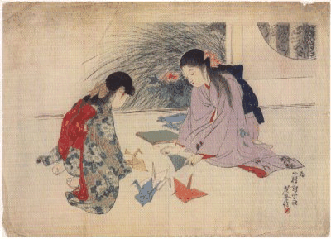
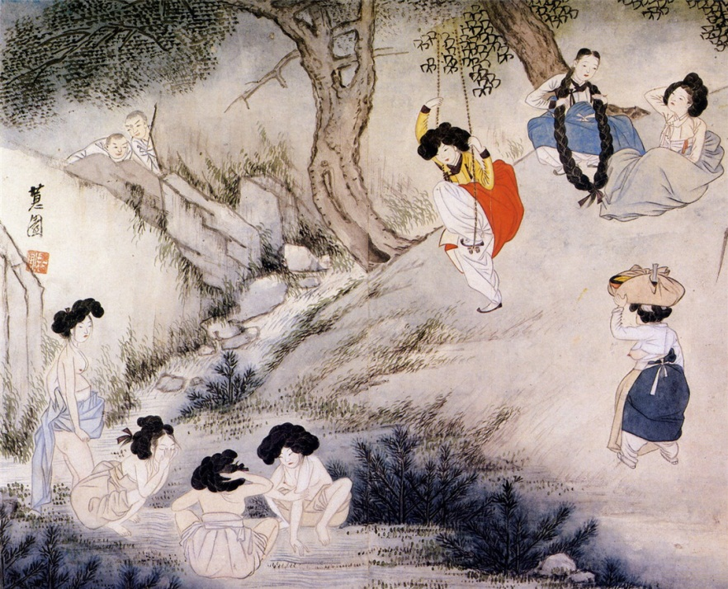
Southeast Asia (600 AD to Present)
Unit 3

Slide 2
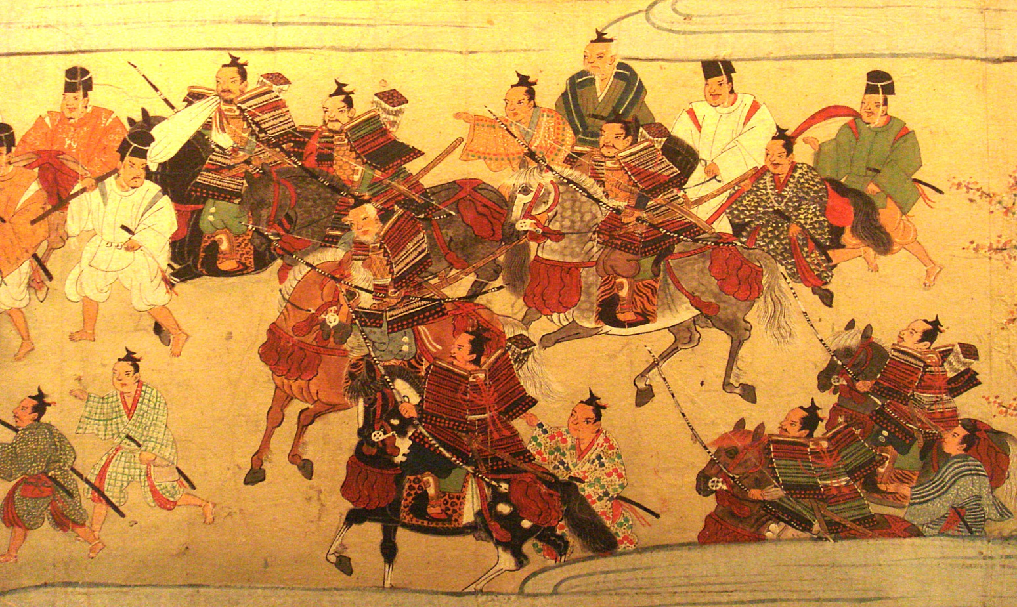
Feudal Powers in Japan
Chapter 12, Section 4

Slide 3
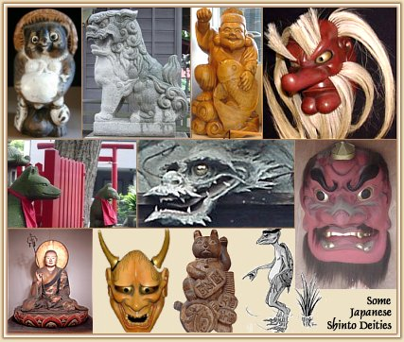
Shinto
Meaning: way of the gods
Different clans in Japan worshipped different gods; altogether thousands of nature gods/goddesses.
Varied customs and beliefs combined into one religion – Shinto

Slide 4
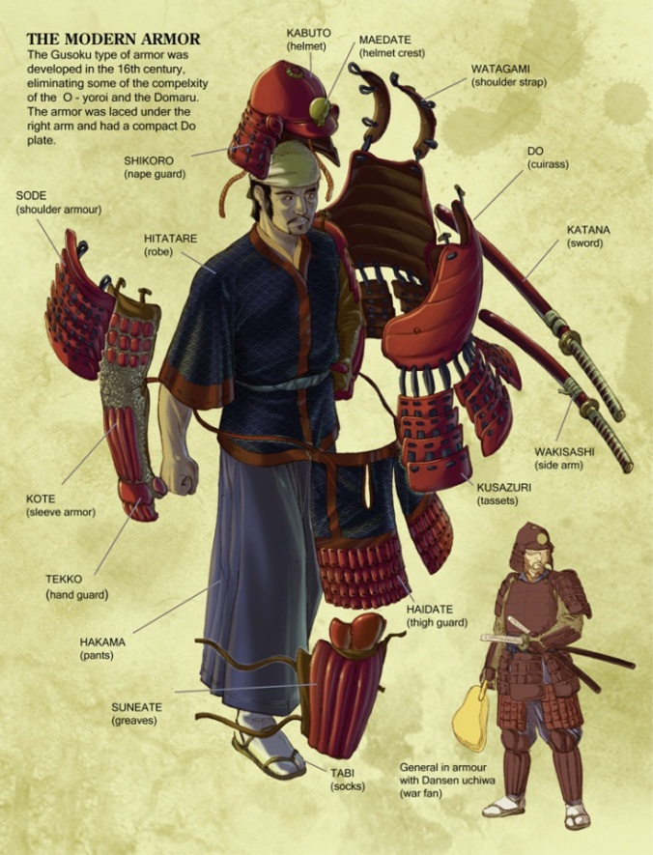
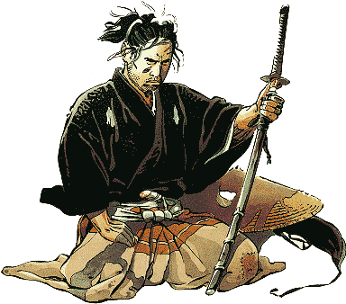
Samurai
Meaning: one who serves
Rival landlords surrounded themselves with loyal bodyguards or warriors called Samurai.
Late 1100s to 1868 warrior class secured national power and dominated Japanese government.
Females could also be samurai.

Slide 5
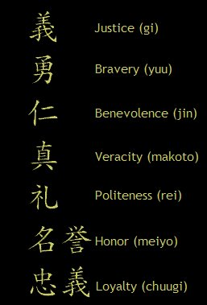
Bushido
Meaning: the way of the warrior
Unwritten code followed by Samurai warriors.
A samurai was expected to show
Reckless courage
Reverence for gods
Generosity and benevolence to those weaker than himself
Dying an honorable death was more important than a long life.

Slide 6
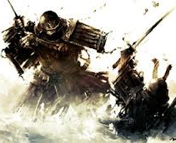
Shogun
Meaning: supreme general to emperor’s army
Title given to military leader in 1192 after the Minamota family won clan war.
Shoguns had power of military dictator.
Ruled Japan from 1200s through puppet emperors.

Slide 7
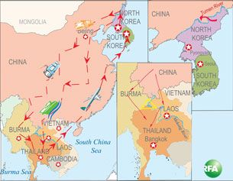
Kingdoms of SE Asia and Korea
Chapter 12, Section 5

Slide 8
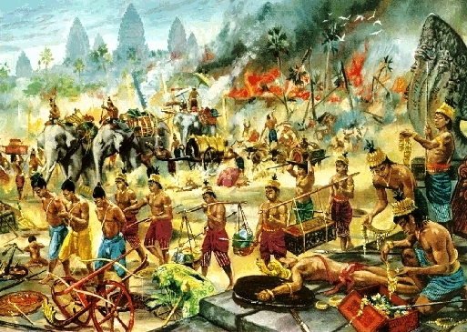
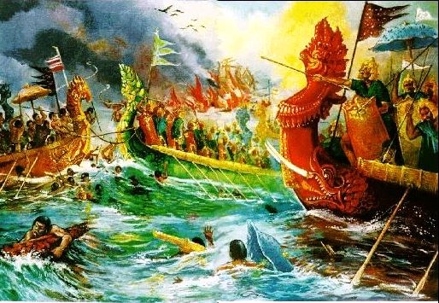
Khmer Empire
Today known as Cambodia
From 800s to 1200s they were main power on Southeast Asian mainland.
Conquered neighboring kingdoms and became empire.
Build waterways and irrigation systems; improved rice cultivation to 3 or 4 crops/year.

Slide 9
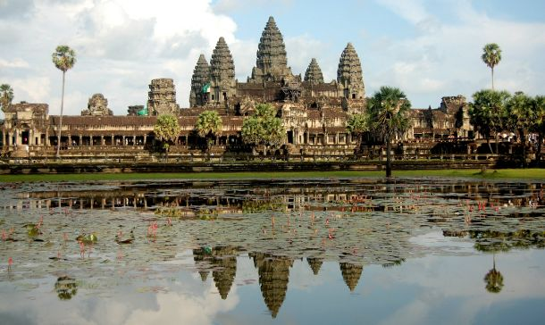
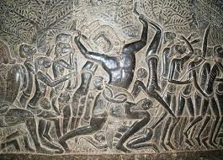
Angkor Wat
One of greatest architectural feats in the world covering nearly a square mile; largest religious construction in world.
Built in sandstone as symbolic mountain dedicated to Hindu god Vishnu.
Style shows Indian influence.
Carvings done directly on stone; covered in gold.

Slide 10
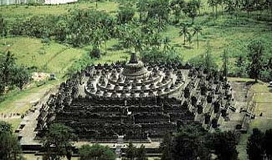
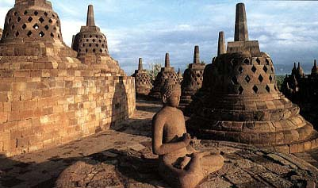
Sailendra Dynasty
Includes Southeast Asian Islands – Sumatra, Burma, Java.
Great agricultural expertise.
Built Buddhist temple at Borobudur; strong Indian influence.
Has nine terraced levels like stepped pyramid.
Ninety-two Dhyani Buddha statues.

Slide 11
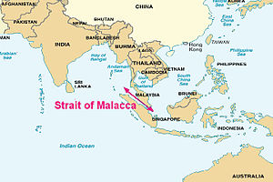
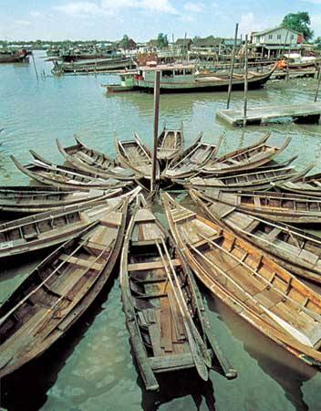
Srivijaya Dynasty
Overpowered Sailendra Dynasty; ruled 7th – 13th Century.
Controlled Strait of Malaca and other waters around islands.
Became wealthy by taxing trade passing through waters.
The capital, Palenbang, became great center of Buddhist learning. Monks from China, India, and Java used to congregate here to learn and teach the lessons of Buddha.

Slide 12
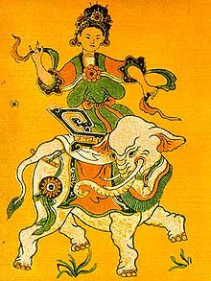
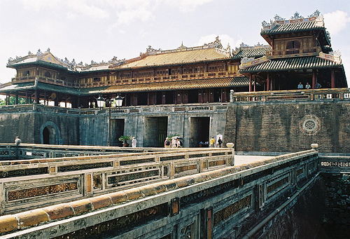
Ly Dynasty
Located in area today known as Vietnam.
Ruled by China during Han dynasty; became independent around 900 A.D. – known as Dai Viet.
Affected by Chinese cultural influences, but preserved independent culture and way of life.
Encourage agriculture and trade; improved road and water transportation.

Slide 13
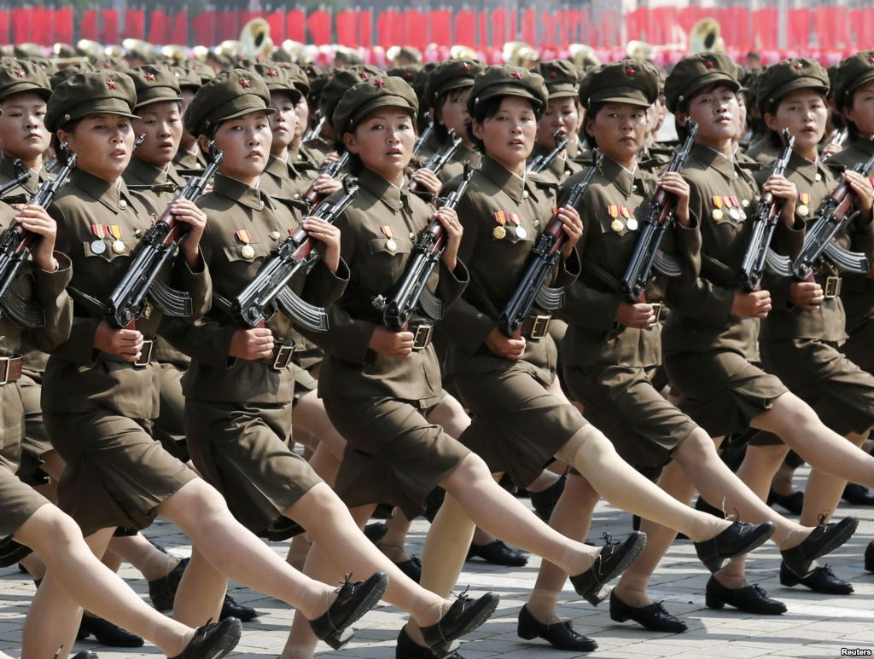
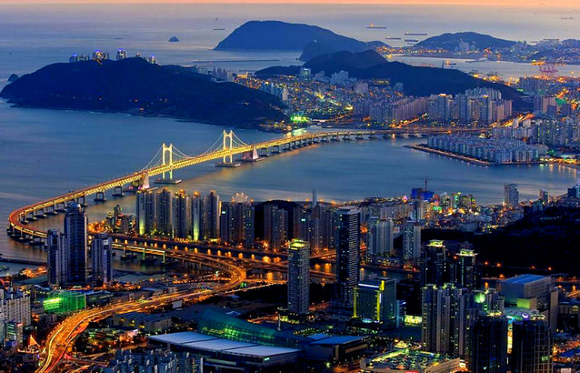
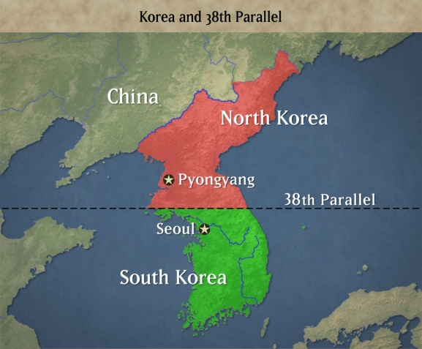
Korea (Modern)
Two sides to Korean culture:
Distinct people with own native traditions
Culture was shaped by Chinese influences and adapted to suit own needs
Today arbitrarily divided into two countries:
North Korea
South Korea.

Slide 14
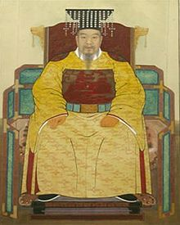
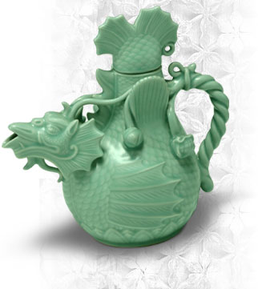
Koryu Dynasty
Lasted about 4 centuries 935-1392.
Government and civil service system modeled on Chinese model.
Despite examination system sons of aristocracy still received best positions which became hereditary.
Period marked by cultural achievements, e.g. light green celadon pottery.

Slide 15
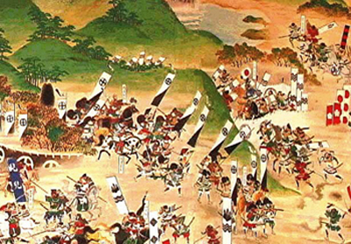
Japan Returns to Isolation
Chapter 19, Section 3

Slide 16
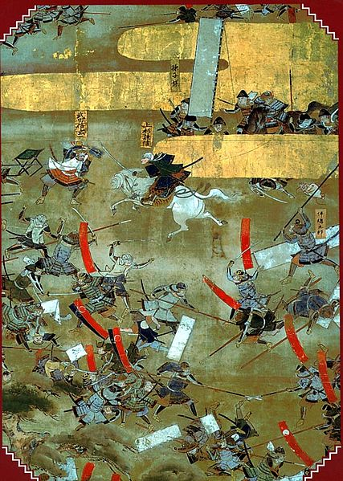
Warring States Period
1467-1568
Powerful shoguns in north and south fought one another for power.
Japanese feudal system collapsed; centralized rule ended.
Powerful samurai seized control of the country.

Slide 17
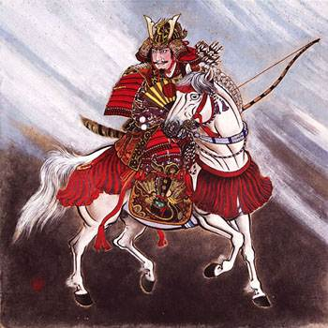
Daimyo
Powerful warrior chieftain seized control of states.
Offered protection to peasants in return for loyalty; known as Daimyo, meaning great name.
Security came from powerful warlords; emperor became mere figurehead.

Slide 18
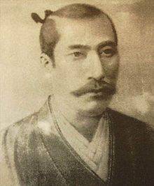
Oda Nobunaga
Vicious and brutal daimyo who defeated his enemies and took control of Kyoto in 1568.
Wanted to eliminate all enemies; killed rivals and attacked monasteries associated with opposition.
Unable to unify country; committed ritual suicide of samurai (“seppuku”) when general turned on him.

Slide 19
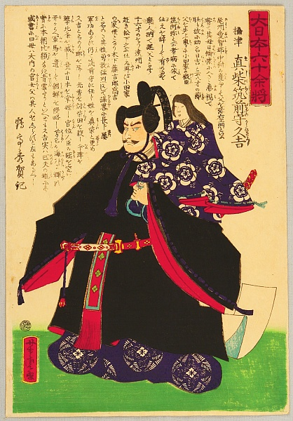
Toyotomi Hideyoshi
Nobunga’s best general; continued mission to destroy enemy.
Controlled most of country by 1592.
Wanted to conquer China; invaded Korea in 1592.
When he died six years later his troops withdrew.

Slide 20
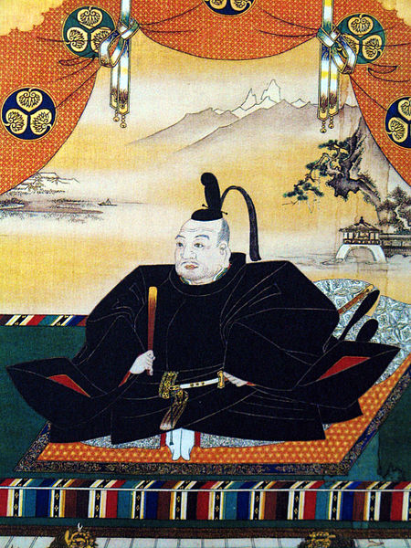
Tokugawa Ieyasa
Completed unification of Japan in 1600.
Defeated enemies in Battle of Sekigara; earned loyalty of other daimyo across country.
Three years later became sole ruler (shogun); moved capital to Edo (later Tokyo).

Slide 21
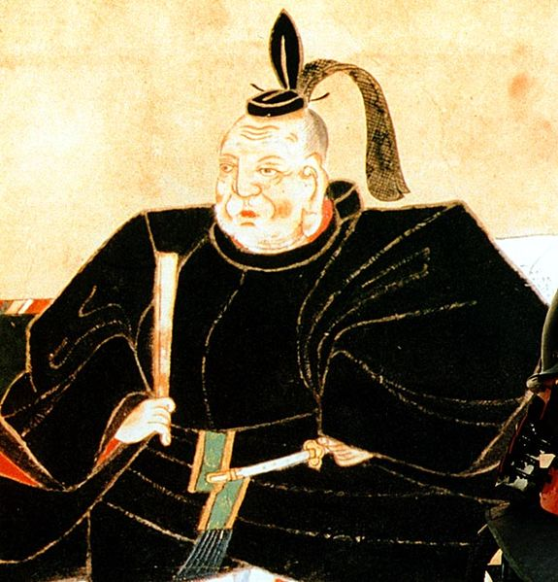
Tokugawa Shogunate
Ieyasu restored centralized government by requiring local daimyo to stay in capital every other year.
Founded Tokugawe Shogunate which held power until 1867.
Later rulers followed advice to be virtuous, and not to neglect, but protect country; allowed for order in Japan.
Period of cultural growth followed.

Slide 22
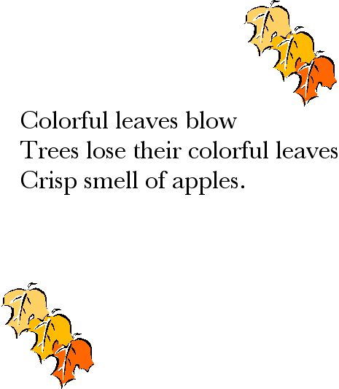
Haiku
Haiku is a very short form of Japanese poetry.
Consists of 17 syllables in three lines of 5, 7 and 5 syllables respectively.
Juxtaposition of two images or ideas and a "cutting word" between them which signals the moment of separation.

Slide 23
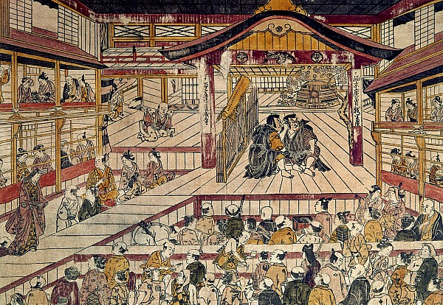
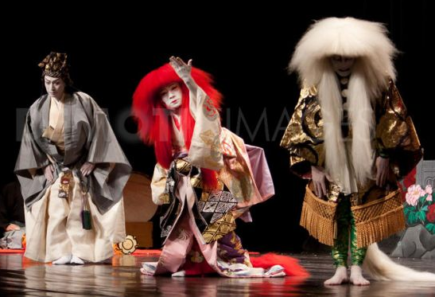
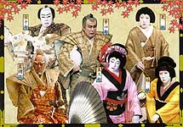
Kabuki
Form of Japanese theater.
Actors
are in elaborate costumes,
use music, dance and mime
perform skits of everyday life

Slide 24
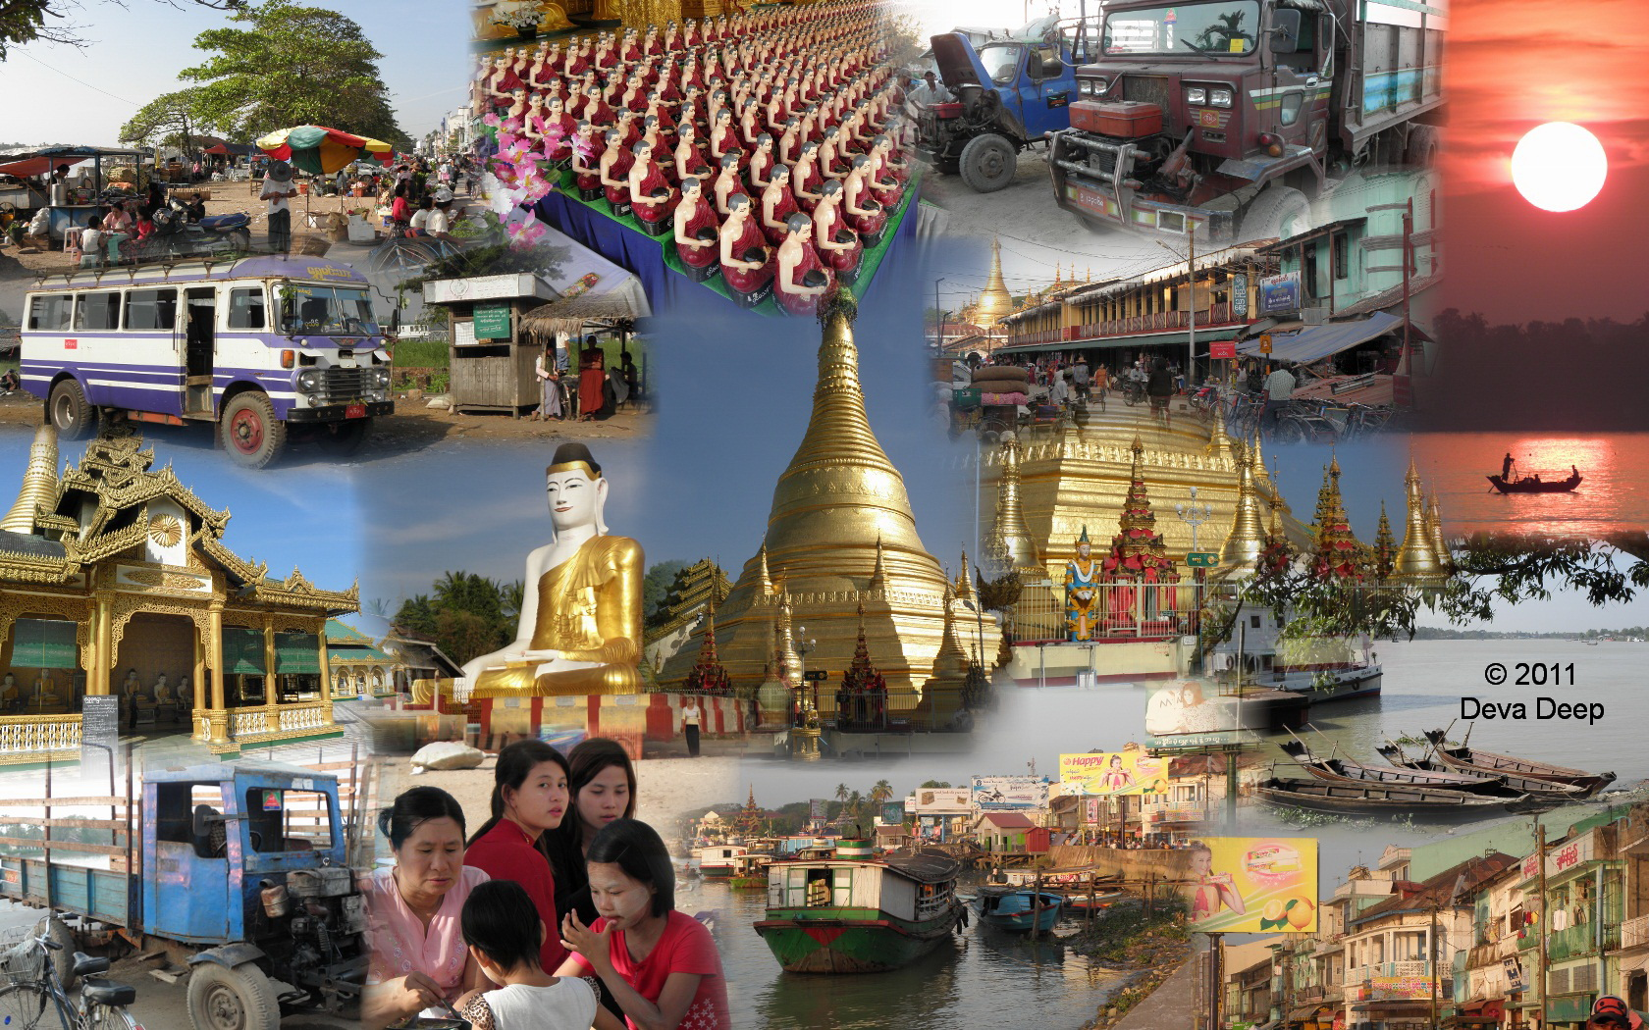
Imperialism in SE Asia
Chapter 27, Section 5

Slide 25
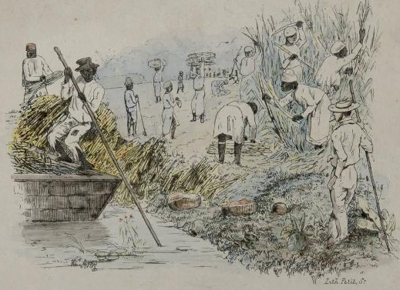
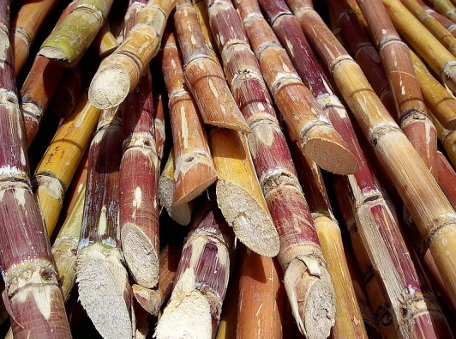
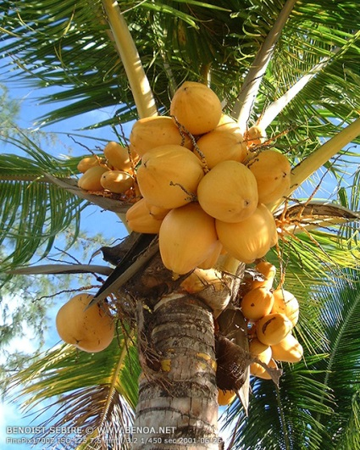
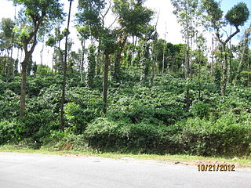
Pacific Rim
As they did in Africa, European powers wanted to carve up countries in SE Asia.
Made highly desirable by strategic location on route to China.
Colonies provided:
tropical agriculture (included sugar cane, coffee, cocoa, rubber, coconuts, bananas, pineapples)
minerals
oil

Slide 26
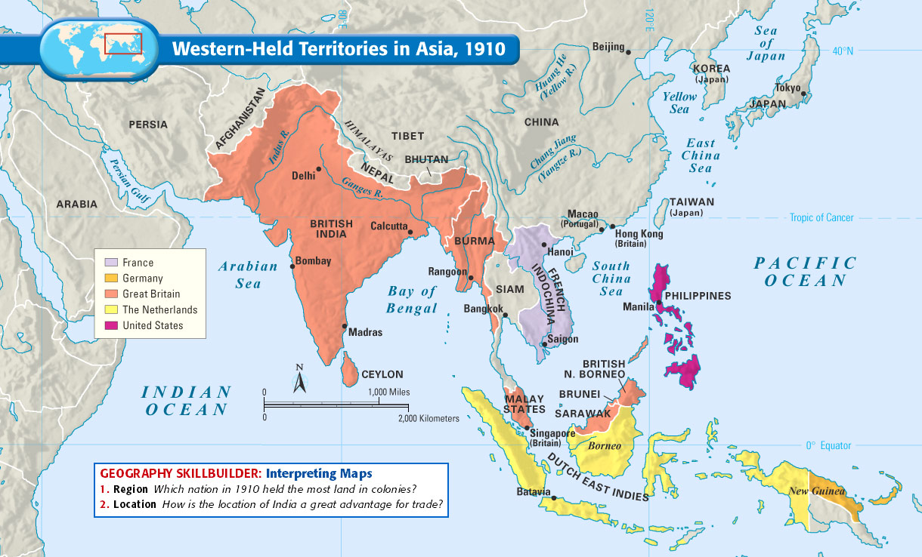
European Expansion
Dutch East India Company controlled Malacca, Java, Sumatra, parts of Borneo, Celebes, the Moluccas and Bali.
Britain confiscated Singapore – an island just off Malay Peninsula.
France controlled Indochina; later Laos, Cambodia and North Vietnam.

Slide 27
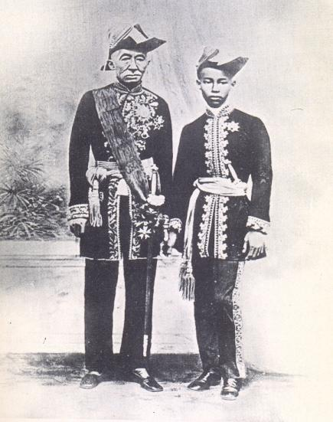
King Mongkut
Siam (today Thailand) lay between Burma (British controlled) and French Indochina.
Remained free from European control.
Kings promoted Siam as a neutral zone.
King Mongut and his son modernized country by
promoting education
reforming legal system
reorganizing government
building railroads and telegraph systems
ending slavery

Slide 28
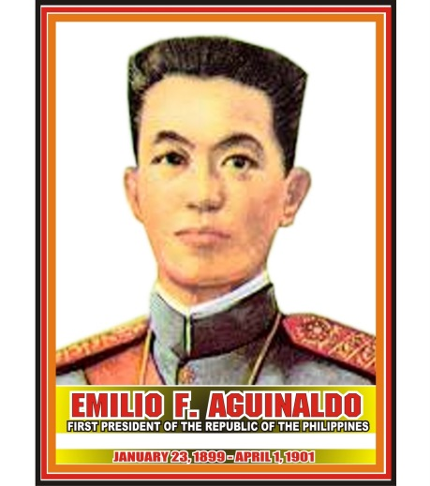
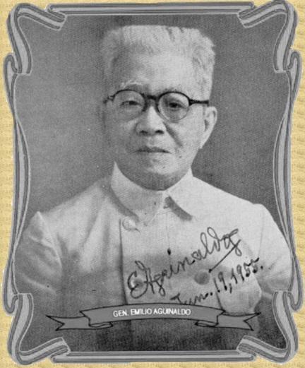
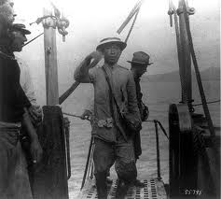
Emilio Aguinaldo
USA acquired the Philippine Islands, Puerto Rico and Guam in 1808 after Spanish-American War.
Filipino nationalists under Emilio Aguinaldo declared independence and established Philippine Republic.
Struggle between USA and Philippines – USA won.

Slide 29
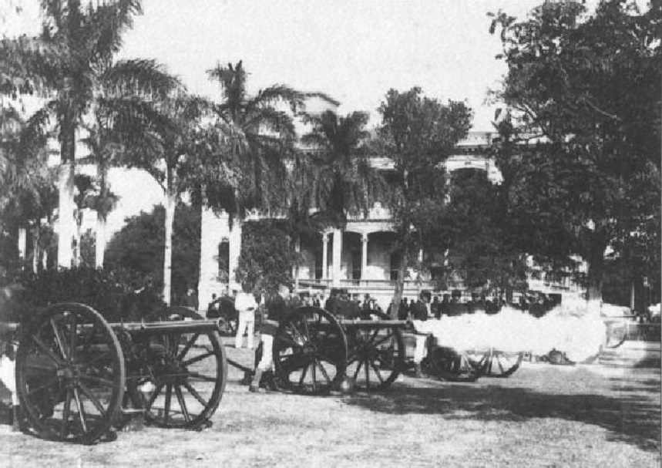
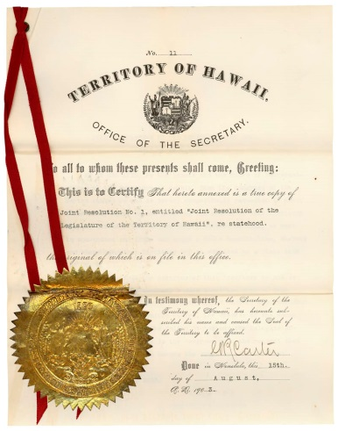
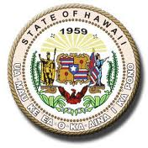
Annexation of Hawaii
Many Americans established sugar plantations on Hawaii; brought wealth to Hawaii.
McKinley Tariff Act in 1890 caused sugar from Hawaii to cost same as sugar from elsewhere; producers lost money.
Pushed for annexation so Hawaii could be part of USA; would bring bigger profits to producers of sugar.

Slide 30
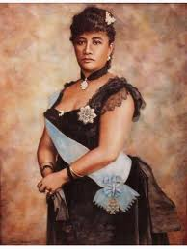
Queen Liliuokalani
Took to throne in 1893; new constitution to increase her power.
Would also restore power of Hawaiians at expense of plantation owners.
American business men hatched plot to overthrow monarchy; new president asked USA to annex Hawaii.
Hawaii became part of USA in 1898.

Slide 31
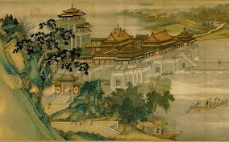
Modernization in Japan
Chapter 28, Section 2

Slide 32
Treaty of Kanagawa
U.S. Commodore Matthew Perry took four steam ships into Tokyo harbor in 1853; steamships and cannons astounded Japanese.
Letter from Pres. Millard Fillmore requested shogun to allow free trade between Japan and U.S.
Perry promised to be back year later with bigger fleet; Japan thus forced to agree to Treaty of Kanagawa in1853.
Forced Japan to open doors to U.S.; soon followed by other countries.

Slide 33
Meiji Era
Japanese angry at ruling shogun for opening Japan to foreigners; turned to young emperor – Mutsuhito.
Shogun stepped down; Mutsuhito, who represented Japanese pride and nationalism, took control of government.
Reign lasted 45 years; known as Meiji Era – meaning “enlightened rule”.

Slide 34
Imperial Japan
By 1890 Japan had become strongest military power in Asia:
several dozen warships
500,00 well-trained soldiers
Gained military, political and economic strength; abolished extraterritorial rights of foreigners.

Slide 35
Japan and China
Japan signed agreement with China not to invade Korea; China broke it and Japan protested by sending troops to fight Chinese in Korea.
Treaty with China led to Japan now owning colonies – Taiwan and Pescadores Islands.
Balance of power changed – Russia and Japan major powers in Asia.

Slide 36
Russo-Japanese War
Russia and Japan at war over Manchuria; 1903 Japan offered to withdraw if Russia agreed to stay out of Korea; Russia refused.
February 1904 Japan launched surprise attack on Russian ships off coat of Manchuria, resulting in war.
Japan drove Russia out of Korea and destroyed Baltic fleet.
Treaty of Portsmouth gave captured areas to Japan; Russia forced to withdraw.

Slide 37
Annexation
After defeating Russia, Japan made Korea a protectorate; sent in advisors who grabbed power from Korean leaders. Korean king forced to give up power
1910 Korea was officially annexed by Japan; harsh and oppressive rule followed that was ignored by rest of the world.

Slide 38
SE Asian Nations Gain Independence
Chapter 34, Section 2

Slide 39
Ferdinand Marcos
Elected president of Philippines 1965.
Imposed authoritarian rule over subjects; stole money from public treasury.
Constitution allowed only eight years of rule, but got around that by imposing martial law 1972-1981.
Chief opponent, Benigno Aquino, was assassinated.

Slide 40
Corazon Aquino
Widow of Benigno Aquino challenged Marcos; won, but Marcos refused to acknowledge her victory.
Public outcry forced him into exile.
$475 million recovered that Marcos had stolen.
Promised more open and democratic government.

Slide 41
Aung San Suu Kyi
Burma (Myanmar) suffered much political turmoil after independence; conflict between repressive military forces and pro-democratic forces.
Aung San Suu Kyi won Nobel Peace Prize for efforts to establish democracy in Myanmar; unable to accept in person as under house arrest.

Slide 42
Sukarno
Led effort to establish independent Indonesia; claimed independence two days after Japan surrendered in 1945.
Independence granted by Dutch four years later.
Diverse and populous nation; unsuccessful in stabilizing economy – inflation rose to 1,000%!

Slide 43
Suharto
Attempted coup in 1965; suppressed by general Suharto.
Seized power for himself; nearly 1 million Indonesians killed.
Indonesia became police state; bribery and corruption commonplace.
Sukarno’s daughter (Megawati Sukarnoputri) now president; moving towards democracy.

