Slide 1
Peopling of the World: Prehistory – 2500 B.C.
Chapter 1, Sections 1, 2 & 3

Slide 2
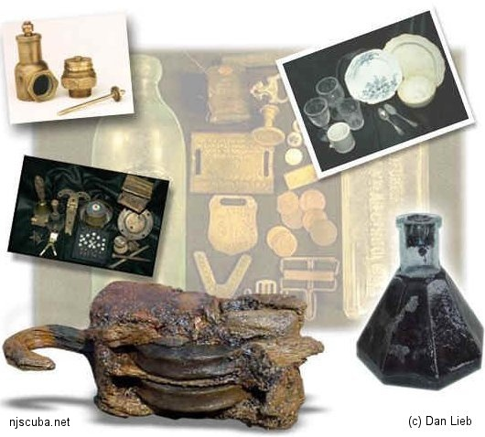
Artifact
Human-made objects such as tools and jewelry.
Used to help create an idea of what people did, and/or how they dressed.

Slide 3
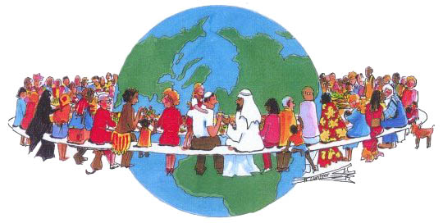
Culture
People’s unique way of life; how they live, dress, etc.
Anthropologists study artifacts to determine culture.

Slide 4
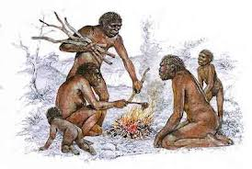
Hominid
Humans and other creatures that walk upright.

Slide 5
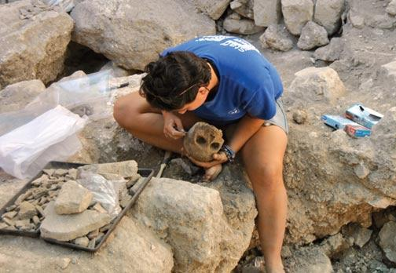
Archaeologist
Scientist who studies past human life and culture by the recovery and examination of remaining material evidence, such as graves, buildings, tools, and pottery.

Slide 6
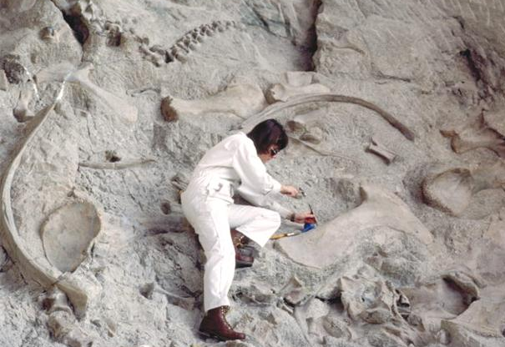
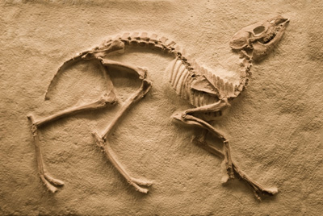
Paleontologist
Scientist who studies the forms of life existing in prehistoric or geologic times, as represented by the fossils of plants, animals, and other organisms.

Slide 7
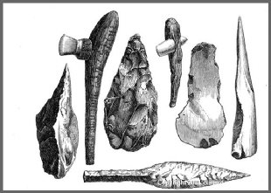
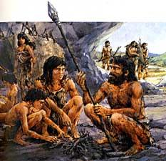
Paleolithic Age
Earlier part of Stone Age.
2.5 million – 8000 B.C.

Slide 8
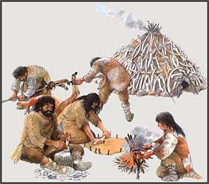
Neolithic Age
Later part of Stone Age.
8000 – 3000 B.C.
People learned to polish stone tools, make pottery, grow crops, and raise animals.

Slide 9
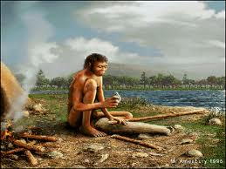
Homo Erectus
1.6 million years ago
“Upright man”
More intelligent and adaptable than Homo Habilis.
Developed technology.

Slide 10
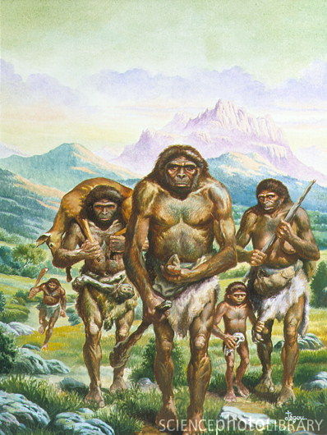
Technology
Developed by Homo erectus.
Refers to way people developed and applied knowledge, tools and inventions.
More sophisticated tools developed for digging, scraping and cutting.

Slide 11
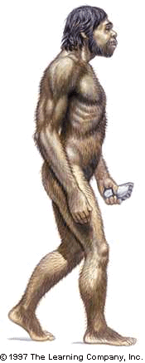
Homo Sapiens
Means “wise men”.
Scientists believe Homo erectus developed into Homo Sapiens.
Physically similar, but larger brain.

Slide 12
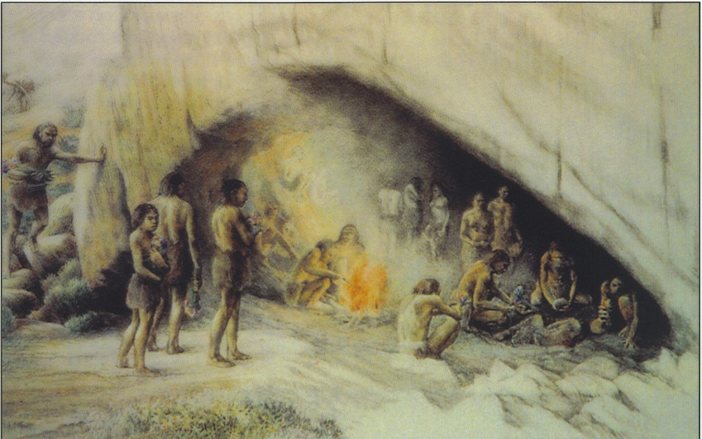
Neanderthal
Lived 200,000 – 30,000 years ago
Evidence of religious rituals (burying dead).
Resourceful
built shelters
made clothes from animal skins
devised tools

Slide 13
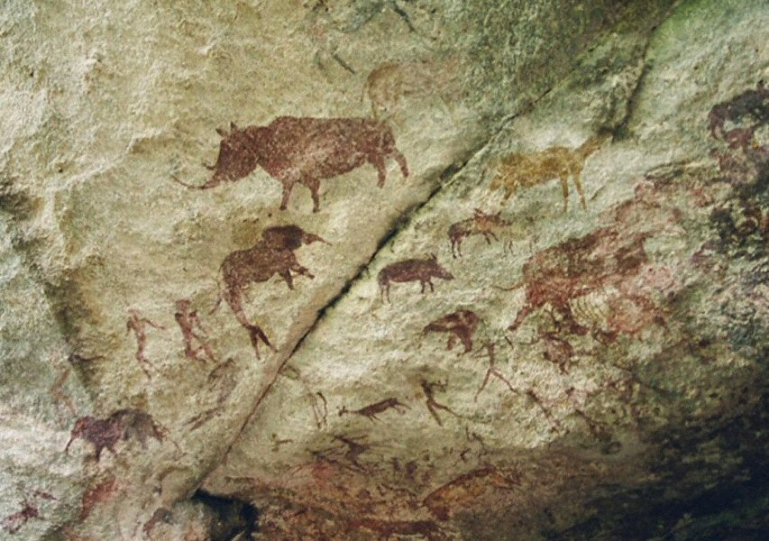
Cave Painting
Found on all continents.
Images of daily activities, e.g. hunting, or mark events.

Slide 14
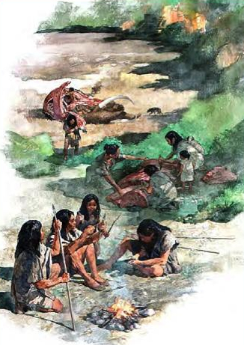
Nomads
Highly mobile (traveling) people during Stone Age.
Moved from place to place searching for food sources.

Slide 15
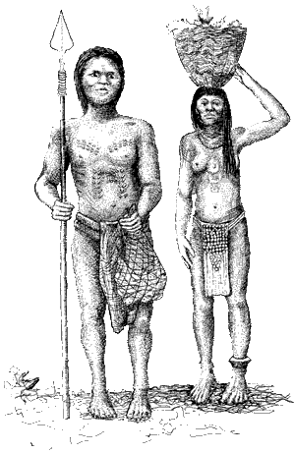
Hunter-gatherer
Food sources of nomadic people depended on hunting and foraging skills.
Developed tools, e.g. spears to hunt from further distance, and digging sticks to dig deeper for roots.

Slide 16
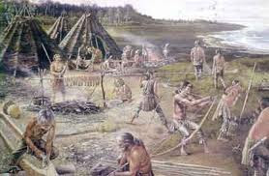
Neolithic Revolution (Change / Development)
10,000 years ago
Discovered how to grow crops; brought about revolution.
Shifted from food-gathering to food-producing.
Beginning of agriculture.

Slide 17
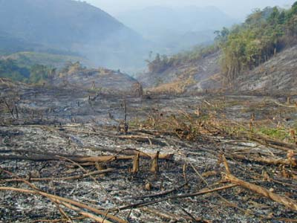
Slash-and-Burn Farming
People cut down trees and burned grasses to clear fields; ashes fertilized soil.
Farmers planted crops for 2-3 years, then moved elsewhere.
Process repeated after few years.

Slide 18
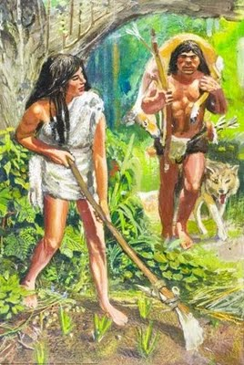
Domestication
Hunters knowledge of animals led to domestication or taming of animals.
Provided constant source of food.

Slide 19
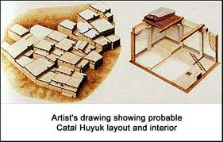
Catal Huyak
Means “forked mound”
South-central Turkey
Advantages:
crops; skilled workers; trade objects; cultural life
Disadvantages:
floods; drought; fire; disease; jealousy of neighbors

Slide 20
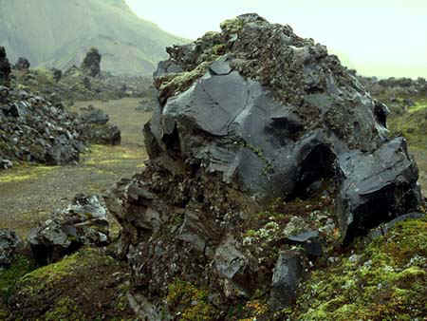
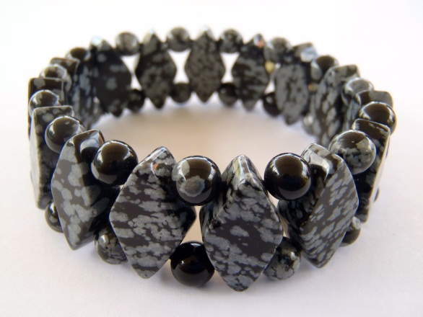
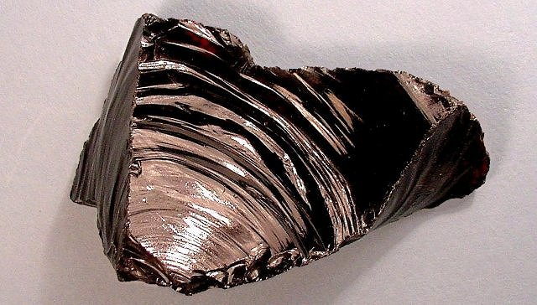
Obsidian
Dark volcanic rock
Looks like glass
Used to create mirrors, jewelry and knives for trade.

Slide 21
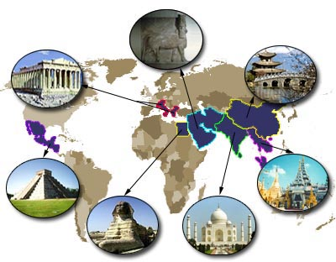
Civilization
Complex society
Five characteristics:
Advanced cities
Specialized workers
Complex institutions
Record keeping
Advanced technology

Slide 22
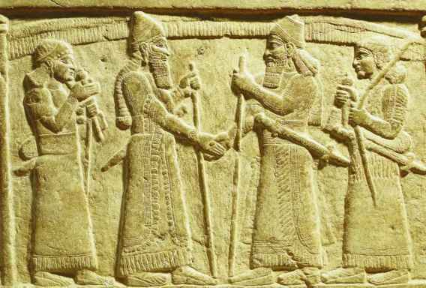
Specialization
Development of skills in a specific kind of work.
Abundance of food allowed people to become experts in other fields besides faming, e.g. becoming merchants or artisans.

Slide 23
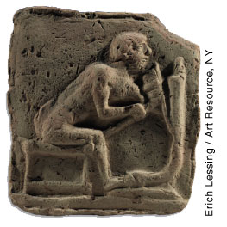
Artisans
Skilled workers who make goods by hand.
Includes jewelry making, designing and making tools, making clothing, pottery, etc.
Wide range of crafts made it possible for cities to become centers of trade.

Slide 24
Institution
Soaring population made systems of ruling necessary to maintain order and establish laws.
Led to development of complex institutions such as government, religion and economy.

Slide 25
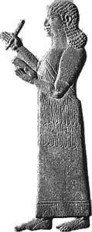
Scribes
Civilizations needed to keep records; led to development of writing.
Records were kept by professional writes or scribes.

Slide 26
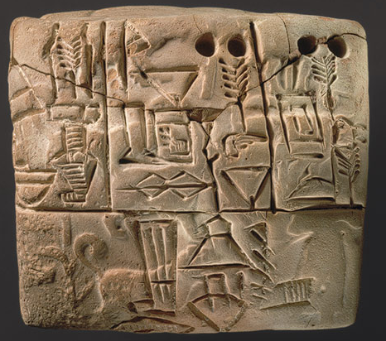
Cuneiform
Sumerian system of writing.
Consisted of pictographs, i.e. symbols to represent objects.
Used reed stylus to impress symbols onto clay tablets.

Slide 27
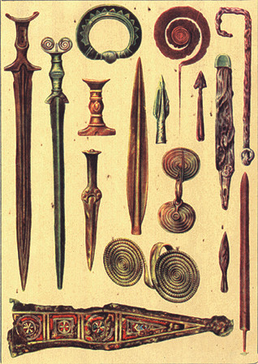
Bronze Age
Development of technology led to Bronze Age around 3,000 B.C.
Refers to age where bronze was used instead of copper and stone to fashion weapons.

Slide 28
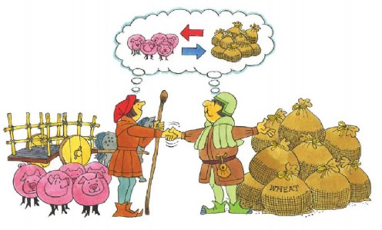
Barter
Way of trading goods and services without money.

Slide 29
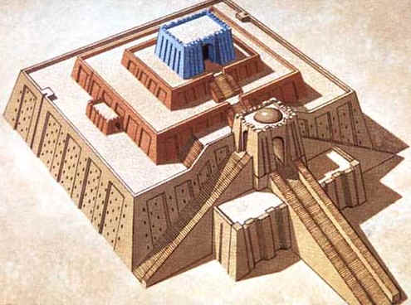
Ziggurat
Means “mountain of god”.
Pyramid-shaped temple in Ur.
Mud-brick stairs led to top where priests conducted religious rituals.

