Slide 1
Chapter 3
People and Ideas on The Move:
Phoenicians

Slide 2
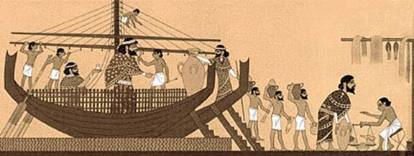
Phoenicians
Remarkable shipbuilders and seafarers.
Powerful traders long the Mediterranean Sea.
Phoenicia was not united; consisted of series of powerful city-states.
Lived in area today known as Lebanon.

Slide 3
Colony
Land controlled by other nations.
Phoenicians built several colonies about 30 miles apart – distance a ship could travel in one day.
Colonies on coast of Africa, Sardinia, Sicily and Spain.
Included Carthage in North Africa.

Slide 4
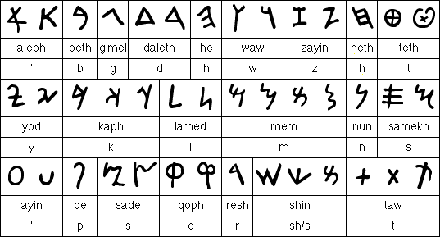
Phoenician Alphabet
Needed a way to record trades; developed a writing system using symbols to represent sounds.
Adapted by other cultures, e.g. Greeks.
Basis of our alphabet today.

