Slide 1
Conflicts in the Middle East
Chapter 34, Section 4

Slide 2
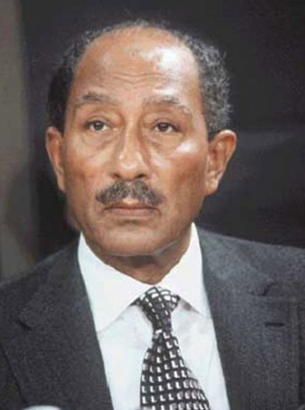
Anwar Sadat
President of Egypt who planned joint Arab attack on Israel in October 1973 on Yom Kippur, a holy Jewish holiday.
Inflicted heavy casualties and recaptured some of territory lost in 1967 during previous war.

Slide 3
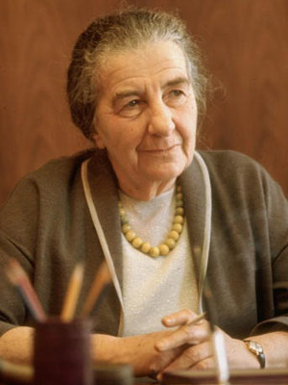
Golda Meir
Israeli teacher and politician.
Became fourth Prime Minister of Israel. on March 17th, 1969.
Launched counterattack on Arabs after Yom Kippur attack; regained most of lost territory.

Slide 4
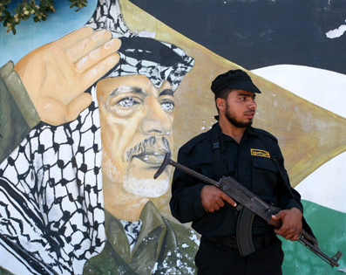
PLO
Palestine Liberation Organization formed in 1964,
Goal was to push for the formation of an Arab Palestinian state that would include land claimed by Israel.
Eventually dominated by guerrilla groups insisting on armed struggle.

Slide 5
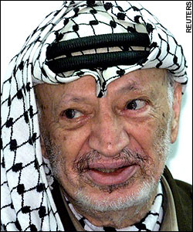
Yasir Arafat
Became chairman of PLO in 1969.
Group carried out numerous terrorist attacks against Israel.

Slide 6
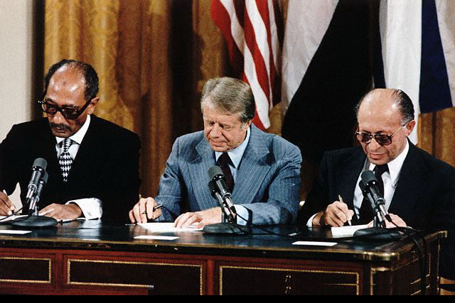
Camp David Accords
Agreement reached between Egypt and Israel leaders in 1979 at Camp David under President Carter in the USA.
Egypt recognized Israel as a legitimate state.
Israel agreed to return the Sinai Peninsula to Egypt.
Ended 30 years of hostilities; first signed agreement between Israel and Arab country.

Slide 7
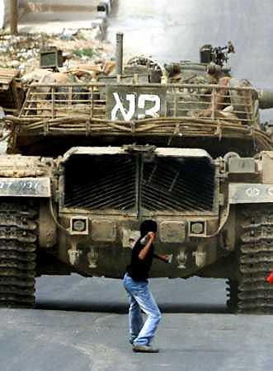
Intifada
Campaign of civil disobedience / uprising by Palestinians against Israel.
Took form of boycotts, demonstrations, attacks on Israeli soldiers, rock throwing by unarmed teenagers.
Affected world opinion and put pressure on Israel to negotiate with Palestinians.

Slide 8
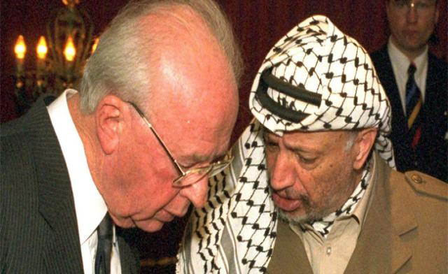
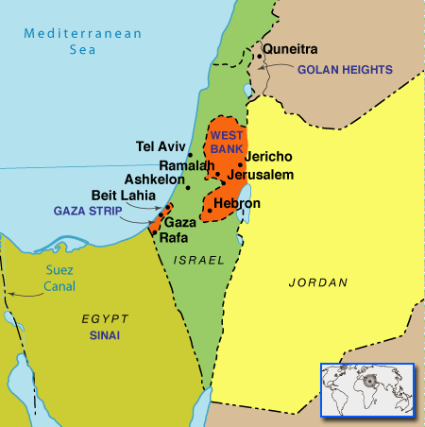
Oslo Peace Accords
Secret talks in Oslo, Norway in 1993 led to agreement between Israel and Palestinians.
PLO was willing to acknowledge Israel's right to exist; Israel acknowledged PLO as representative for Palestinians.
Accord granted self-rule to Palestinians in Gaza Strip and West Bank.

Slide 9
Global Interdependence: 1960 - Present
Chapter 36 (Relevant Sections)

Slide 10
Globalization
Process that makes something worldwide in its reach or operation.
Mostly used in reference to spread and diffusion of economics and cultural influences.
Includes all interactions that occur across borders.
Has advantages and disadvantages.

Slide 11
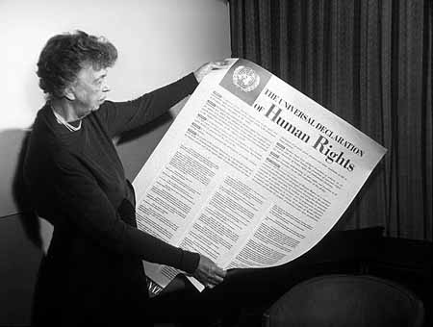
Universal Declaration of Human Rights
Issued in 1948 by United Nations to set human rights standards for all nations.
Also addressed in Helsinki Accords of 1975.
Lists specific rights that all humans have.
Declaration and accords are nonbinding, but inspired many to ensure that human rights are respected.

Slide 12
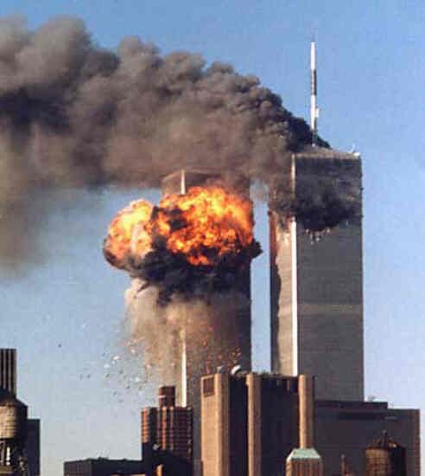
Terrorism
Use of violence against people or property to force changes in government or societies.
International problem as many terrorists cross international borders to call attention to their goals and motives.

Slide 13
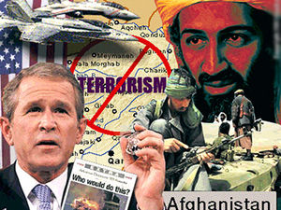
Department of Homeland Security
Created in 2002 after 9/11 attacks.
Function is to
coordinate national efforts against terrorism and
respond to terrorist attacks.

Slide 14
Cyber Terrorism
The politically motivated use of computers and information technology to cause severe disruption or widespread fear in society.

Slide 15
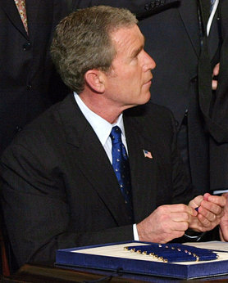
USA Patriot Act
Act of Congress that was signed into law by President George W. Bush on October 26, 2001.
The title of the act is a ten-letter acronym that stands for Uniting Strengthening America Providing Appropriate Tools Required Intercept Obstruct Terrorism Act of 2001.

