Slide 1
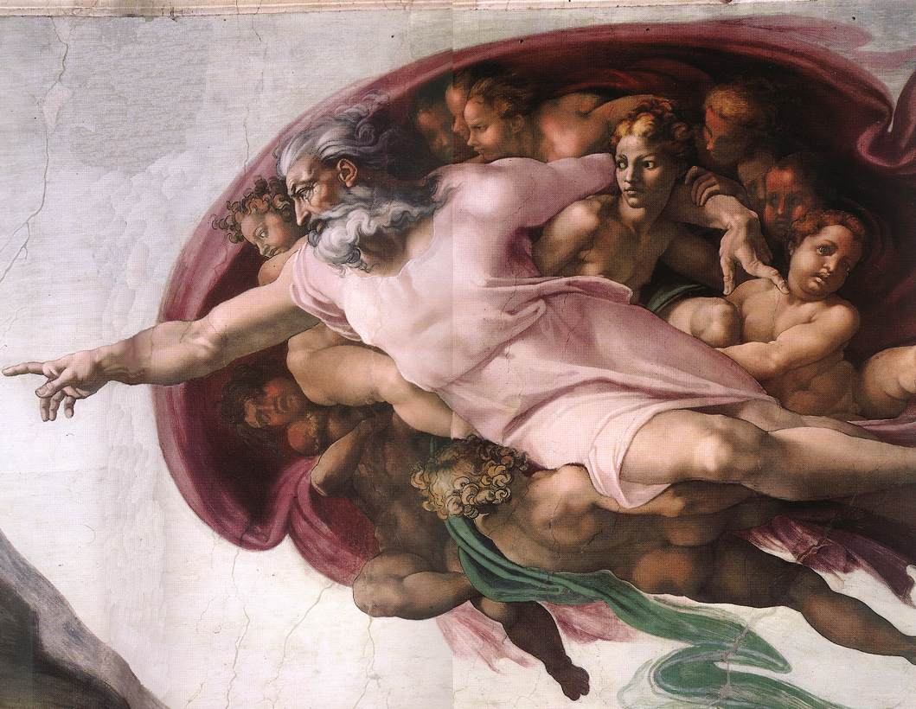
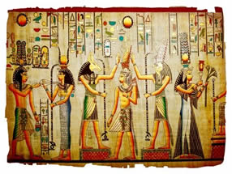
Monotheism vs. Polytheism
World History and Geography A

Slide 2
Definition
Judaism / Monotheism
Monotheism is the belief in a singular God
The One True God Alone is to be worshipped

Slide 3
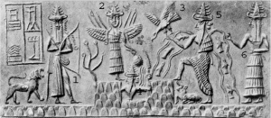
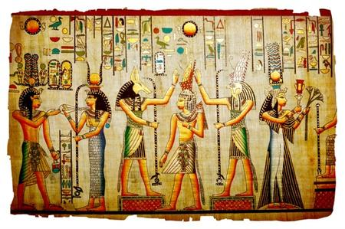
Definition
Polytheism
Polytheism is the belief of multiple deities
Numerous deities, each worthy of worship
Assembled into a pantheon of gods and goddesses
Each god / goddess has own mythologies and rituals

Slide 4
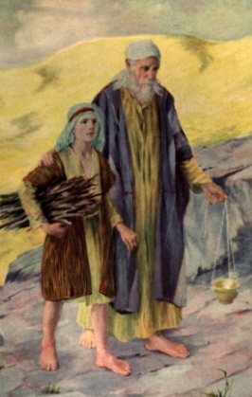
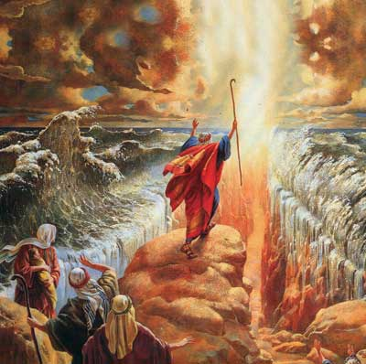
History
Judaism / Monotheism
Began about 2000 BC in Palestine
Founder: Abraham
Moses led Jews out of Egypt to Promised Land

Slide 5
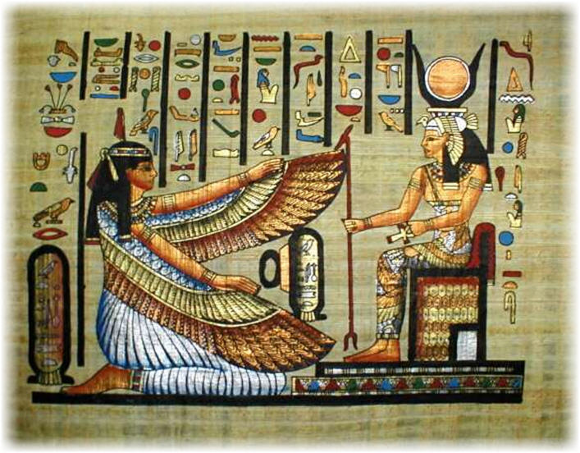
History
Polytheism
Result of an earlier belief in spirits, demons and other supernatural forces; similar to animism
Gods take on the form and characteristics of objects found in nature (trees, animals, etc.)
These supernatural forces were personified and organized into a cosmic family that becomes the nucleus of a culture's belief system

Slide 6
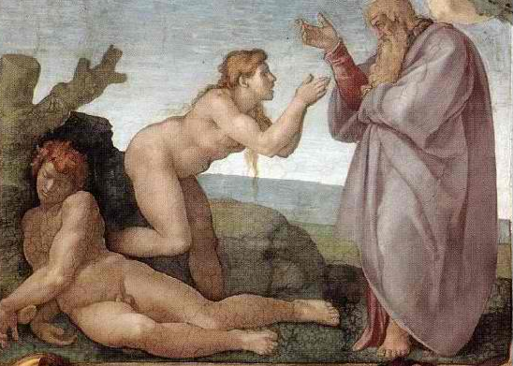
Creation
Judaism / Monotheism
God created the earth and all that is in it in six days.

Slide 7
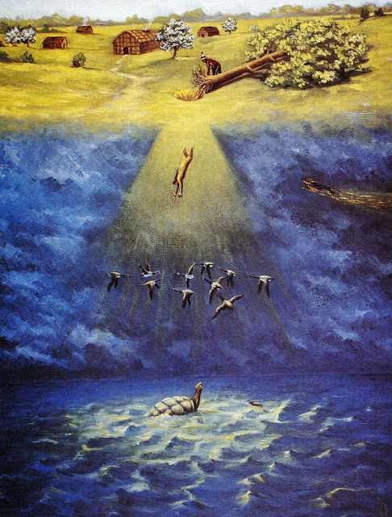
Creation
Polytheism
Several legends exist to explain the creation of the world; based on rivalry between various gods that existed before humans.

Slide 8
Beliefs
Judaism / Monotheism
Judaism is one of the oldest religions in the world.
Judaism has no official creed
Their sacred text, the Hebrew Bible, teaches several doctrines - such as those about God, the Messiah, human beings, and the universe

Slide 9
Beliefs
Polytheism
Deities were in control of forces of nature; role of humans was to appease the gods and serve them through elaborate rituals
The gods were quite limited in power; they are not considered ever-present, all-powerful or wise

Slide 10
Worship and Rituals
Judaism / Monotheism
Observant Jews are expected to recite three prayers daily and more on the Sabbath and Jewish holidays
Attending synagogue to pray with a minyan (quorum of 10 adult males) is considered ideal
Parts of the services are recited standing
Bowing is done at certain points in the services
Tallit (prayer shawl) - Jewish visitors are expected to don a tallit
Appropriate dress for a house of worship is expected.

Slide 11
Worship and Rituals
Polytheism
In Mesopotamia priests acted as intermediaries between people and the gods
Offered lavish meal to gods every day to win their favor
In Egypt, the Pharaoh was believed to be descended from the gods
Acted as the intermediary between his people and the gods
Obligated to sustain the gods through rituals and offerings so that they could maintain order in the universe

Slide 12
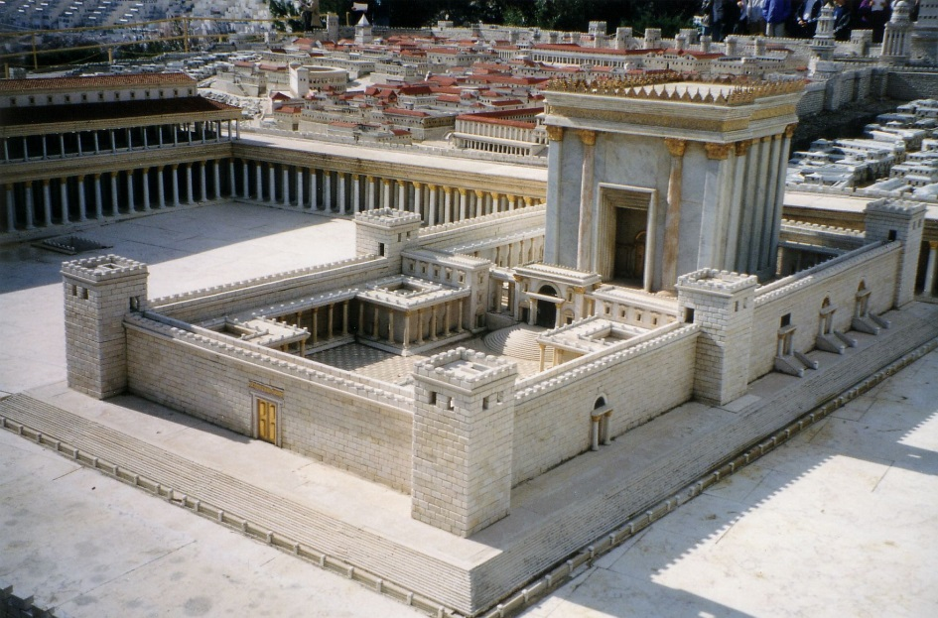
Place of Worship
Judaism / Monotheism
The Temple is the ancient center of Jewish worship where sacrifices were performed
A Jewish "church" is called a synagogue, shul or temple
A synagogue is a place of worship and study, and a "town hall“

Slide 13
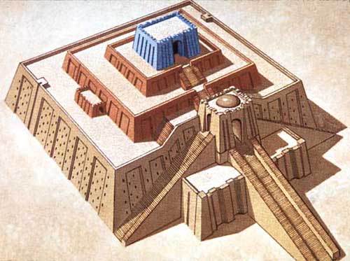
Place of Worship
Polytheism
Built lavish temples for various gods; temples were seen as houses for the gods or kings to whom they were dedicated
Variety of rituals, e.g.
Offerings to gods
Celebrations and Festivals
Rituals to ward of forces of chaos

Slide 14
Life After Death
Judaism / Monotheism
Traditional Judaism firmly believes that death is not the end of human existence.
However, because Judaism is primarily focused on life here and now rather than on the afterlife, Judaism does not have much dogma about the afterlife, and leaves a great deal of room for personal opinion.

Slide 15
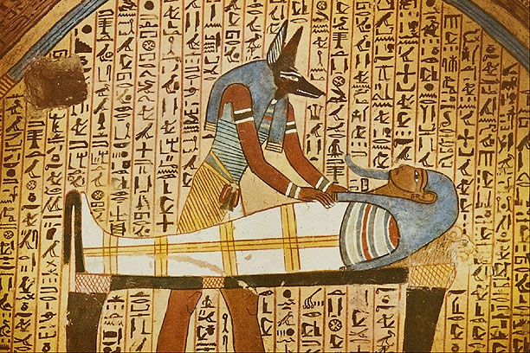
Life After Death
Polytheism (Egypt)
The Egyptians made great efforts to ensure the survival of their souls after death
Provided tombs, grave goods, and offerings to preserve the bodies and spirits of the deceased

