Slide 1
Age of Imperialism (1850 – 1914)
Selected Chapters

Slide 2
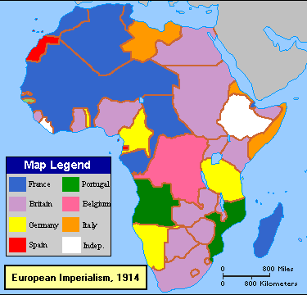
European Imperialism

Slide 3
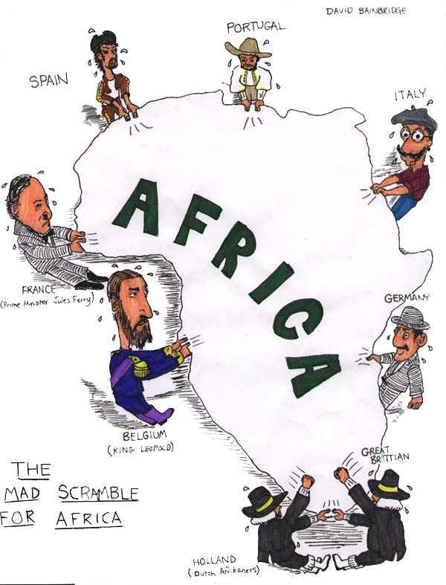
Imperialism
Industrial Revolution led to need for raw materials and new markets.
“Scramble for Africa” - a process of invasion, occupation, colonization and annexation of African territory.
Stronger countries dominated political, economic and social life in weaker countries.

Slide 4
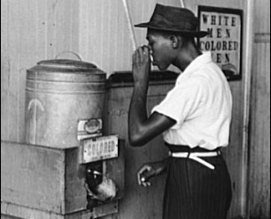
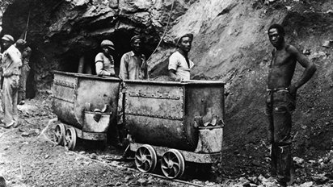
Racism
Belief that inherent differences among the various human races determine cultural or individual achievement.
Usually involves the idea that one race is superior and has the right to rule others.

Slide 5
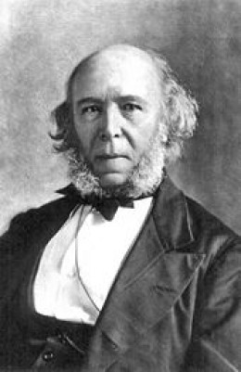
Social Darwinism
Social theory - strongest and fittest were considered superior.
Non-Europeans were considered lower on social scale as they lacked technological progress of Europeans.
Europeans believed they had right to bring progress to other countries.
Herbert Spencer,
the father of
Social Darwinism

Slide 6
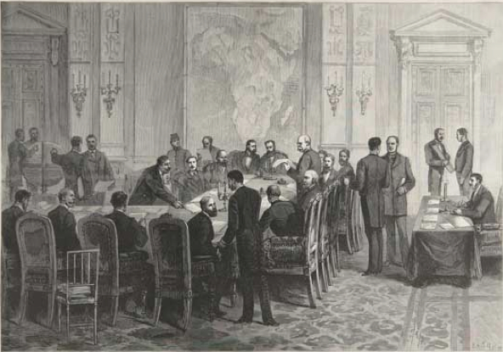
Berlin Conference
1884-1885
14 European countries met in Berlin
Purpose was to lay down rules for division of Africa.
No thought about how African ethnic or language groups were distributed.
No African leaders invited.
By 1914 only Ethiopia and Liberia free from European control.

Slide 7
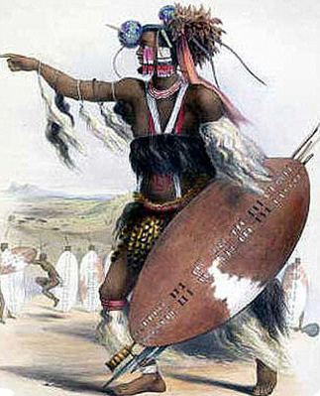
Shaka
Zulu chief - South Africa
Had good military organization and highly disciplined warriors.
1816 created large centralized state.

Slide 8
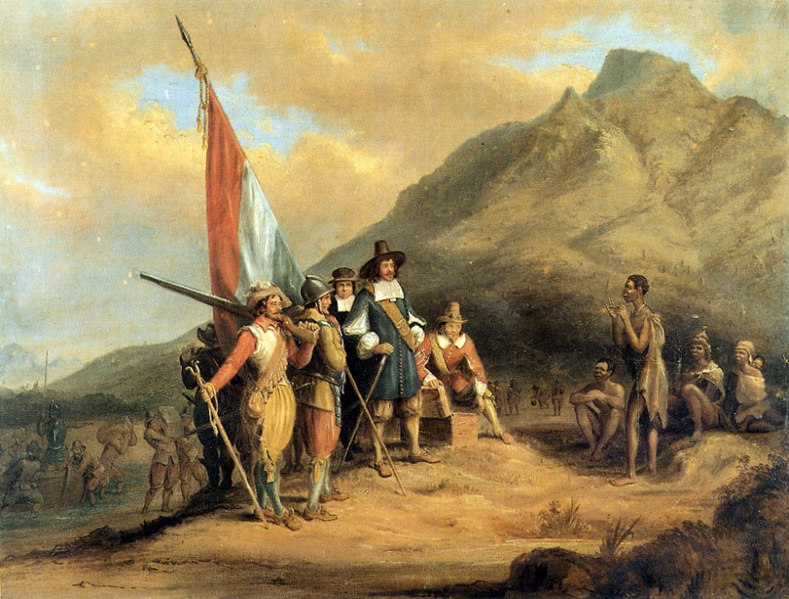
Boer
First Europeans to settle in South Africa were Dutch; purpose to build half way station for ships.
Dutch settlers known as Boers took land from Africans and established large farms.

Slide 9
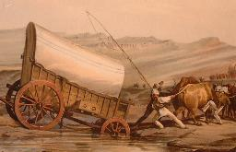
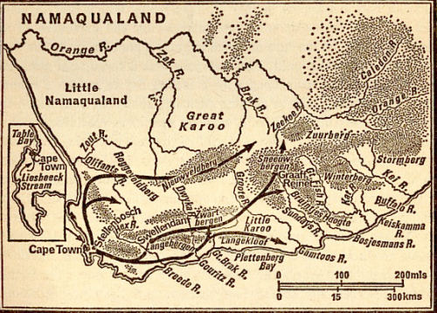
Great Trek
Boers (Dutch Farmers) in South Africa moved inland to escape British Rule.
Fierce fighting with ensued between Boers and African groups such as Zulus.

Slide 10
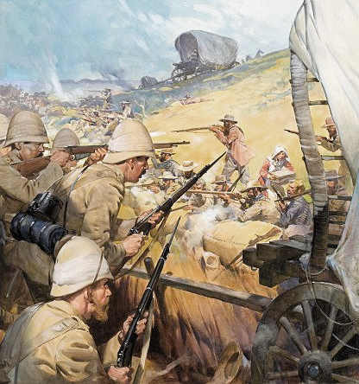
Boer War
Discovery of diamonds (1860’s) and gold (1880’s) in Africa.
Resulted in Boer War between the British and Boers.
Britain won war; 1910 Union of South Africa controlled by British.

Slide 11
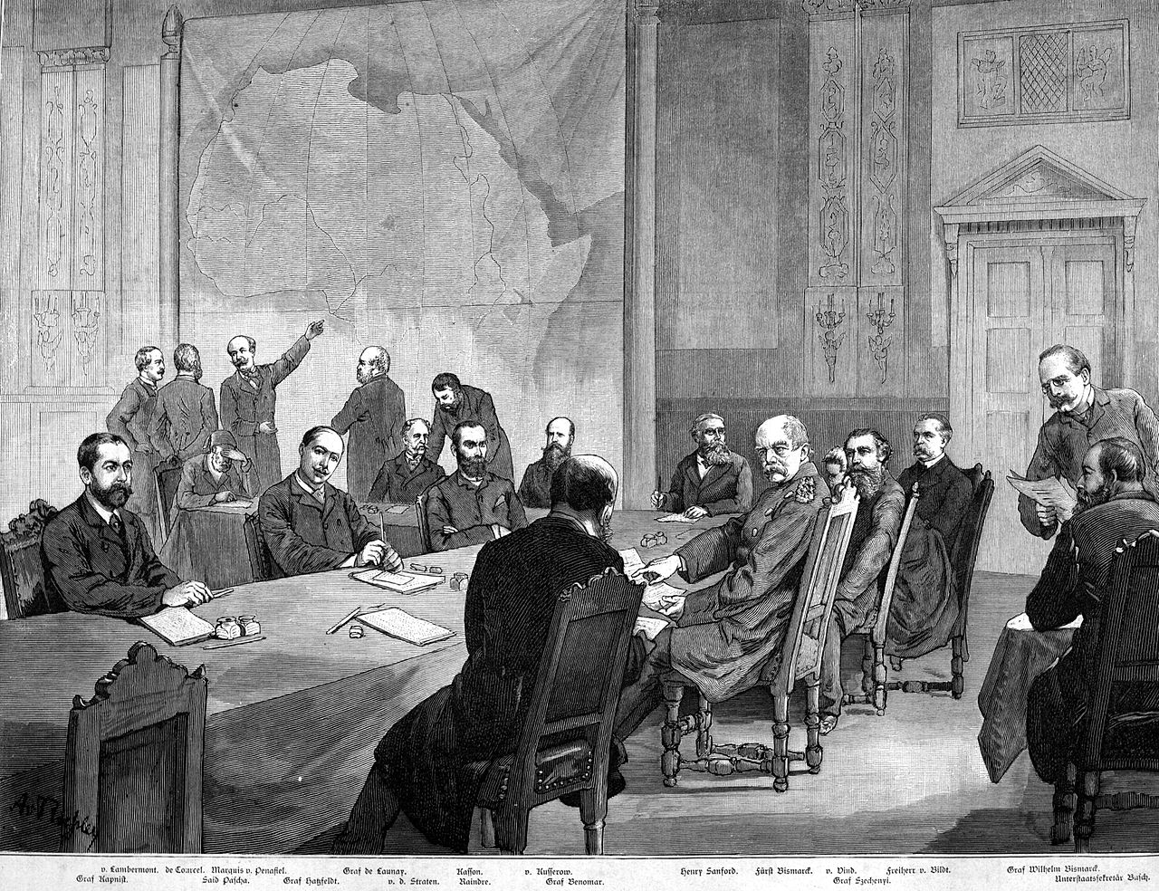
Paternalism
Some Europeans preferred direct control of colonies.
Viewpoint that Africans unable to rule country; needed to be supervised and governed in parental way; policy of paternalism.

Slide 12
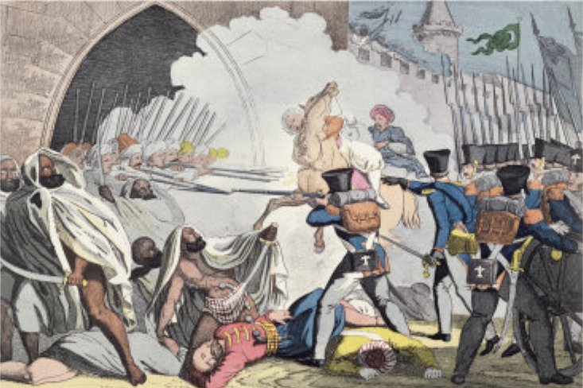
Assimilation
Policy followed by French; idea was that local populations could adopt French culture.
Local schools, courts and businesses patterned after French institutions.

Slide 13
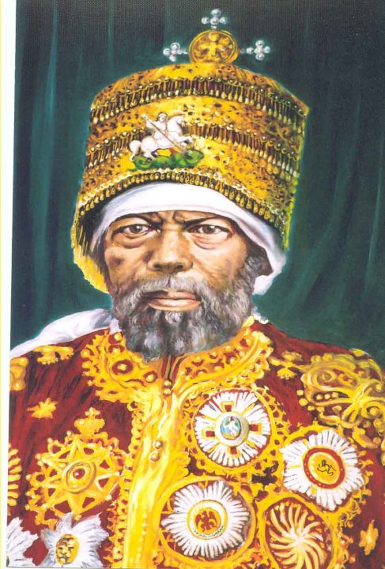
Menelik II
Ethiopia, under Menelik II, emperor of Ethiopia, resisted Europeans.
Played Italians, French and British off against one another.
Obtained weapons from France and Russia.
1886 won war against Italy.

Slide 14
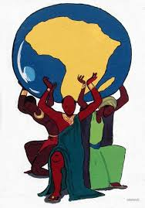
Negritude Movement
Growing sense of black consciousness and pride in traditional Africa.
Negritude movement celebrates African culture, heritage and values.
After WWII no longer willing to accept colonial rule.

Slide 15
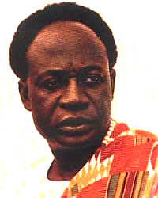
Kwame Nkrumah
Leader of non-violent movement working to liberate British colony of Gold Coast (later Ghana).
Organized strikes and boycotts that lead to independence; first prime minister and later president-for-life.

Slide 16
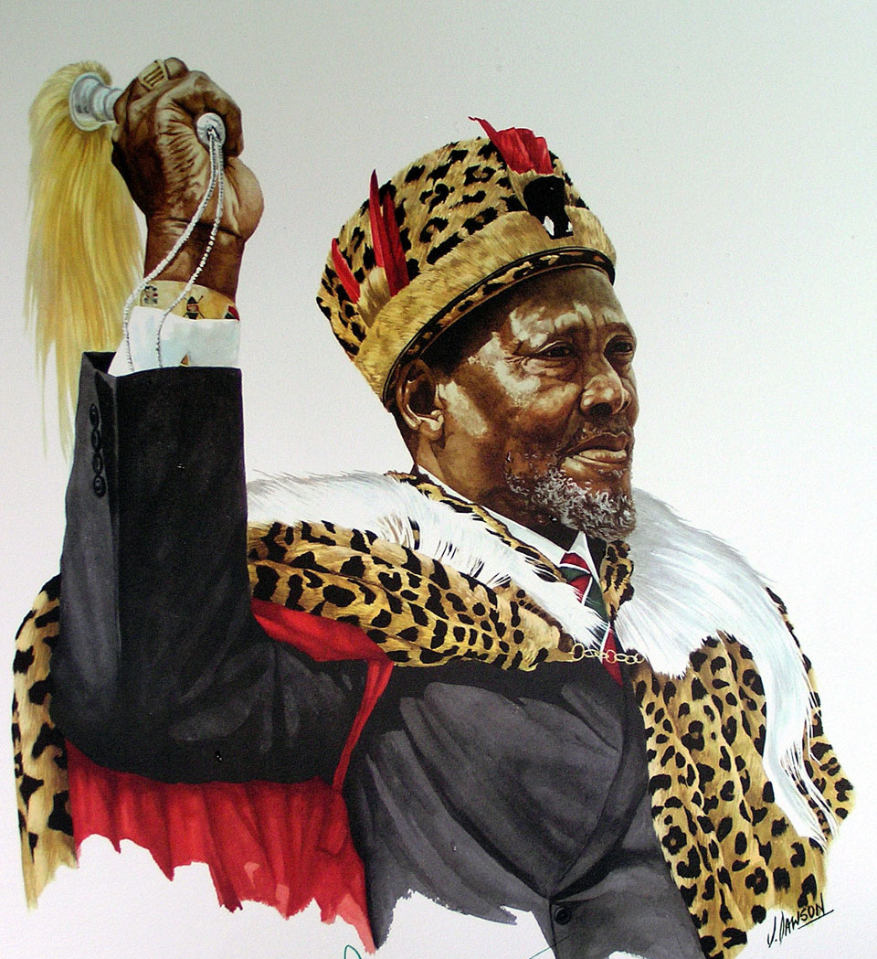
Jomo Kenyatta
Strong leader in Kenyan nationalist movement.
Not connected to Mau Mau (used guerrilla tactics to force white farmers out), but refused to condemn them.
Became first president of new nation; worked to unite various ethnic and language groups.

Slide 17
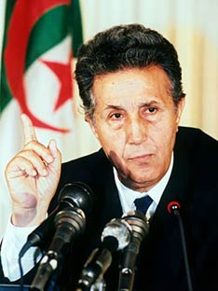
Ahmed Ben Bella
Leader of Algerian National Liberation Front (FLN).
FLN announced intention to fight for independence of Algeria in 1954; country gained independence 1962.
Became first president of independent Algeria; unsuccessfully tried to turn it in Socialist state.

Slide 18
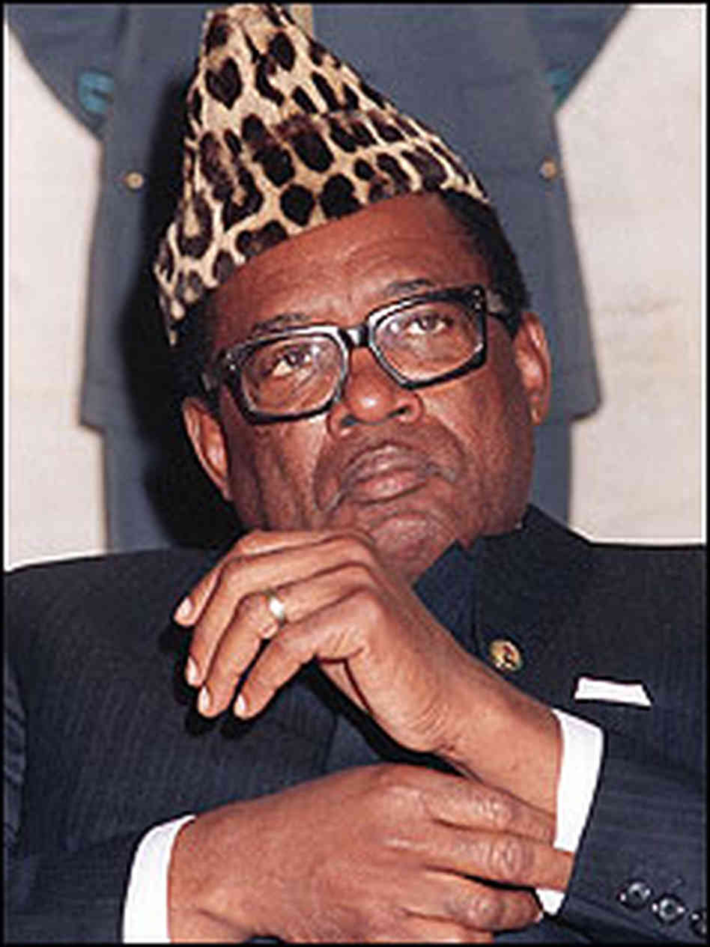
Mobutu Sese Seko
Congo’s independence from Belgium in 1960 created upheaval.
Mobuto seized power in 1965; ruled country that he renamed Zaire for 32 years.
Used force, one-party rule and gifts to supporters to maintain control.
Overthrown in 1997.

Slide 19
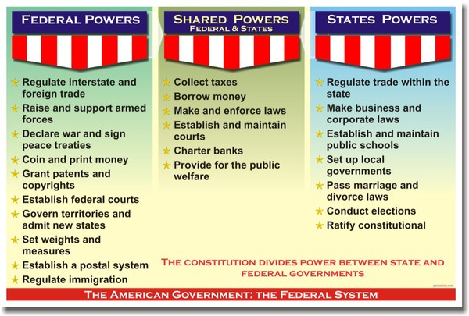
Federal System
Government system where power is shard between state governments and central authority.
EXAMPLES:
Nigeria
Switzerland
USA

Slide 20
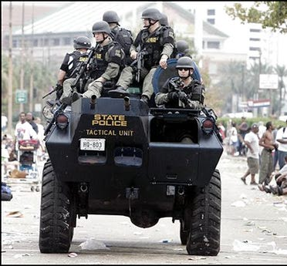
Martial Law
The exercise of government and control by military authorities over the civilian population of a specific territory.
Usually an extreme and rare measure used to control society during war or periods of civil unrest or chaos.

Slide 21
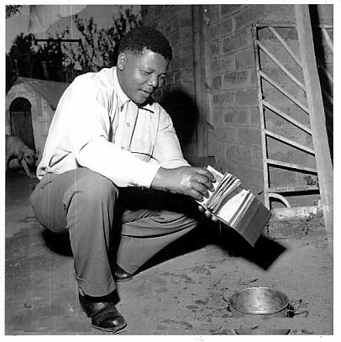
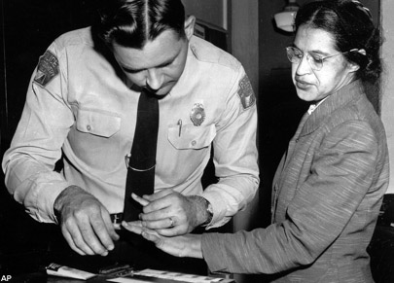
Dissident
Someone who disagrees with an established religious or political system, organization, or belief.
Nelson Mandela burning passbook required by law.
Rosa Parks arrested for disobeying the law.

Slide 22
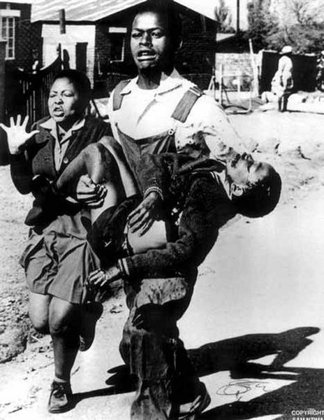
Apartheid
Literally "the state of being apart“.
System of racial segregation enforced through legislation by the National Party in South Africa 1948 to 1994.
The rights of the majority black inhabitants of South Africa were curtailed and minority rule of Afrikaners was maintained.
Photograph of the dying Hector Pieterson being carried by a fellow student during Soweto Riots in South Africa, 1976.

Slide 23
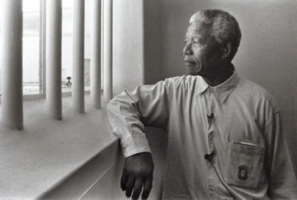
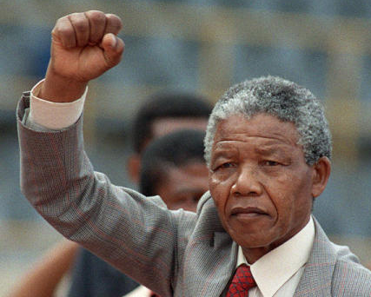
Nelson Mandela
South African anti-apartheid revolutionary and politician; leader of ANC.
Imprisoned when he joined armed struggle against apartheid.
President of South Africa from 1994 to 1999.

