Slide 1
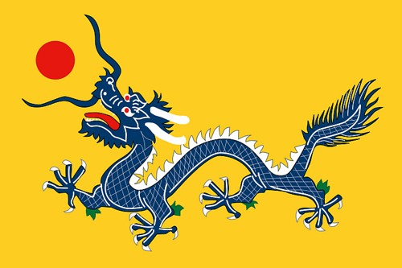
East Asia 3500 B.C. – A.D. 1350
UNIT 4

Slide 2
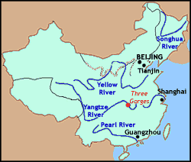
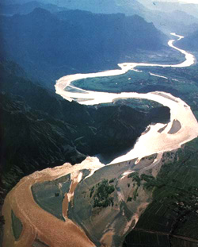
River Dynasties in China
Chapter 2, Section 4

Slide 3
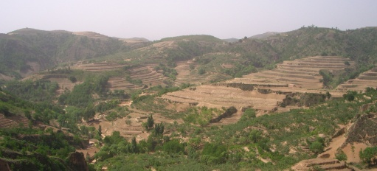
Loess
Yellowish silt deposited when the Huang He (“Yellow River”) overflows.
Loess is extremely fertile.
Blown by the winds from deserts in north and west.

Slide 4
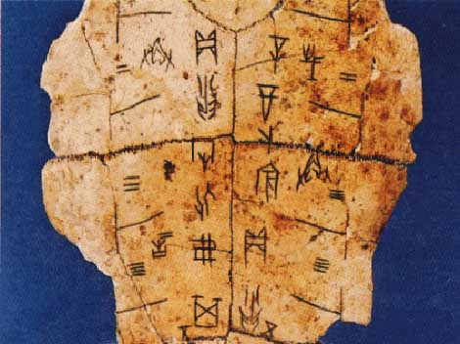
Oracle Bones
Shang kings consulted the gods through oracle bones.
Priests scratched questions to the gods on animal bones and tortoise shells.
Priests applied a hot poker to it and then interpreted the cracks that resulted.

Slide 5
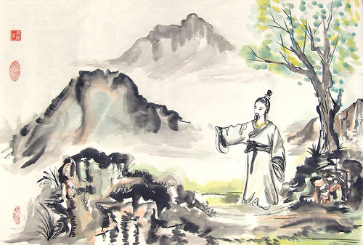
Mandate (command) of Heaven
Zhou people maintained gods had taken away Shang’s poor rule and gave it to them.
Concept developed into belief - authority to rule from heaven.
Viewpoint became central to government.
Disasters are sign that gods are displeased; led to rebellion, civil war and new dynasties.

Slide 6
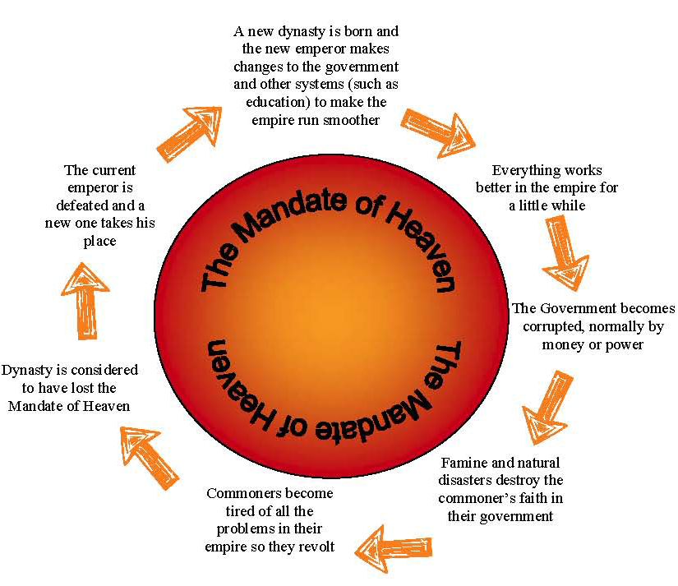
Dynastic Cycle
Chinese believed in Mandate of Heaven; poor rulers replaced by stronger rulers,.
Dynastic cycle refers to pattern of rise, decline, and replacement of dynasties.

Slide 7
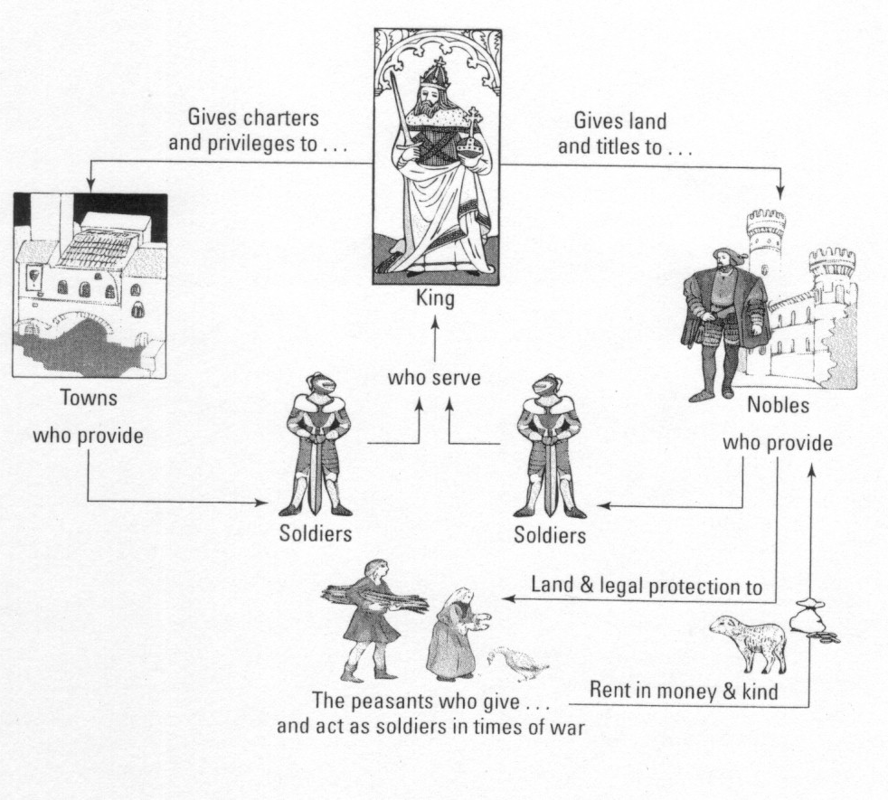
Feudalism
Form of government where control over areas belonging to king is given to royal family and nobles.
In return nobles owed loyalty and military services to king and protection of people living on the land.

Slide 8
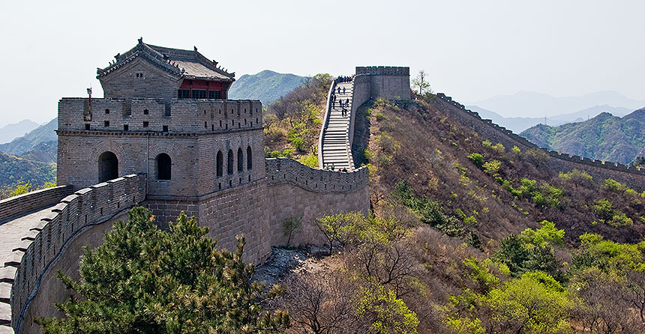
The Unification of China
Chapter 4, Section 4

Slide 9
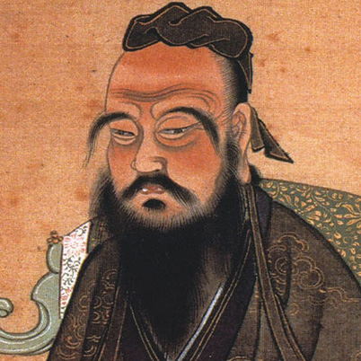
Confucius
Most influential scholar in China.
551-479 B.C. around decline of Zhou Dynasty
Scholarly life; studied history, music and moral character.
Created ethical system.
Social harmony organized around five relationships:
Ruler and subject
Father and son
Husband and wife
Older brother and younger brother
Friend and friend

Slide 10
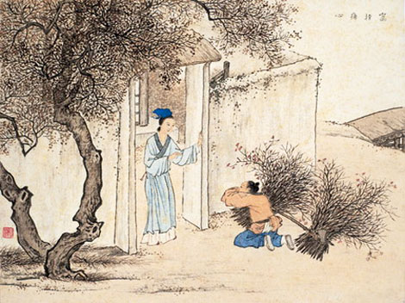
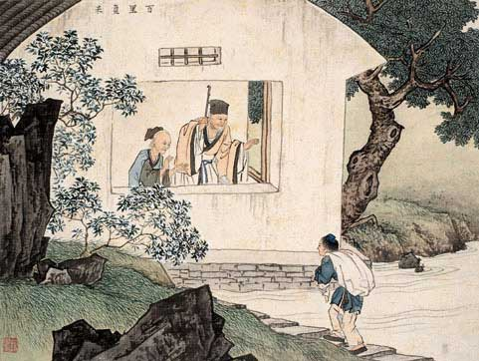
Filial Piety
Three of Confucius’ relationships based on family.
Stressed that children should practice filial piety, or respect for parents and ancestors.
Should devote oneself to parents during lifetime; honor memories after death.

Slide 11
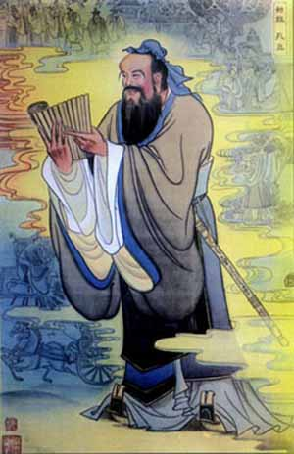
Bureaucracy
Confucius believed education could transform humbly born person into a gentleman.
Laid groundwork for government bureaucracy and training of civil servants.

Slide 12
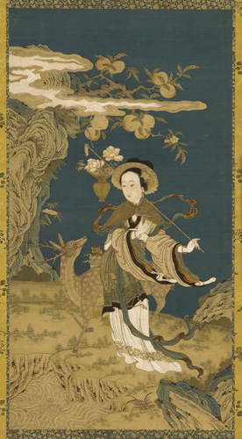
Daoism
Another ethical system in China developed by Laozi.
Believed Dao (the Way) guides all things in Nature, but humans no longer listen.
Search for knowledge and understanding of Nature lead to development in alchemy, astronomy and medicine.

Slide 13
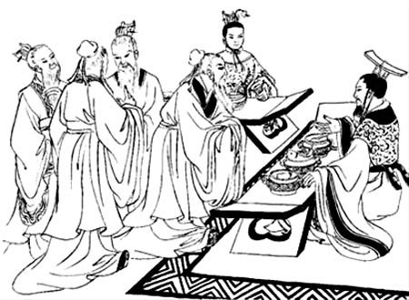
Legalism
Highly organized and efficient government key to restoring order in society.
Believed government should use law to end civil disorder and restore harmony.
Rewarded people who followed laws; harsh punishments for those that disobeyed.

Slide 14
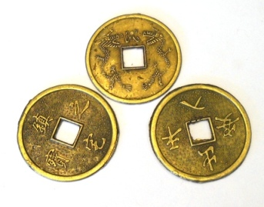
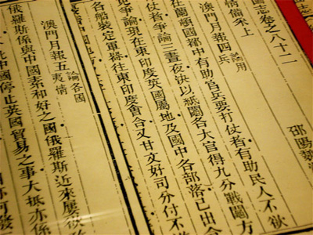
I Ching
Book of oracles used to solve ethical or practical problems.
Used the book by throwing a set of coins and interpreting the results.

Slide 15
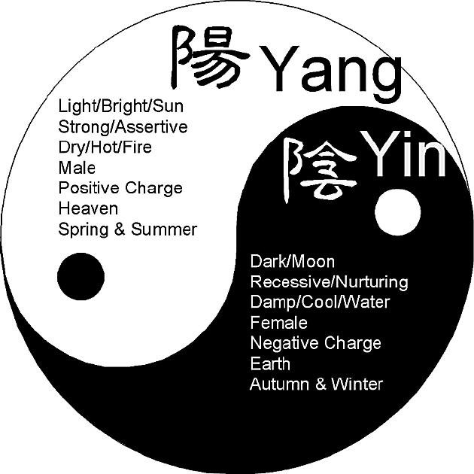
Yin and Yang
Two powers represent the natural rhythms of life.
Yin represents all that is cold, dark, soft and mysterious.
Yang represents all that is bright, hard and clear.
Symbol is a circle with two halves in perfect harmony.

Slide 16
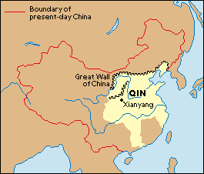
Qin Dynasty
Third century B.C . Qin Dynasty replaced the Zhou Dynasty.
Leader Shi Huangdi, employed Legalist ideas to subdue warring states and unify country.

Slide 17
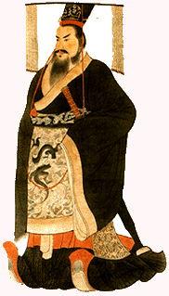
Shi Huangdi
First ruler of the Qin Dynasty.
Name means “First Emperor”.
Halted internal battles and quelled invaders.
Suppressed political opposition by “strengthening the trunk and weakening the branches”.

Slide 18
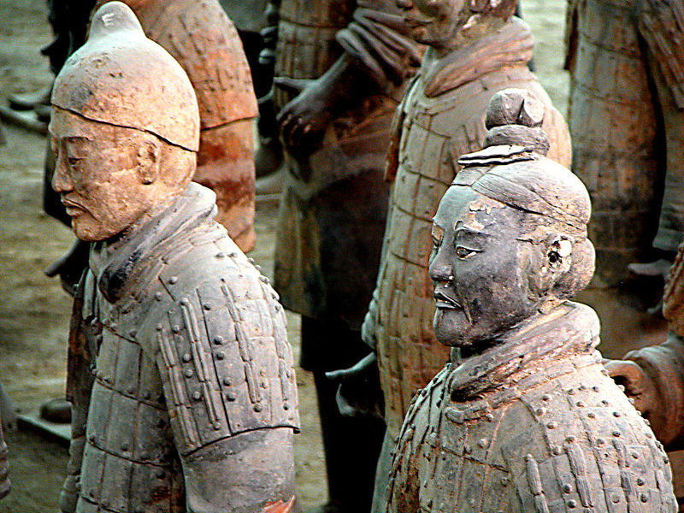
Autocracy
Shi Huangdi ruthlessly oppressed political opposition.
Seized land from noble families and moved them to cities.
Country divided into 36 administrative districts and controlled by officers.
Murdered Confucius scholars and burned books; built Great Wall of China.

Slide 19
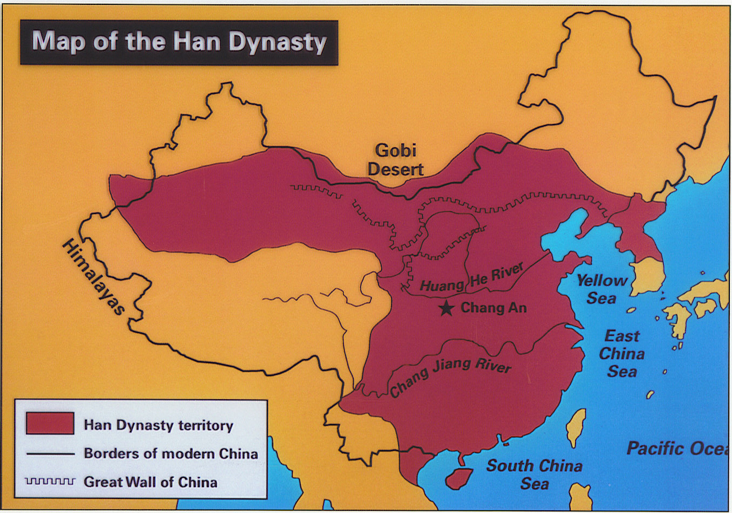
Han Emperors in China
Chapter 7, Section 3

Slide 20
Han Dynasty
After death of Shi Huangdi civil unrest erupted.
202 B.C. dynasty finally taken over by Liu Bang; became first Han emperor.
Han Dynasty collapsed A.D. 220; ruled China for more than 400 years.

Slide 21
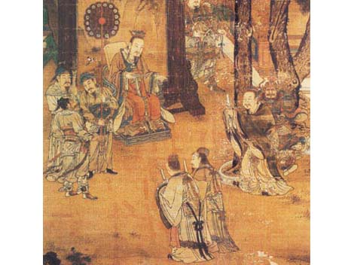
Centralized Government
Liu Bang established centralized government in which central authority controls the running of the state.
Hundreds of local provincials (commanderies) reported to central authority.

Slide 22
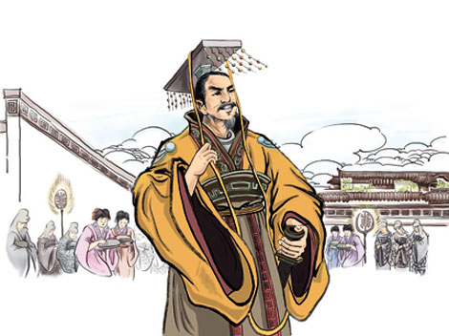
Civil Service
During Han Dynasty a return to Confucian principles of civil service.
Bureaucracy included 18 ranks of civil service; obtained jobs by taking examinations.

Slide 23
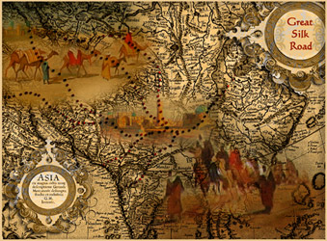
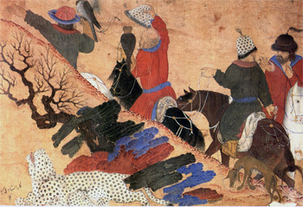
Monopoly
Occurs when a group has exclusive control over production and distribution of certain goods.
EXAMPLE: Silk trade in China

Slide 24
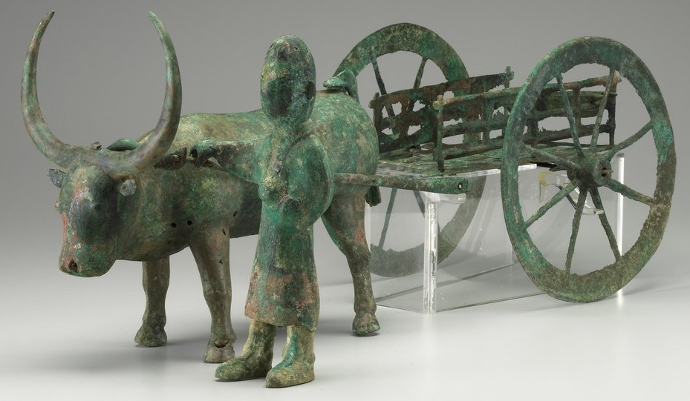
Assimilation
Process of making conquered people part of the nation.
EXAMPLE: Chinese government sent farmers to settle in conquered areas.

Slide 25
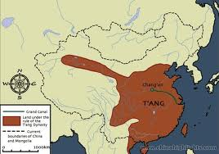
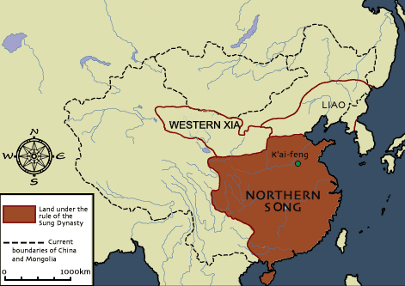
Tang and Song China
Chapter 12, Section 1

Slide 26
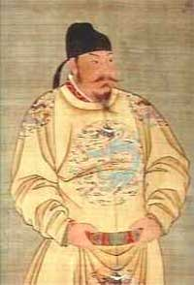
Tang Taizong
After Han Dynasty, about 350 years without strong leadership.
Tang Dynasty ruled nearly 300 years (618-907. A.D.)
First emperor, Tang Taizong, ruled 626-649
Gained back conquered lands, and expanded dynasty.
Reformed government and law code.

Slide 27
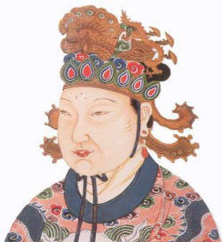
Wu Zhao
Wife of Tang Taizong.
Ruled on behalf of weaker emperors from about 668.
Became empress in 690; only woman to ever do so.
Built on work begun by Taizong; added Korea to Chinese Empire.

Slide 28
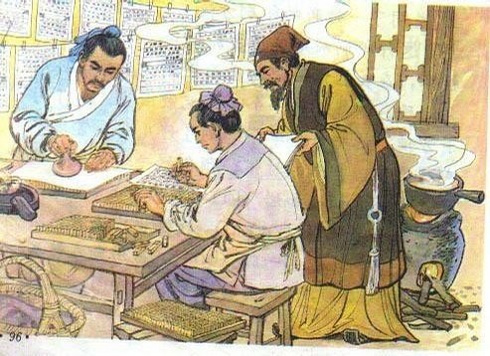
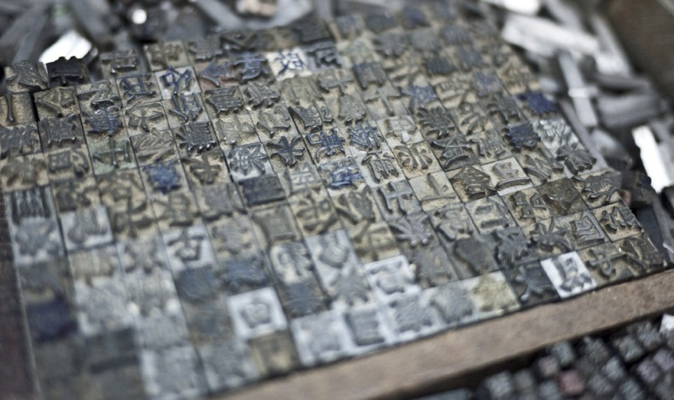
Movable Type
One of several important Chinese inventions.
Printer can now arrange blocks of individual characters in a frame and use it to print several copies of a document.
Time-saving; previously had to carve out entire page for printing.

Slide 29
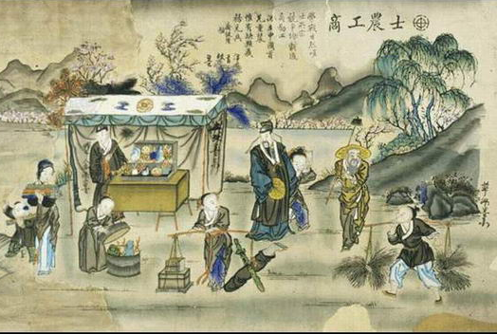
Gentry
Upper class in China.
Made up of powerful and prosperous people.
Attained status through education and civil service; not land ownership.

Slide 30
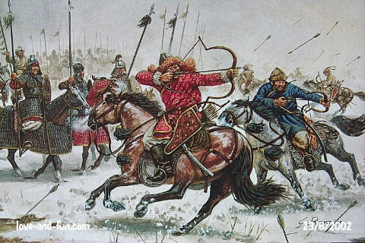
The Mongol Conquests
Chapter 12, Section 2

Slide 31
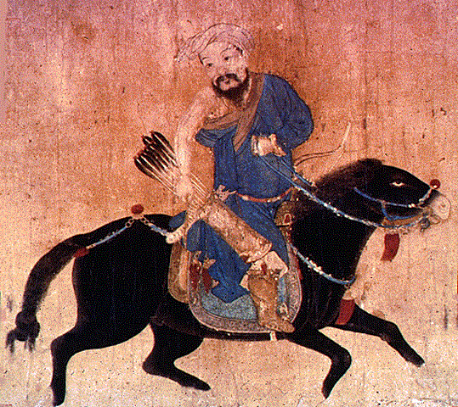
Pastoralist
Nomadic people who herded domesticated animals.
Constantly on the move, searching for food for their herds.
Followed a seasonal pattern; returned to campsites.
Depended on animals for food, clothing and housing.

Slide 32
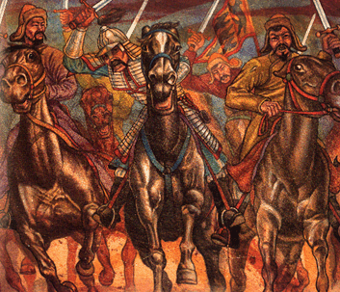
Clan
Pastoralists travelled in kinship or family groups called clans.
Members had a common ancestor.
Sometimes clans banded together to attack common enemies or raid neighbors.

Slide 33
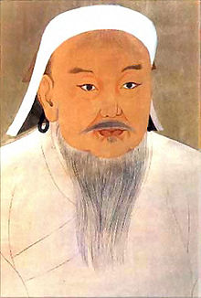
Genghis Khan
1162 (?) – 1227
Temujin united various clans into single group known as Mongols.
Later called Genghis Khan, meaning universal ruler.
Brilliant organizer and strategist; extremely cruel.
Led Mongols in conquering much of Asia starting out with China., and moving to Islamic area west of Mongolia.

Slide 34
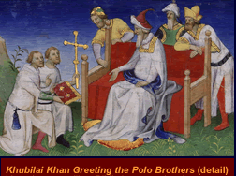
Pax Mongolica
Mid 1200s – 1300s Mongols established stability, law and order across Eurasia.
Guaranteed safe passage for caravans, travelers and missionaries traveling from one end of empire to other.
Led to active trade and spread of ideas and inventions.

Slide 35
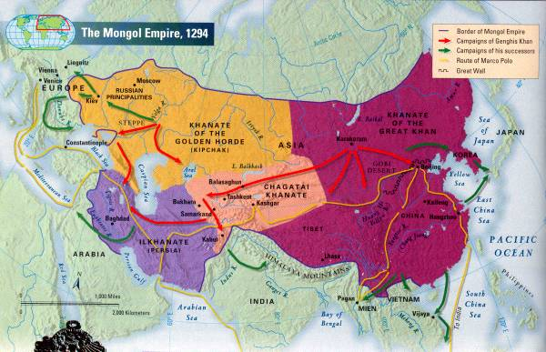
The Mongol Empire
Chapter 12, Section 3

Slide 36
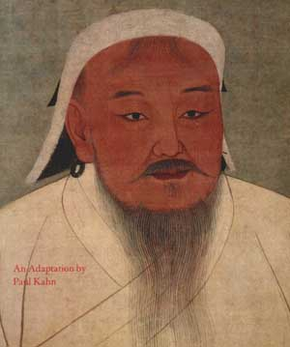
Kublai Khan
Grandson of Genghis Khan.
Empire had split into four khanates; Kublai Khan focused on one
Mongolia, Korea, Tibet and northern China.
Unable to conquer Japan (kamikaze / divine wind)
Began (new) Yuan Dynasty, uniting China for first time in 300 years.

Slide 37
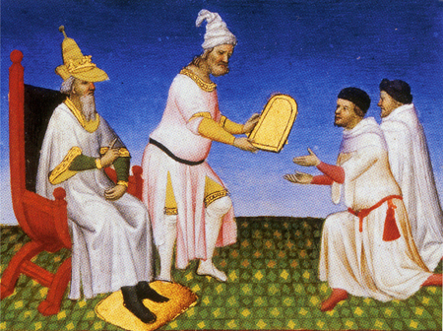
Marco Polo
Venetian trader who visited China around 1275.
Sent by Kublai Khan to Chinese cities on government missions.
Later captured in Italy; told about travels, but many did not believe him.

