Slide 1
Early Israelites
Chapter 3, Section 4

Slide 2
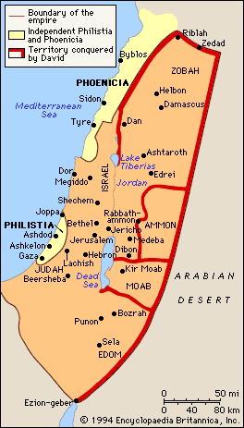
Palestine
Area inhabited by Phoenicians, and other cultures, including Philistines,
Hebrews occupied area within Palestine called Canaan.

Slide 3
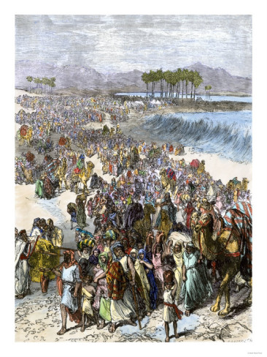
Canaan
Area within Palestine occupied by Jews.
Their history, legends and moral laws became basis of Judaism, Christianity and Islam.

Slide 4
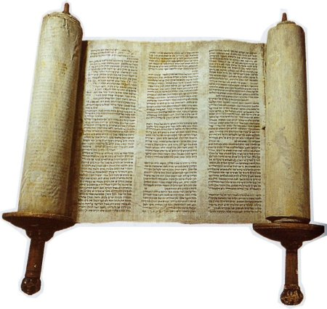
Torah
First five books of the Hebrew Bible (Old Testament).
Considered most sacred writings within Jewish tradition.

Slide 5
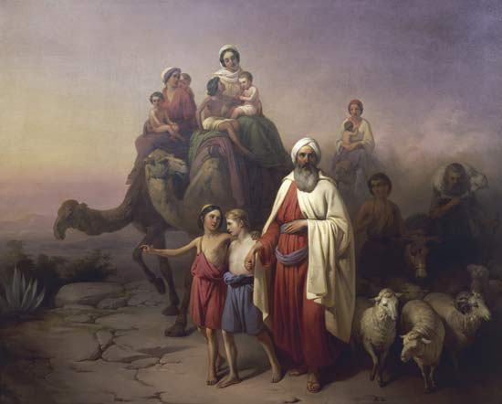
Abraham
In Torah, God chose Abraham as the father of the Hebrew people.
Shepherd who lived in Ur (Mesopotamia) around 1800 B.C.
Told by God (Yahweh) to move his people to Canaan.

Slide 6
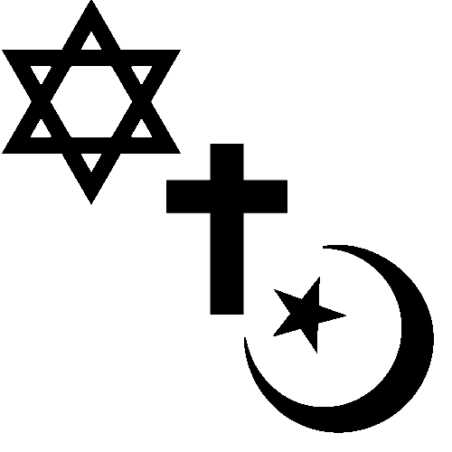
Monotheism
Belief in only one God:
Mono = “one”;
theism = “god-worship”
Hebrews were monotheists, i.e. they believed in only one God - Yahweh.
Main monotheistic religions today:
Judaism
Christianity
Islam

Slide 7
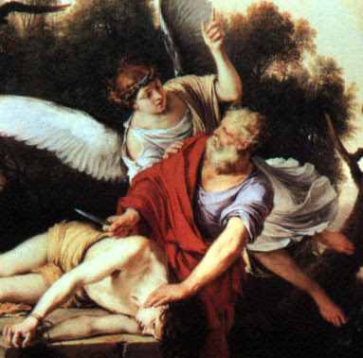
Covenant
Mutual promise between God and Abraham that Jews would obey God, and in return, God would protect them.

Slide 8
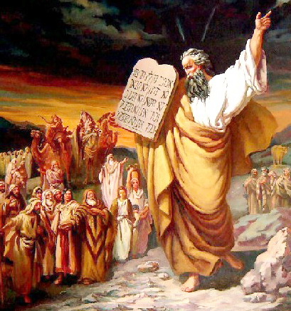
Moses
Led Jews out of Egypt and slavery around 1300 -1200 B.C.
While travelling, went to top of Mount Sinai to pray; brought down two stone tablets on which Yahweh had written Ten Commandments.

Slide 9
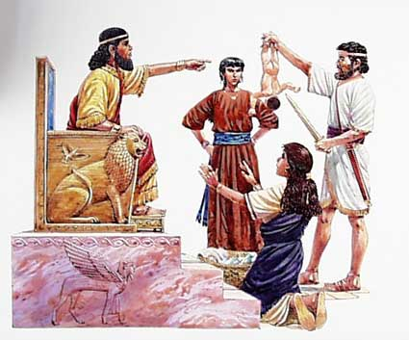
Israel
1020 – 922 B.C. the Hebrews united under three kings – Saul, David and Solomon.
The new kingdom was called Israel.
Period of power and independence for Jews.

Slide 10
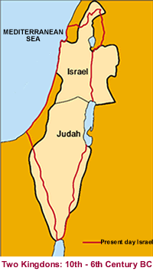
Judah
Solomon built a new temple.
Strained finances of Israel, and Jews were also forced to work on building projects.
Discontent led to kingdom splitting in two – Israel in north and Judah in the south.

Slide 11
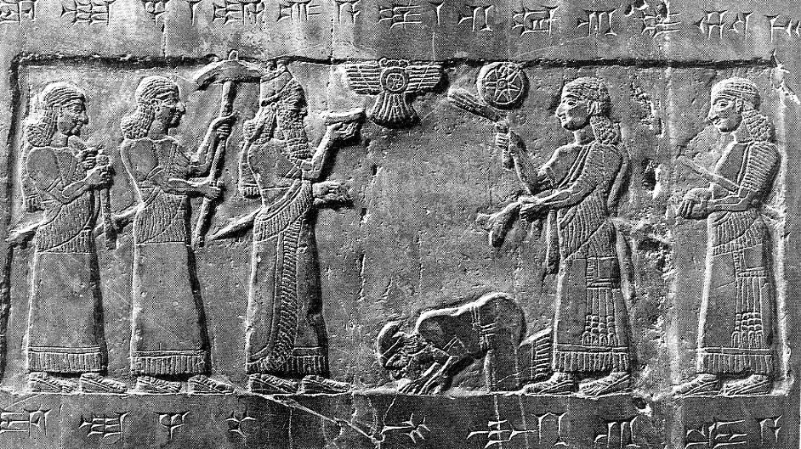
Tribute
Israel and Judea lost independence to Assyria in 738 B.C.
Forced to pay tribute, or peace money to Assyria.

Slide 12
Rise/Expansion of Islam
Chapter 10, Section 1, 2 & 3

Slide 13
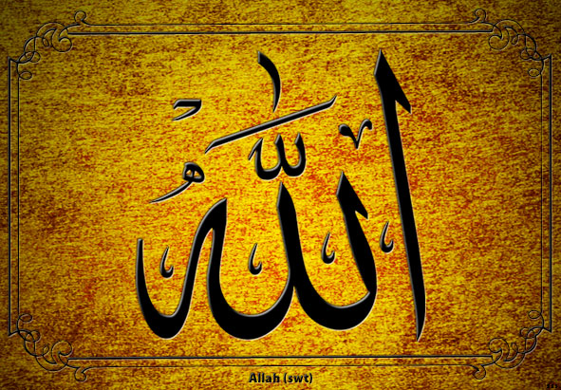
Allah
Monotheism: many people in Middle East believed in one God only, e.g.
Christians
Jews
Arabic word for GOD: ALLAH

Slide 14
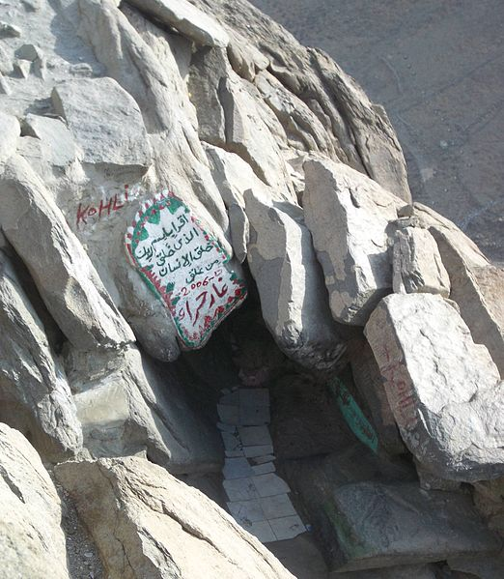
Muhammad
Born in clan of powerful family from Mecca.
Worked caravan trade as young man.
While meditating in a cave in Mecca he heard the voice of the angel Gabriel; told him he was the messenger of Allah.
Cave Hira where Muhammad had a vision
of the angel Gabriel.

Slide 15
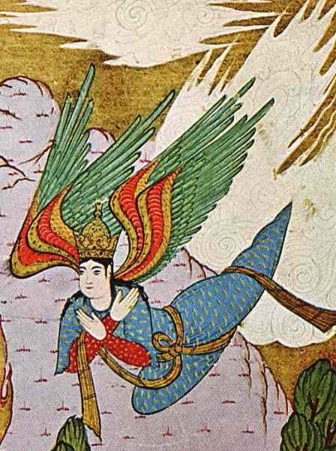
Islam
Muhammad believed he was the last of the prophets.
Began to teach Allah was the one and only God; all others had to be abandoned.
Religion became known as ISLAM, meaning submission to God’s will.

Slide 16
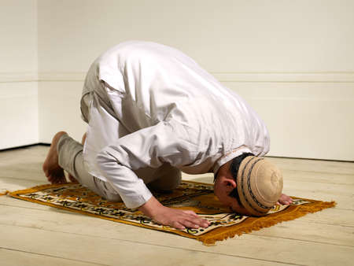
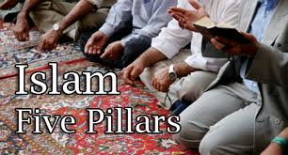
Muslim
Word means one who has submitted.
Refers to those who choose to submit to the will of God (Islam).

Slide 17
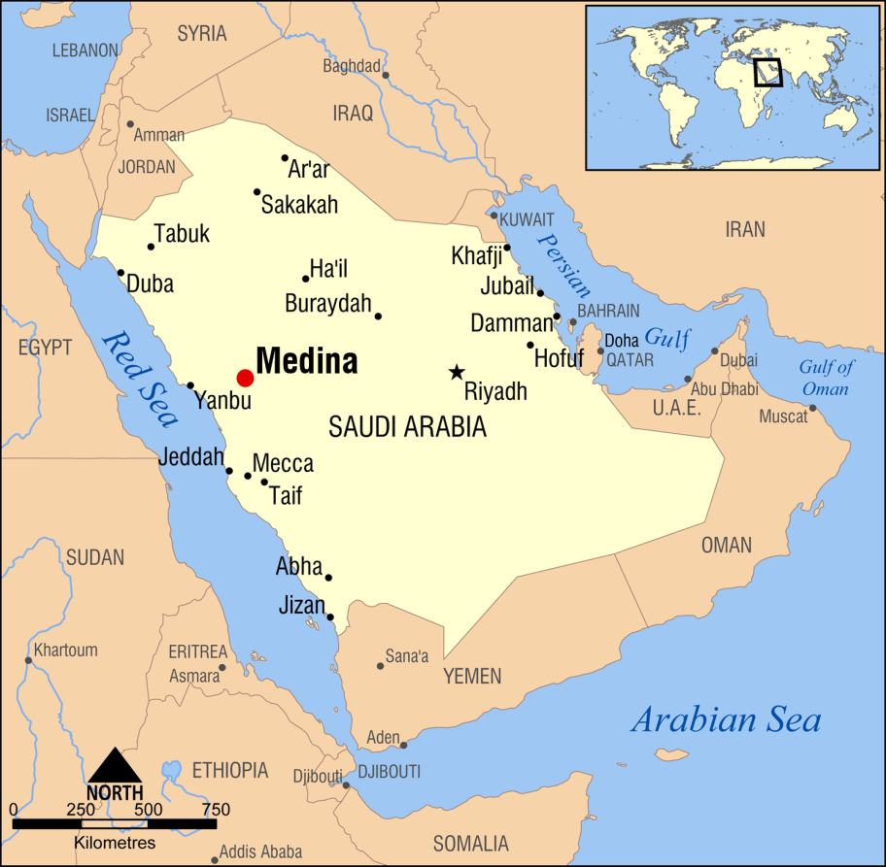
Hijrah
The flight of Muhammad from Mecca to Medina to escape persecution 622 A.D.
Regarded as the beginning of the Muslim Era.

Slide 18
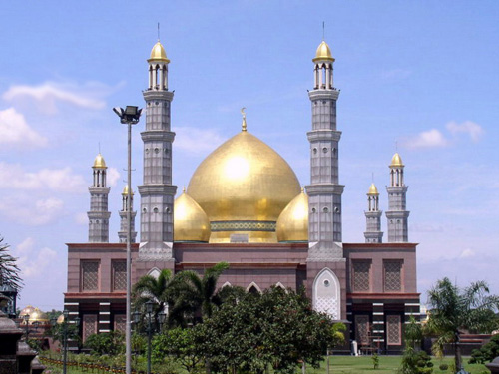
Mosque
Islam house of worship, or place Muslims may use to pray to Allah.

Slide 19
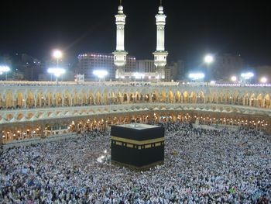
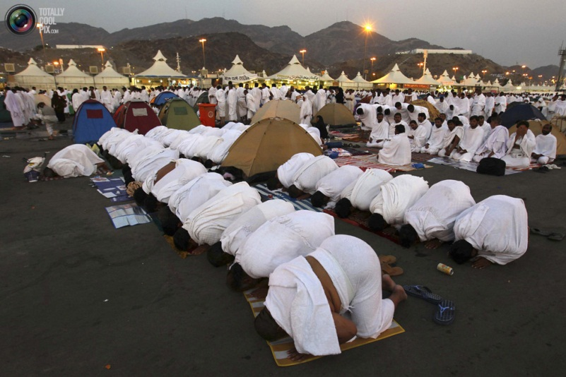
Hajj
Islam practice
All Muslims who are physically and financially able should perform the hajj or pilgrimage to Mecca in their lifetime.
One of Five Pillars or duties believers are expected to perform.

Slide 20
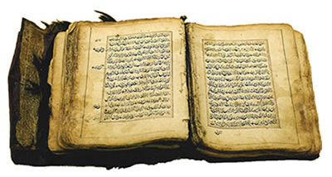
Qur’an
Muslims believe that Allah revealed his will through the angel Gabriel to Muhammad.
After his death these revelations were collected in a book written in Arabic, known the Holy Book of the Muslims, or the Qur’an.

Slide 21
Sunna
Muhammad’s example or model for living according to the Qur’an is known as the Sunna.
Muslims believe this is the best model for proper living.

Slide 22
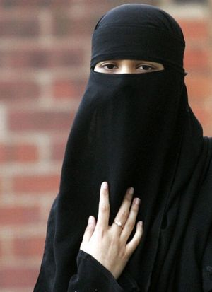
Shari’a
The guidelines of the Qur’an and Sunna were assembled in a body of laws known as shari’a.
This system of law regulates family life, moral conduct, and business and community life of Muslims.; sometimes also prescribes punitive measures.

Slide 23
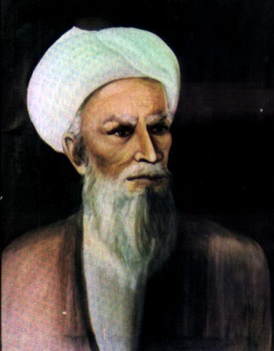
Caliph
Title means successor or deputy.
Refers to leaders who took place of Muhammad when he died.
First Caliph was Muhammad’s friend, Abu-Bakr.

Slide 24
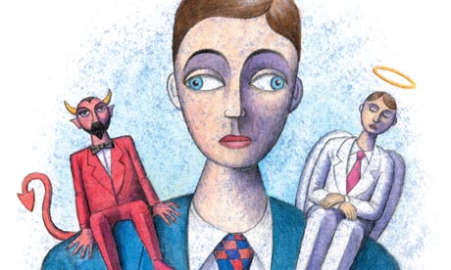
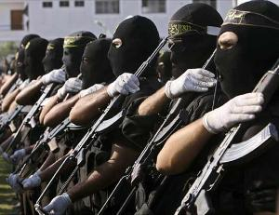
Jihad
Means striving, and refers to person’s inner struggle against evil
Word is also used in the Qur’an – refers to armed struggle against unbelievers.

Slide 25
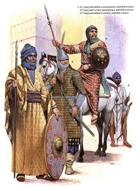
Umayyads
After death of Ali, last elected caliph, the Umayyads came into power.
Moved Muslim capital to Damascus; made control of conquered areas easier.
Surrounded themselves with wealth; gave rise to division in Muslim community.

Slide 26
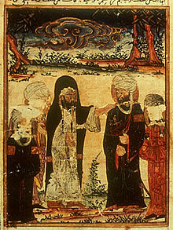
Shi’a
Muslim group that did not accept the Umayyads’ rule; developed alternative view of role of caliph.
Believed caliph should be a descendant of the Prophet; called Shi’a, meaning party of Ali.
The Investiture of Ali at
Ghadir Khumm

Slide 27
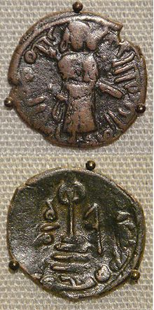
Sunni
Those who followed the Umayyads became known as the Sunni.
Means followers of the Sunna or Muhammad’s example.

Slide 28
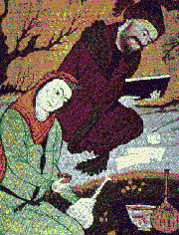
Sufi
Another group that did not accept leadership and luxurious life of the Umayyads.
Pursued a life of poverty and devotion to a spiritual path.

Slide 29
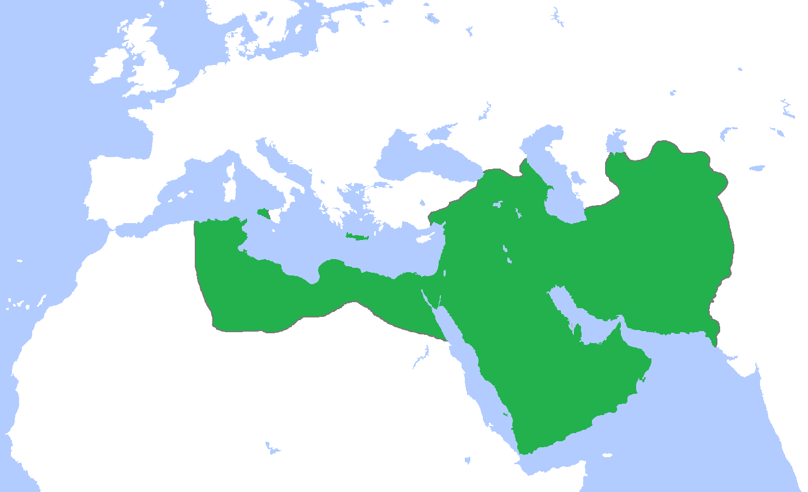
Abbasids
Political and religious opposition lead to downfall of Umayyads.
Powerful rebel group, the Abbasids, took control of empire in the year 750.

Slide 30
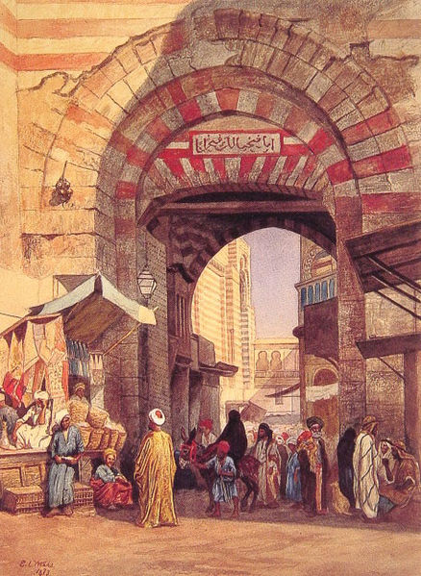
An-Andalus
Berbers from North Africa advanced to within 200 miles of Paris before halted at the Battle of Tours in 732.
Established a Muslim state in southern Spain known as al-Andalus.
Moorish Bazaar

Slide 31
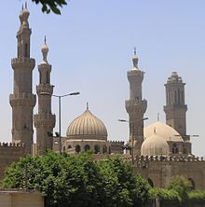
Fatimid
Abbasid were not able to maintain full control over all Muslims; various independent Muslim states formed.
The Fatimid caliphate was formed by Shi’a Muslims who claimed descent from Muhammad’s daughter, Fatima.
The Al-Azhar University Cairo, Egypt. Built by Fatimid Shi’ites, it has become an important center of Sunni Islamic learning

Slide 32
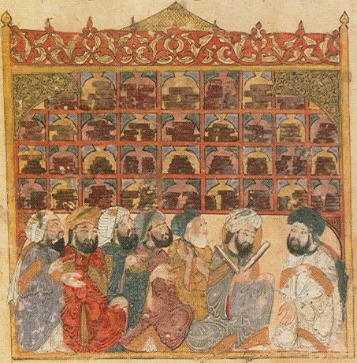
House of Wisdom
Learning and education is important to Muslims.
Caliph al-Ma-mun established combination of library, academy and translation center in Baghdad called House of Wisdom.
Scholars of different beliefs and cultures worked together to translate texts from Greece, India, Persia, etc. into Arabic.

Slide 33
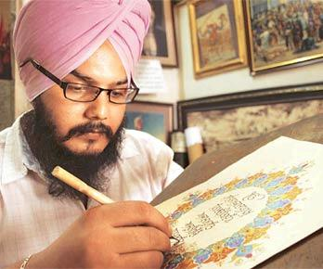
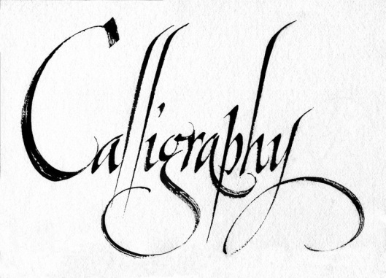
Calligraphy
Ornamental or beautiful handwriting.
In pictorial calligraphy pictures are formed using letters of the alphabet.
Important as it is a way to reflect the glory of Allah.

