Slide 1
Early Empires: Egypt, Nubia, Assyria & Persia
Chapter 4, Sections 1, 2 & 3

Slide 2
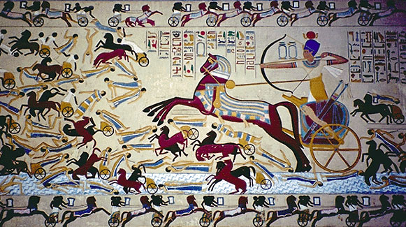
Hyksos
Invaders from Asia
Used chariots to cross the Isthmus of Suez.
Ruled Egypt 1640 – 1570 B.C.

Slide 3
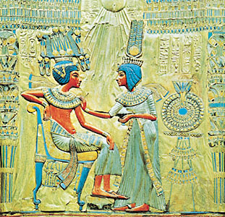
New Kingdom
Several warlike rulers overthrew Hyksos and restored Egypt’s power; Hebrews enslaved.
New Kingdom developed into an empire 1570 – 1075 B.C.

Slide 4
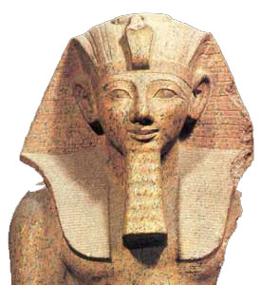
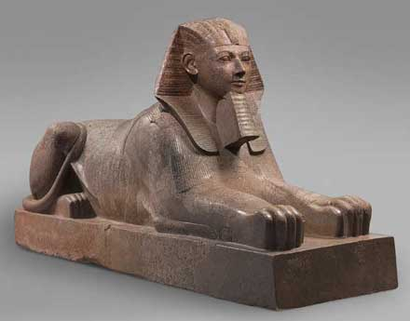
Hatshepsut
Female pharaoh who reigned 1472 – 1458 B.C.
Encouraged trade instead of just waging war; Egypt became more prosperous.

Slide 5
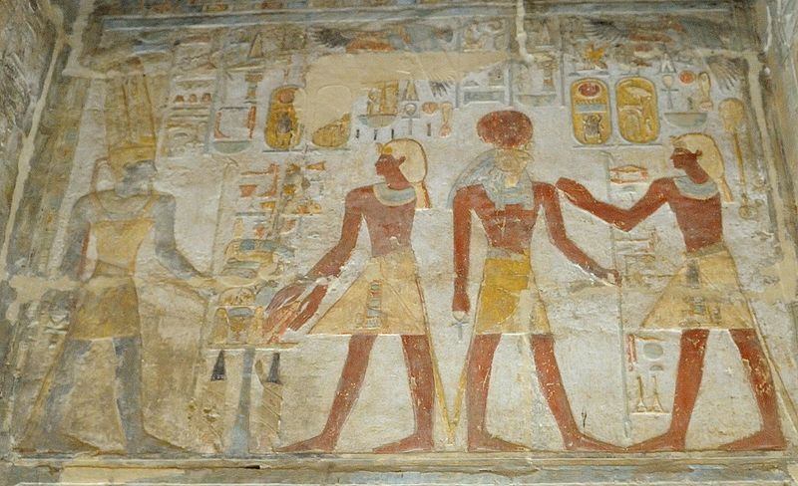
Thutmose III
Queen Hatsheput’s stepson; led several successful invasions into Palestine and Syria (Hittites).
Also conquered Nubia in south.

Slide 6
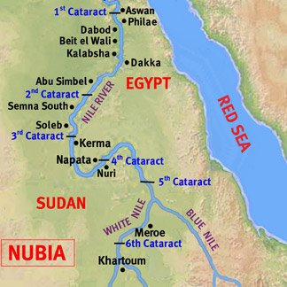
Nubia
Region of Africa that straddled upper Nile River.
Egypt had traded with Nubia and influenced region since time of Middle Kingdom.

Slide 7
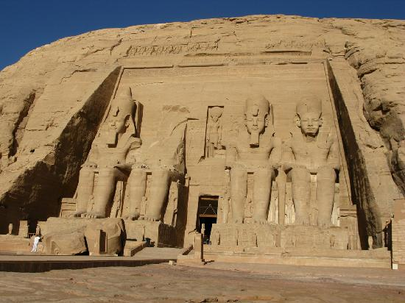
Ramses II
Ruled 1290 – 1224 B.C.
One of great builders of the New Kingdom; includes Great Temple.
Egyptians and Hittites constantly clashed; Ramses II established peace treaty with king of Hittites.

Slide 8
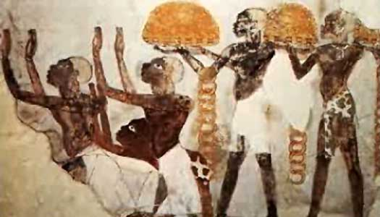
Kush
Nubian kingdom dominated by Egypt 2000 – 1000 B.C.
During Hyksos period Kush emerged as regional power.
Served as trade corridor between Egypt and Mediterranean world.

Slide 9
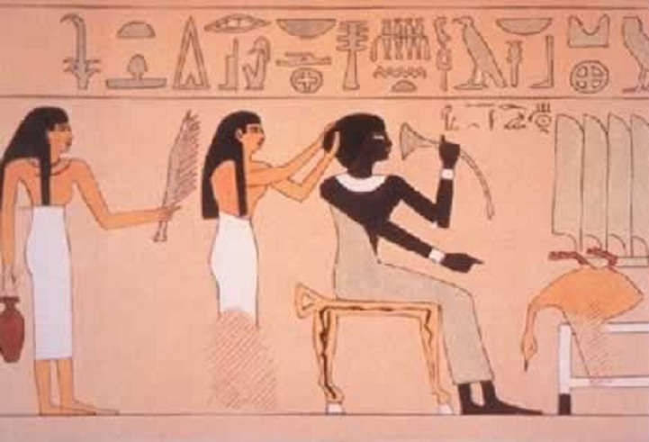
Piankhi
Kushite king
Overthrew Libyan rulers in Egypt 751 B.C.
United entire Nile Valley from the delta in the north to Napata in the south.

Slide 10
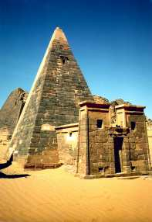
Meroë
Kushite royal family moved to Meroë after defeat by Assyrians.
Natural resources – major rainfall and iron ore.
Closer to Red Sea - flourishing trade between Africa, Arabia and India.
Eventually defeated by Aksum.

Slide 11
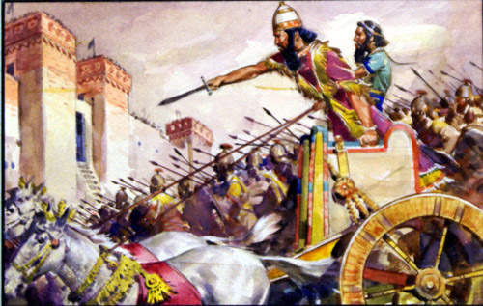
Assyria
850 – 650 B.C. greatest power in Southwest Asia.
Advanced military organization and modern weaponry.
Stretched east and north of Tigris unto central Egypt.

Slide 12
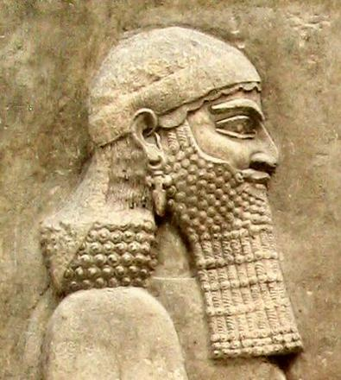
Sennacherib
Assyrian king who bragged that he had destroyed 89 cities and 820 villages; also burned Babylon.

Slide 13
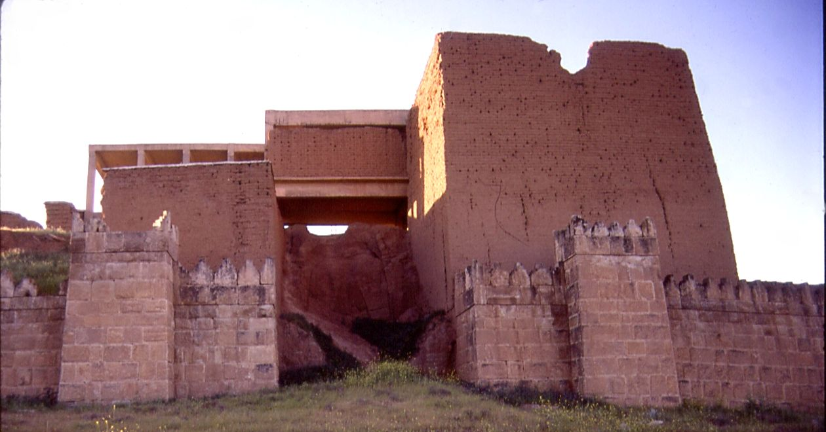
Nineveh
Assyrian capital along Tigris River.
Walled city three miles long and one mile wide.
Also held world’s largest library.

Slide 14
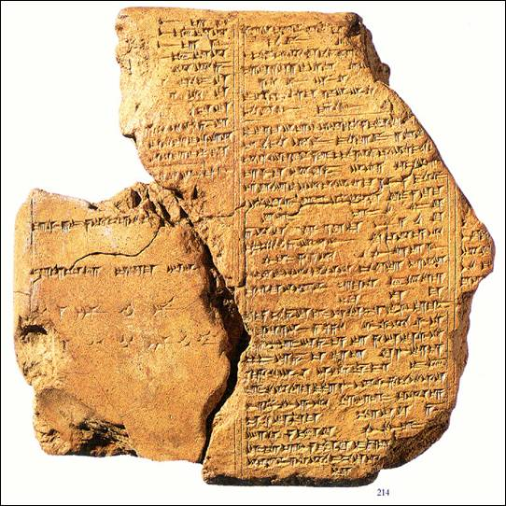
Ashurbanipal
King of Assyria who collected more than 20,000 clay tablets throughout empire.
Collection included Sumerian poem Epic of Gilgamesh.
Provides information of earliest civilizations to historians.

Slide 15
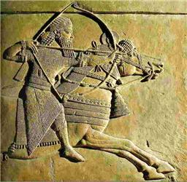
Medes
Assyrian empire was eventually defeated by a combined army of Medes and Chaldeans.

Slide 16
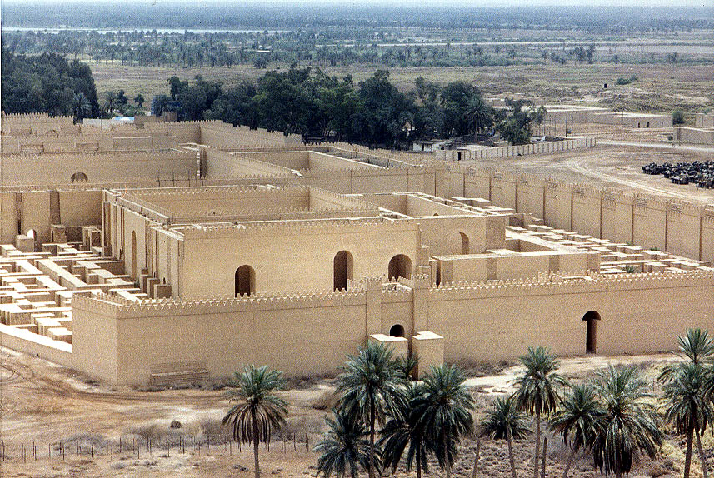
Chaldeans
After defeating the Assyrians, the Chaldeans made Babylon their capital.
Babylon center of new empire – 600 B.C.

Slide 17
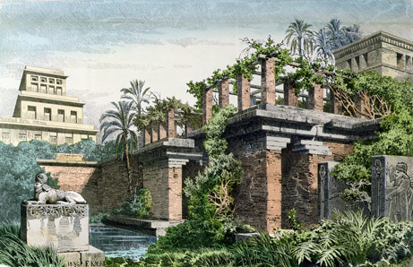
Nebuchadnezzar
King of Caldeans who restored Babylon.
Built famous hanging gardens for his wife.

Slide 18
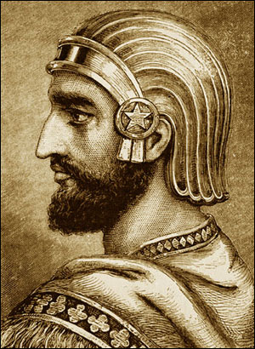
Cyrus
Persian king ruling 550 – 539 B.C.
Controlled massive empire spanning 2,000 miles from Indus River to Anatolia.
Best known for kind treatment of conquered people.

Slide 19
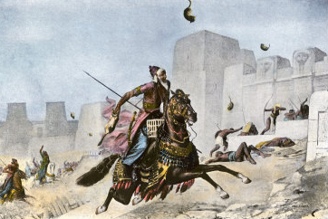
Cambysus
Son of Cyrus; ruled 530 – 522 B.C.
Conquered Egypt; ordered Egyptian gods be burned.

Slide 20
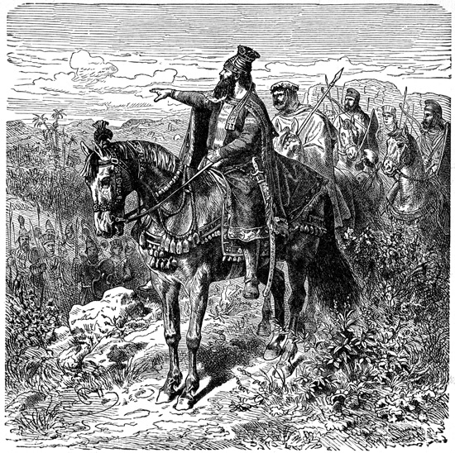
Darius
Began career as king’s bodyguard.
Spent first three years suppressing revolts.
Extended empire to over 2,500 miles.
Real genius lay in administration of sprawling empire.

Slide 21
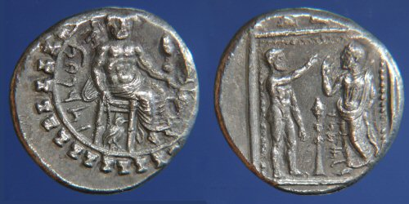
Satrap
King Darius established 20 provinces within empire; ruled by local governor called a satrap.

Slide 22
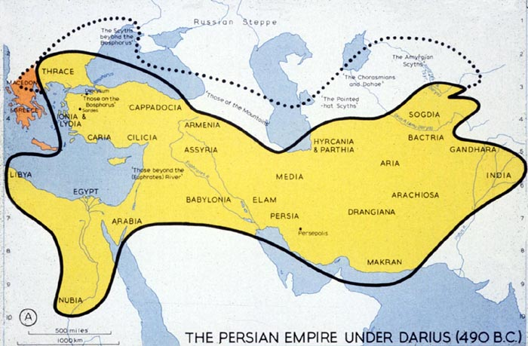
Royal Road
King Darius built excellent system of roads to improve communication and trade across empire.
Royal Road (Susa, Persia, - Anatolia) - 1,677 miles.

Slide 23
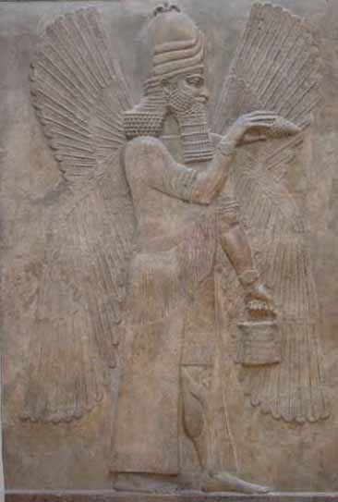
Zoroaster
Persian prophet; lived around 600 B.C.
Earth a battleground between good and evil; each person to take part in battle, and account for life after death.

