Slide 1
The Atlantic Slave Trade
Chapter 20, Section 3

Slide 2
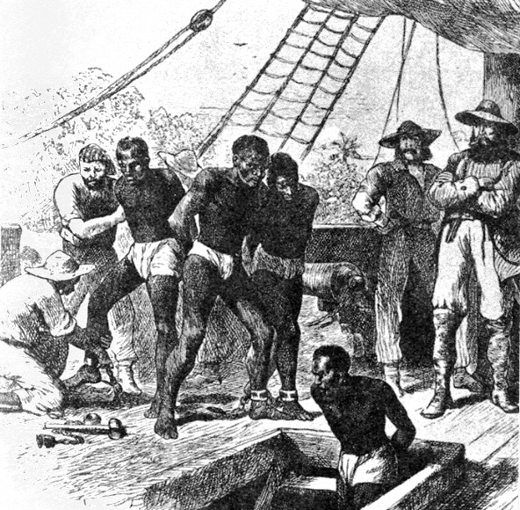
Atlantic Slave Trade
Buying and selling of Africans for work in the Americas.
Massive enterprise:
300,000 Africans sold during 1500’s
1.3 million in 1600’s
By 1870 9.5 million Africans imported to Americas.

Slide 3
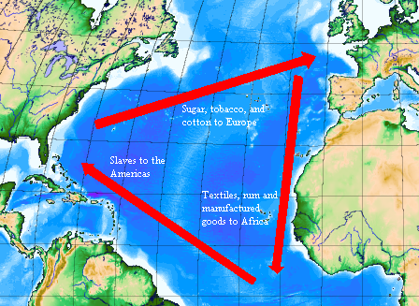
Triangular Trade
Transatlantic slave trading network.
Europeans transported and traded goods to west coast of Africa in exchange for captured Africans.
Africans then transported to West Indies; exchanged for sugar, coffee and tobacco.

Slide 4
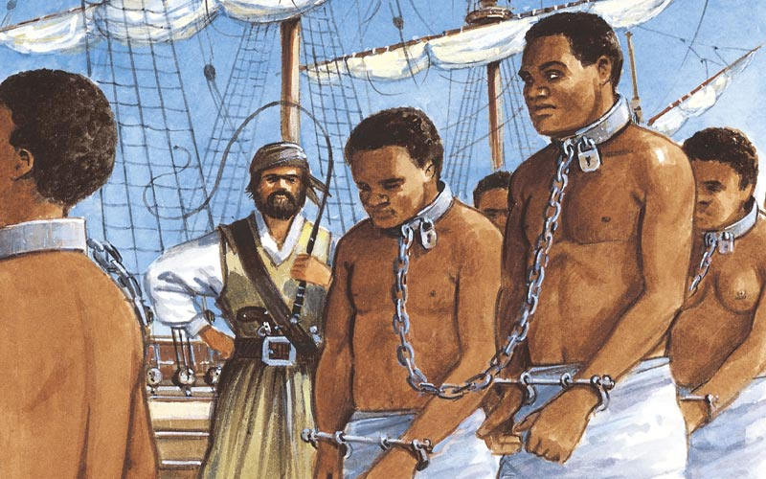
Middle Passage
Middle leg of transatlantic trade triangle; brought captured Africans to West Indies, and later to Americas.
Horrendous treatment:
Stayed in ship holds
Endured whippings
Diseases
Suicide

