Slide 1
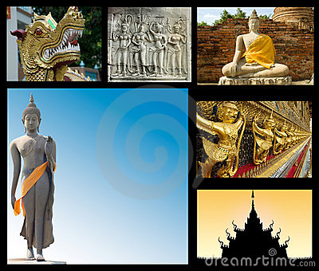
World History Vocabulary
TRIMESTER 2

Slide 2
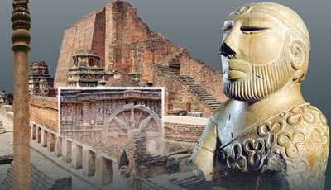
South Asia 2500 B.C. – A.D. 600
UNIT 1

Slide 3
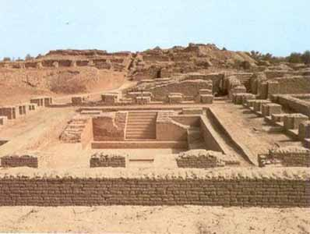
Planned Cities on the Indus
Chapter 2, Section 3

Slide 4
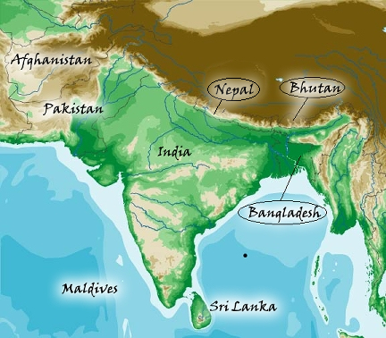
Subcontinent
India, Pakistan and Bangladesh are often referred to as Indian subcontinent.
Area is separated from rest of Asia by wall of high mountains (Hindu Kush, Karakorum and Himalayas).

Slide 5
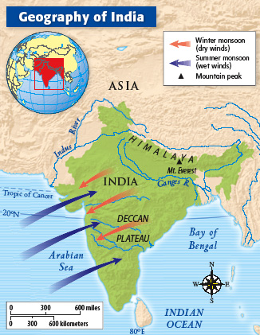
Monsoon
Seasonal winds dominate climate
Winter Monsoons:
October to February
From northeast
Blow westward
Summer Monsoons
June – October
From southwest
Blow eastward
Bring much moisture – leads to flooding
Drought when fail to develop

Slide 6
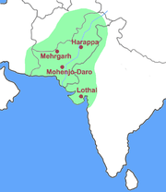
Harappan Civilization
Around 2500 B.C. - same time as Egyptian civilization.
Several ancient cities in area of Indus Valley (today Pakistan).
Civilization mainly based on agriculture.

Slide 7
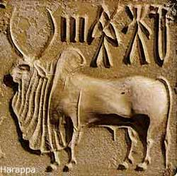
The Indo-Europeans
Chapter 3, Section 1

Slide 8
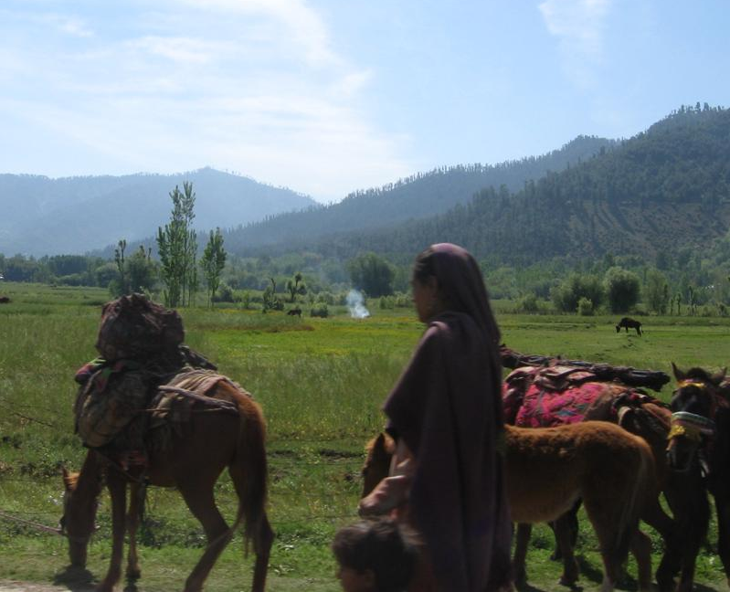
Indo-Europeans
Nomadic people who migrated into Europe, India and Southwest Asia.
Pastoral people – herded cattle, sheep and goats; tamed horses.
Spoke Indo-European.

Slide 9
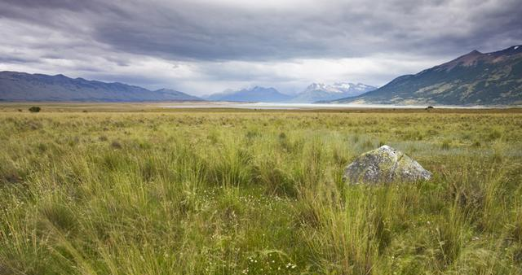
Steppes
Dry grasslands situated north of Caucasus Mountains between Black and Caspian Seas.

Slide 10
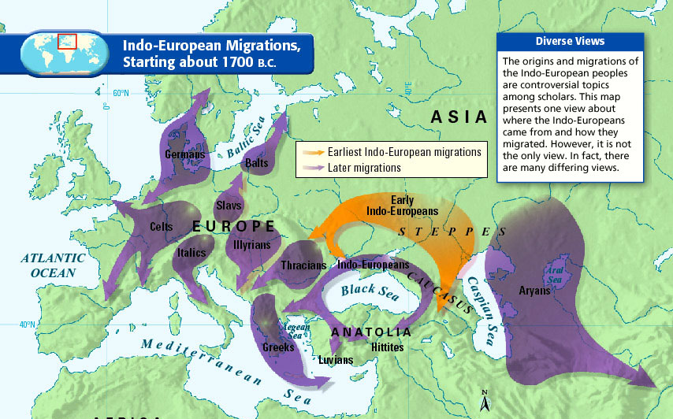
Migration
Movement of a people from one region to another.
Indo-Europeans migrated 1700 – 1200 B.C. from steppes.

Slide 11
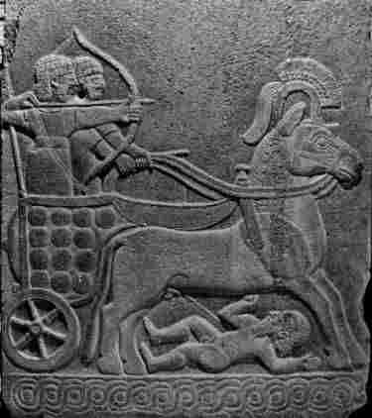
Hittites
Group of Indo-European speakers.
Lived around 2000 B.C. in Anatolia.
Used chariots and iron weapons in war.
Formed empire around 1650 B.C.; ruled 450 years.

Slide 12
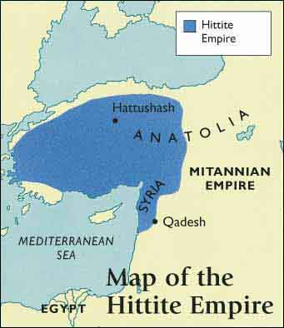
Anatolia
Also called Asia Minor.
Area in modern-day Turkey occupied by Hittites about 2000 B.C.
Huge peninsula that juts out into Black and Mediterranean seas.
Most believe iron technology started here.

Slide 13
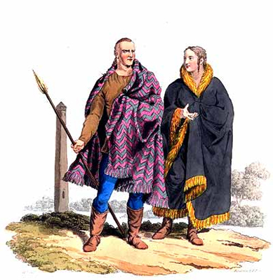
Aryans
Another Indo-European group that lived same time as Hittites.
Organized into four groups based on occupations, becomes caste system later on:
Brahmins (priests)
Warriors
Traders and Landowners
Peasants and traders

Slide 14
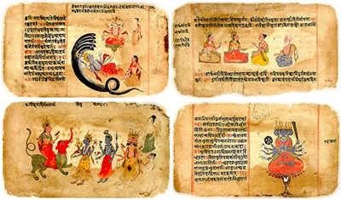
Vedas
Sacred literature of the Aryans.
Four collections of prayers, hymns, magic spells and instructions for performing rituals.

Slide 15
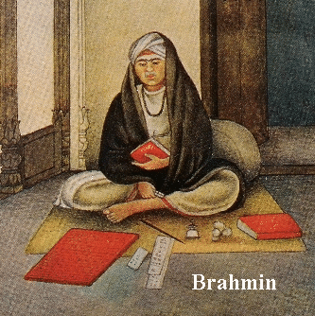
Brahmin
Aryan priests
Identified with the creator god, Brahma
Considered mouthpiece of Purusha (the first human being).

Slide 16
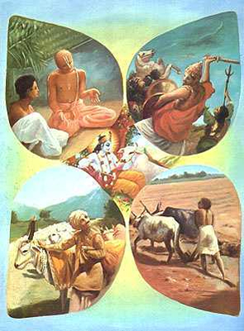
Caste
Dark-skinned laborers (“varnas”) who were forced to work for Aryans.
Renamed castes by Portuguese.

Slide 17
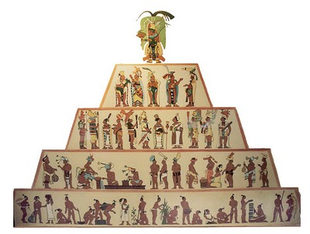
Caste System
Complex system with many subdivisions.
Membership is determined by work one does.
Regulates who one can associate with, marry, etc.
Cleanliness and purity are all-important.
Most impure based on occupation (butchers, gravediggers, trash collectors, etc.) particularly unclean; known as untouchables.

Slide 18
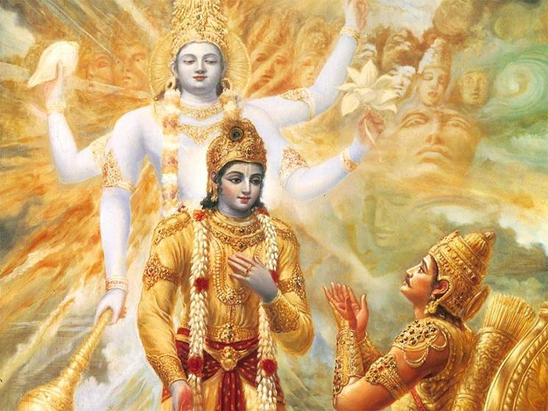
Mahabharata
Great Indian epic.
Reflects struggles of the Aryan kings to control Indian lands.
One section titled Bhagavad Gida tells story of Krishna (god in human form).

Slide 19
Hinduism and Buddhism Develop
Chapter 3, Section 2

Slide 20
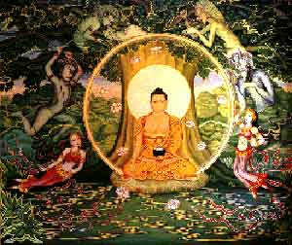
Moksha
Hindu term to describe perfect state of understanding all things.
Being liberated from illusions, disappointments and mistakes of everyday living.

Slide 21
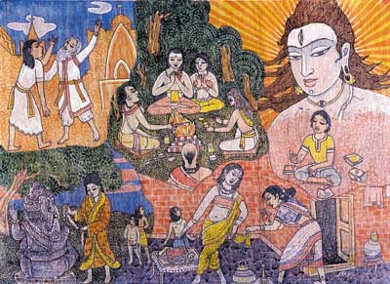
Reincarnation
Religious goal of moksha (perfect understanding) is not possible in one lifetime.
Through reincarnation the soul is born again and again until moksha is achieved.
Belief perpetuates and reinforces caste system.

Slide 22
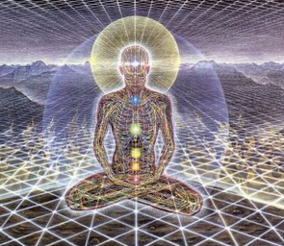
Karma
Each soul has karma – good or bad deeds – that follows from one reincarnation to another.
Karma influences specific life circumstances, e.g. caste one is born in, health, wealth, etc.

Slide 23
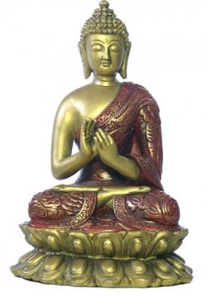
Siddharta Gautama
Founder of Buddhism
Born in noble family ; isolated in palace until 29 years old.
Spent life searching for religious truth and end to life’s suffering - enlightenment.
Eventually known as Buddha – “the enlightened one”.

Slide 24
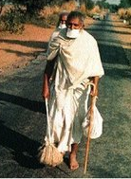
Jainism
Religion founded by Mahavira – 599 B.C.
Believed everything in the universe has a soul and should not be harmed – even insects.
Look for occupations that do not harm others; traditionally trade and commerce.
Believe in religious tolerance – little effort to convert others.

Slide 25
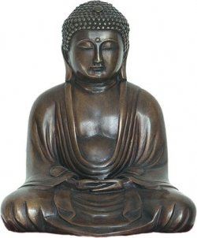
Enlightenment
In Buddhism the state of true wisdom; perfect understanding of life and suffering.
Those seeking follow Middle Way and its Eightfold Path – a guide to behavior – one step at a time.
Would eventually lead to nirvana.

Slide 26
The 4 Noble Truths
First: Life is filled with suffering and sorrow.
Second: The cause of suffering is people’s selfish desire for temporary pleasures of this world (attachment).
Third: The way to end all suffering is to end all desires; become detached.
Fourth: The way to overcome desires and get enlightenment is to follow the Eightfold Path.

Slide 27
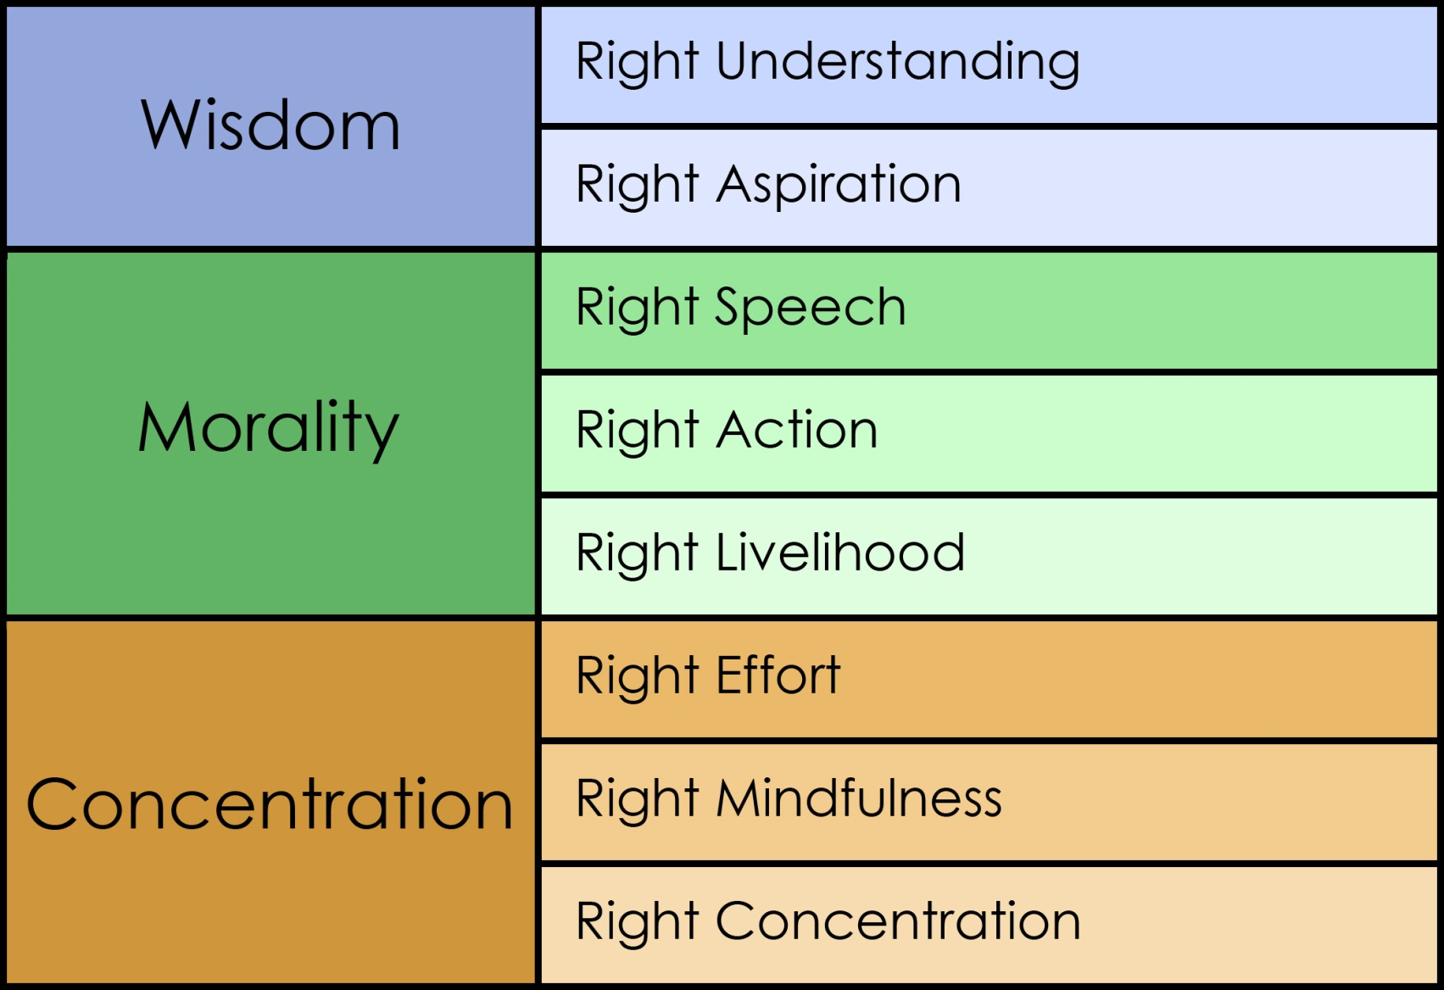
The Noble Eightfold Path

Slide 28
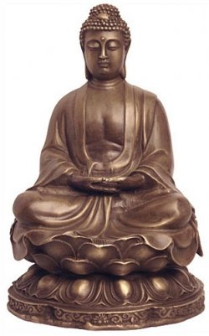
Nirvana
In Buddhism nirvana refers to final step on the Eightfold Path – the Middle Way between desire and self-denial.
Could take several lifetimes to reach nirvana; believers embrace reincarnation.
Brings final release from selfishness and pain; ends cycle of life and death.

Slide 29
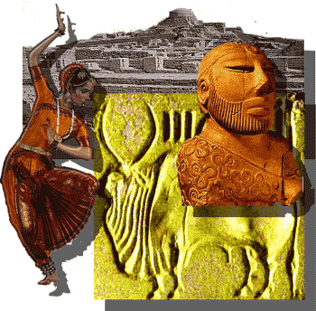
India’s First Empires
Chapter 7, Section 1

Slide 30
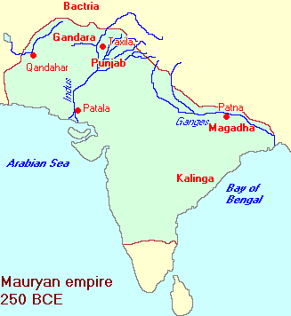
Mauryan Empire
Kingdom of Magadha ruled by Nanda family.
Military leader Chandragupta Mauraya killed Nanda king and claimed throne 321 B.C.; start of Mauryan Empire.
United northern India; empire stretched over 2,000 miles.

Slide 31
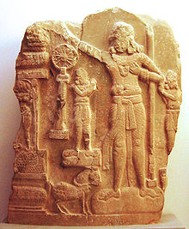
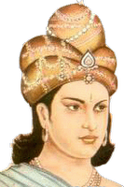
Asoka
Grandson of Chandragupta; became king 269 B.C.
Expanded empire through war, but afterwards followed Buddha’s teaching of peace.
Ensured religious toleration and fair treatment of subjects.

Slide 32
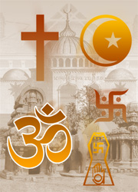
Religious Toleration
Acceptance of people who hold different religious beliefs.
Key to Asoka’s successful reign of Mauryan Empire.

Slide 33
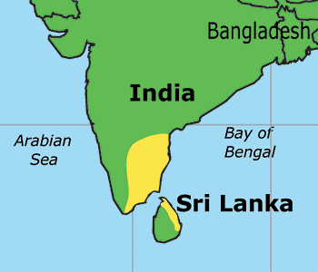
Tamil
Language spoken by Tamil people in Southern India.
Area belonged to three kingdoms that were never overcome by the Mauryans.

Slide 34
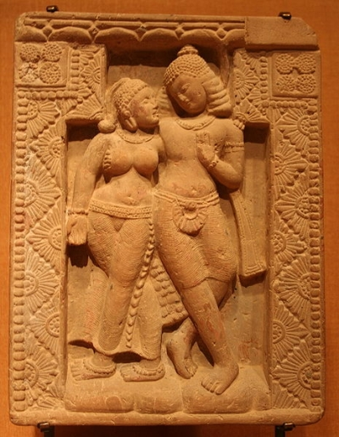
Gupta Empire
India’s second empire A.D. 320. - 500 years after Mauryan Empire.
Established by Chandra Gupta when married into royal family.
Oversaw flowering of Hindu culture.

Slide 35
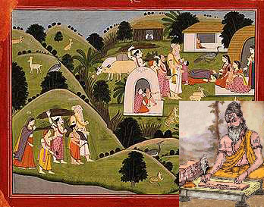
Patriarchal / Matriarchal
Patriarchal: Families headed by eldest male.
Matriarchal: Families headed by mother rather than father; property passed through female line.

Slide 36
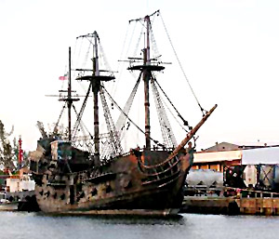
Trade Spreads Indian Religions and Cultures
Chapter 7,
Section 2

Slide 37
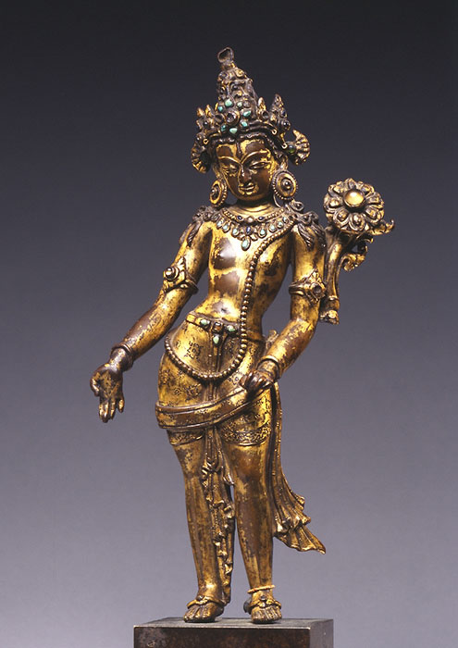
Mahayana
Eastern Buddhism
Teaches the Pali Canon (religious text in Theravada Buddhism), but it also includes additional texts beliefs.
Believes that the person must practice universal compassion to attain the “Awakened Mind” of Buddha hood.

Slide 38
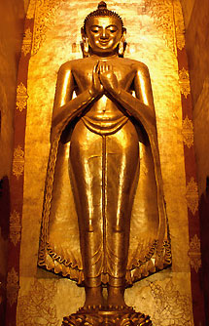
Theravada
First form of Buddhism
Word means “the Doctrine of the Elders”.
Aim is to use meditation to train mind, and to encourage freedom of the mind from suffering.
Will allow follower to reach Nirvana.
Only surviving school from the earliest years of Buddhism.

Slide 39
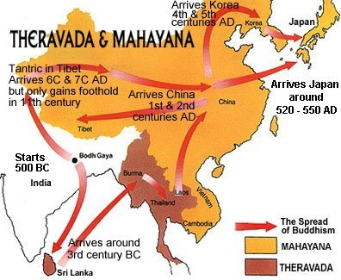

Slide 40
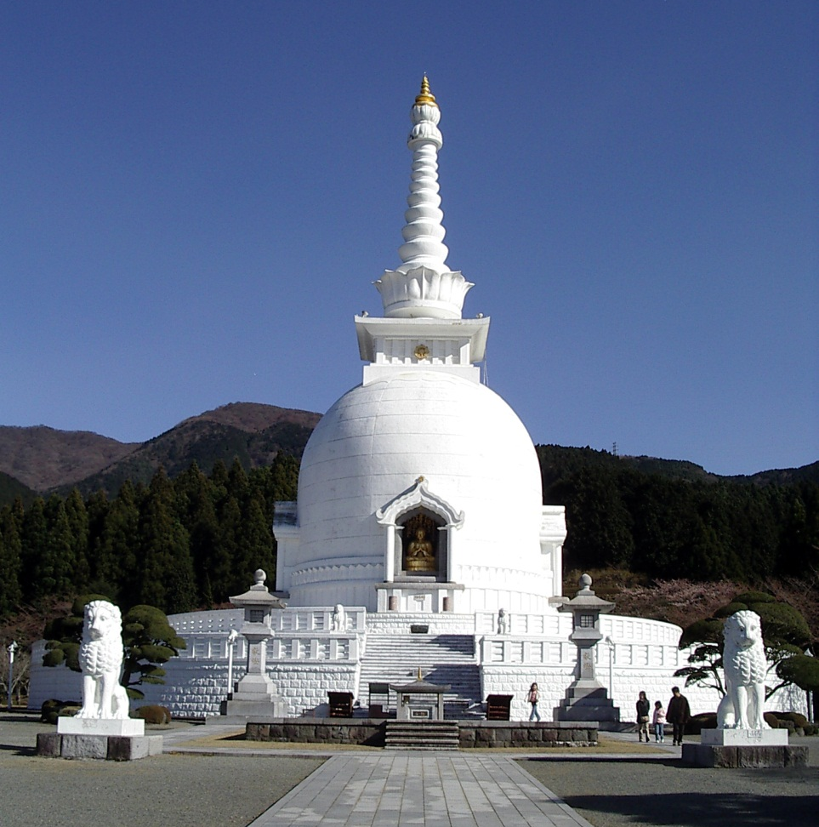
Stupa
Buddhist commemorative monument housing sacred relics associated with the Buddha.
The hemispherical form of the stupa came from pre-Buddhist burial mounds in India.
Circular base supporting a massive solid dome from which projects an umbrella.
The whole of the Great Stupa is encircled by a railing and four gateways.

Slide 41
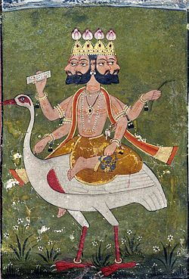
Brahma
One of three important Hindu gods; part of one divine force in the universe.
Creator of the world.

Slide 42
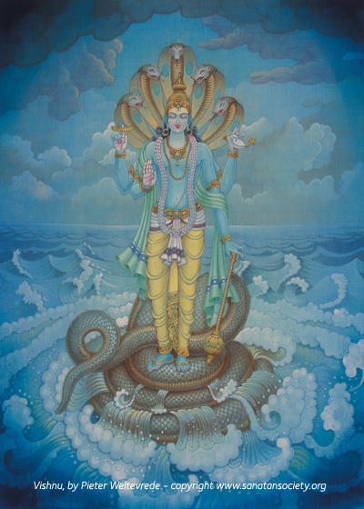
Vishnu
One of three important Hindu gods; part of one divine force in the universe.
Preserver of the world.

Slide 43
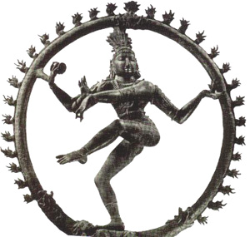
Shiva
One of three important Hindu gods; part of one divine force in the universe.
Destroyer of the world.

Slide 44
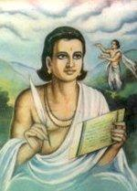
Kalidasa
One of India’s greatest writers.
Plays are skillfully written; emotionally stirring.
Most famous play: Shakantula

Slide 45
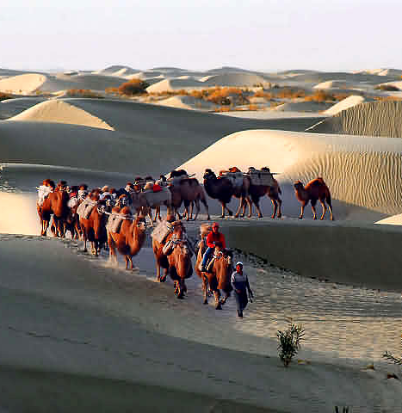
Silk Roads
Routes used to bring silk from China to western Asia and Rome.
India realized profits were to be made acting as middlemen; built stations along Silk Roads.
Indian trade expanded as result.

