Slide 1
The Mughal Empire in India
Chapter 18, Section 3

Slide 2
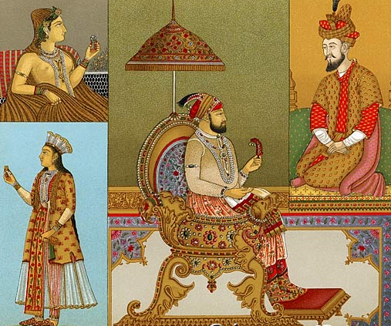
Mughals
Warlike Muslim tribes from Central Asia that invaded India after long period of turmoil.
Word means Mongols

Slide 3
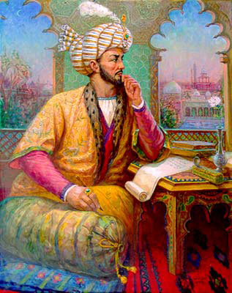
Babur
As 11-year old boy inherited a kingdom in 1494; driven from it by his elders.
Built up an army; was a brilliant general.
Invaded India and lay foundation for Mughal Empire.

Slide 4
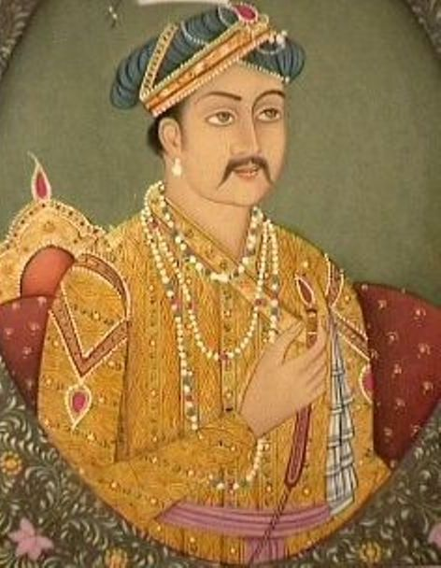
Akbar
Grandson of Babur; means “Great”.
Ruled India 1556-1605
Strong military leader
Wise and tolerant leader:
religious tolerance
fair tax system
blending of cultures
supported arts, literature and architecture

Slide 5
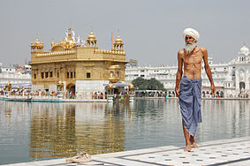
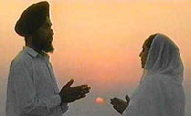
Sikhs
Non-violent religious group.
Independent traditions; not offshoot of other religions.

Slide 6
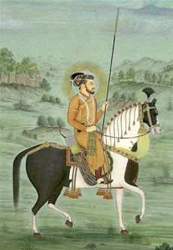
Shah Jahan
Son of Jahangir; secured throne by assassinating rivals.
Obsessed with beautiful buildings.
Married Persian princess, Mumtaz Mahal; built tomb for his wife – Taj Mahal – after her death.
Neglected government during reign and people suffered; led to beginning of decline of Mughal Empire.

Slide 7
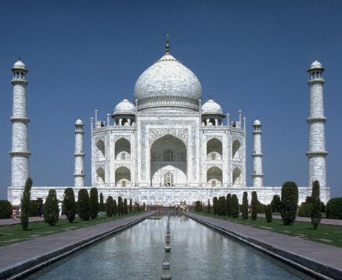
Taj Mahal
The Taj Mahal is a white marble mausoleum (tomb).
Located in Agra, Uttar Pradesh, India.
Built by Mughal emperor Shah Jahan in memory of his third wife, Mumtaz Mahal.

Slide 8
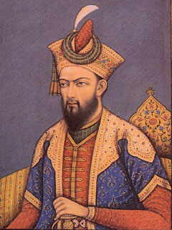
Aurangzeb
Third son of Jahan.
Imprisoned father and executed older brother and rival to throne.
Master military strategist and empire builder; expanded Mughal holdings.
Power of empire weakened under his rule because of cruel oppression of people.

Slide 9
Europeans Explore the East
Chapter 19, Section 1

Slide 10
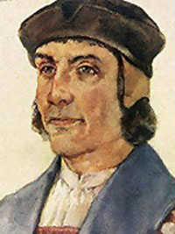
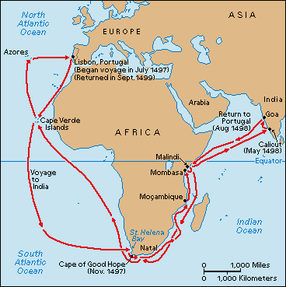
Bartolomeu Dias
Early European explorer from Portugal.
Wanted to find trade route to India.
First European to sail around the southernmost tip of Africa in 1488.

Slide 11
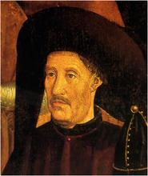
Prince Henry
Also known as “the Navigator”.
Son of Portugal’s king.
Used own fortune to organize more than 14 voyages along western coast of Africa.
Founded navigation school – mapmakers, shipbuilders, sea captains, etc. together to perfect trade.

Slide 12
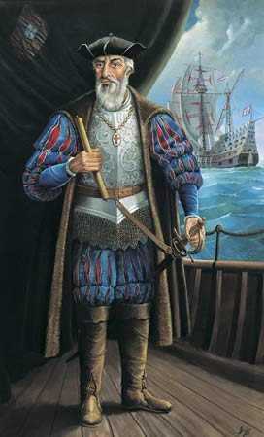
Vasco da Gama
Portuguese explorer.
First to reach India using sea route around Africa - 1498.
Meant whole voyage would be made by sea; wouldn't need to cross Mediterranean nor Arabia.
Paved the way for the Portuguese to establish a long lasting colonial empire in Asia.

Slide 13
Treaty of Tordesillas
1493 Pope Alexander VI granted Spain all the lands west of a line about 320 miles west of the Cape Verde Islands.
Portuguese expeditions were to keep to the east.
At Tordesillas - line moved further west; Portugal able to claim Brazil when it was discovered in 1500.

Slide 14
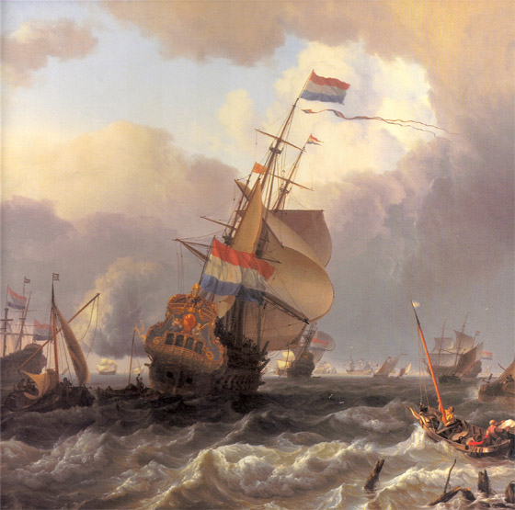
Dutch East India Company
By 1600’s the Netherlands became leading sea power.
Formed Dutch East India Company.
Power to mint money, make treaties and raise own armies; allowed expansion.
Established halfway stop in Cape of Good Hope.

Slide 15
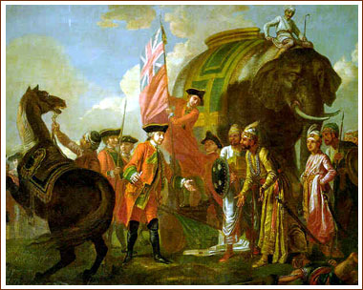
British Imperialism in India
Chapter 27, Section 4

Slide 16
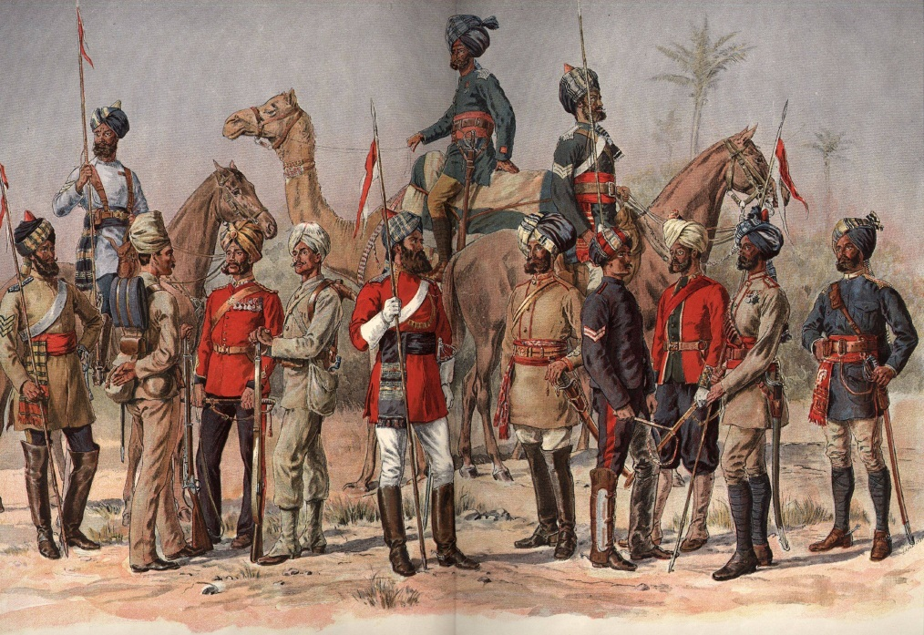
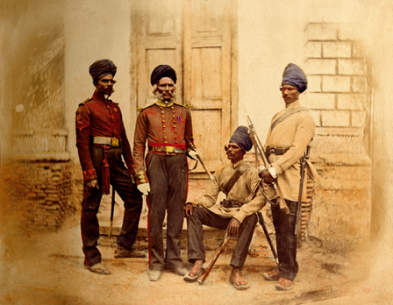
Sepoys
Indian soldiers employed by British East India Company.
Could not rise higher than rank of sergeant.

Slide 17
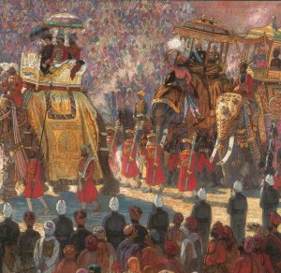
“Jewel in Crown”
British considered India most valuable of all British colonies – “jewel of the crown”.
After Industrial Revolution India became major supplier of raw materials.
300 million people large potential market.

Slide 18
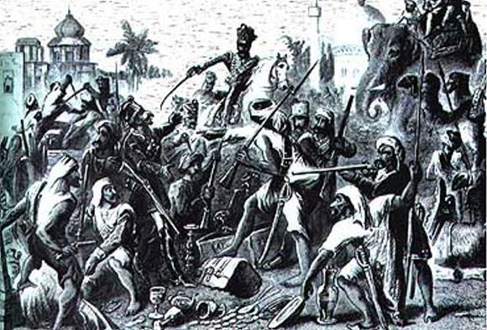
Sepoy Mutiny
May 1857 – April 1859
Cartridges of rifles greased with beef and pork fat.
Uprisings during the British colonization of India caused by direct British control over 2/3 of India.
Fierce battles, but Indians unable to unite against British because of religious differences.

Slide 19
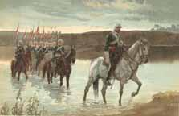
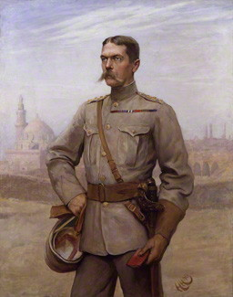
Raj
Refers to British rule of India after 1858; took direct control.
British governor-general in India (later viceroy) carried out British government’s orders.
Led to increased distrust between British and Indians.
Lord Kitchener

Slide 20
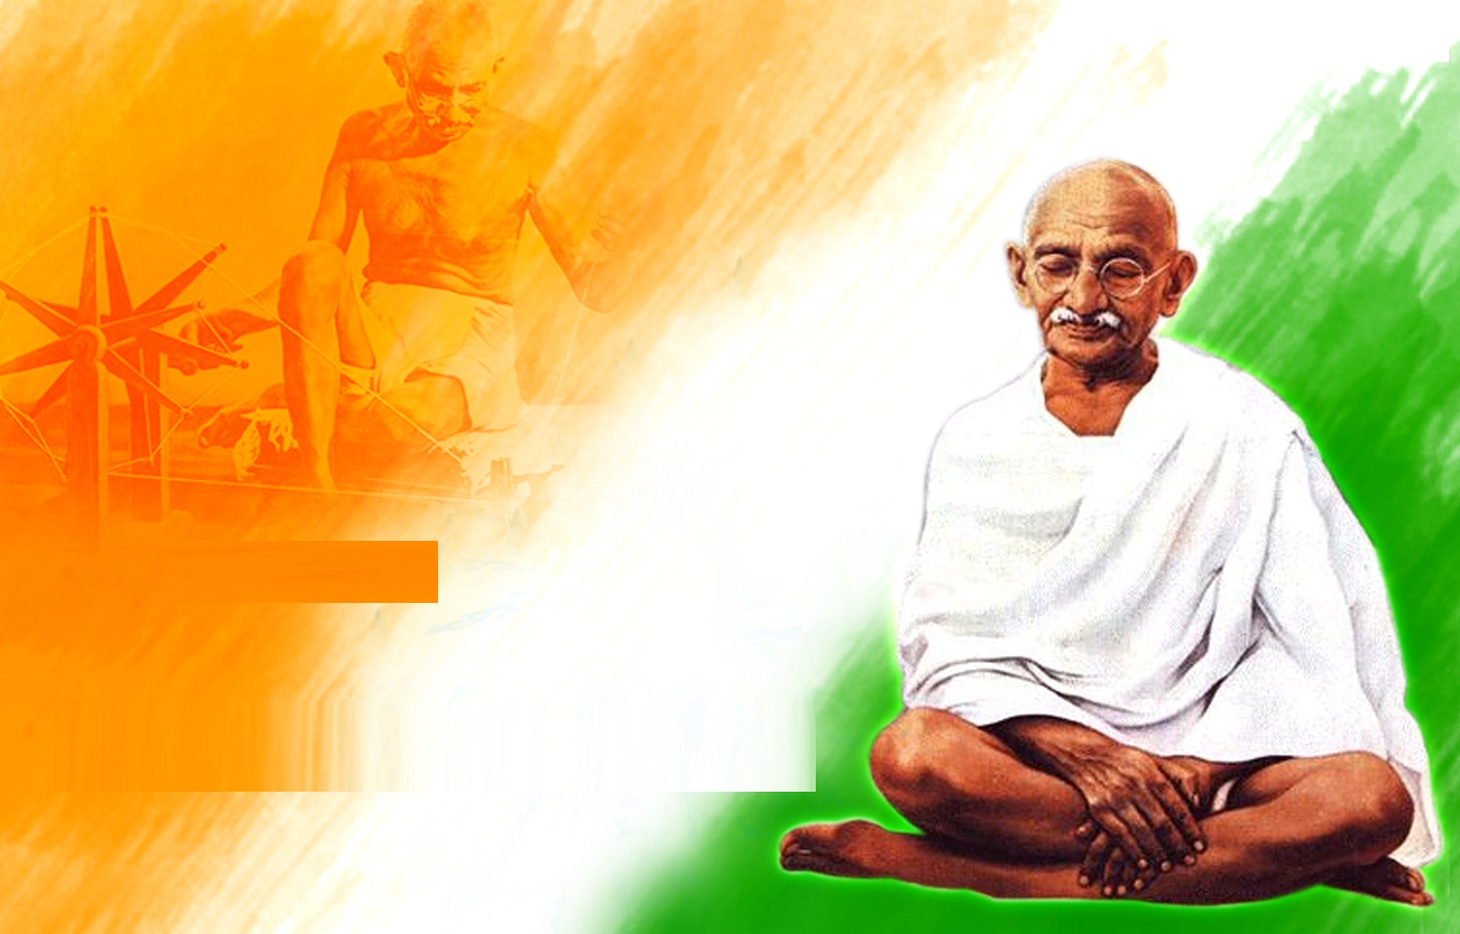
Nationalism in India and Southwest Asia
Chapter 30, Section 4

Slide 21
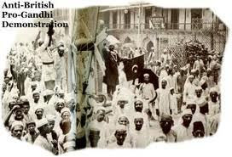
Rowlatt Acts
Many Indians enlisted for WWI; Britain promised reform when soldiers returned.
When they return, little changed; lead to violence.
British passed Rowlatt Acts to curb dissent; denied trial by jury for Indians.

Slide 22
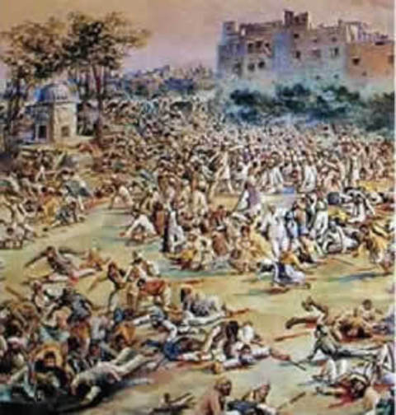
Amritsar Massacre
10,0000 Indians gathered in Punjab to protest Rowlatt Acts in 1919.
Gathering intended to be non-violent, but British were alarmed; banned the meeting.
Most Indians didn’t know; troops ordered to shoot into crowd.
400 dead; 1,200 wounded

Slide 23
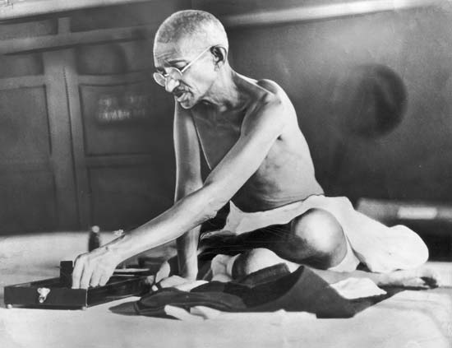
Mohandas K. Gandhi
Leader of independence movement.
Strategy to battle inequality evolved from deeply religious viewpoints.
Blended ideas from various religions.
Called Mahatma – meaning “great soul”.

Slide 24
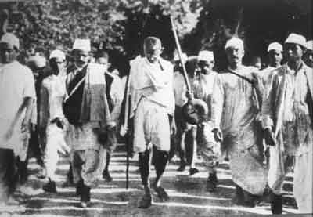
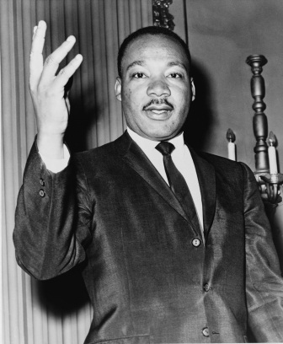
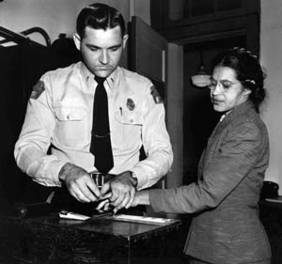
Civil Disobedience
Policy of non-cooperation with authorities.
Deliberate and public refusal to obey an unjust law.
Achieve independence through non-violence.
Includes boycotts, strikes and demonstrations.
Influenced later leaders, e.g. Martin Luther King and Malcolm X.

Slide 25
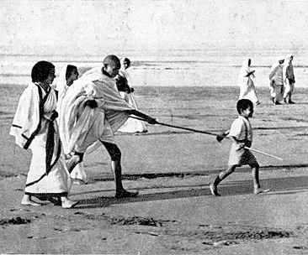
Salt March
Indians were forced to buy salt from British government and pay taxes on it.
1930 Gandhi and followers showed opposition by walking 240 miles to coast, where they made their own salt.

Slide 26
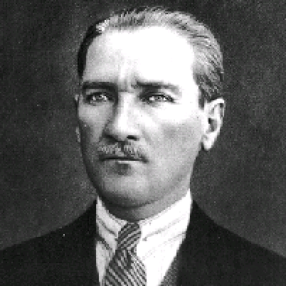
Mustafa Kernal
1881 - 1938
Born in the former Ottoman Empire.
Involved with the Young Turks, a revolutionary group that deposed the sultan in 1909.
Led the Turkish War of Independence.
Signed the Treaty of Lausanne in 1923; Turkey became a republic.
Elected its first president; ushered in reforms that modernized Turkey.

Slide 27
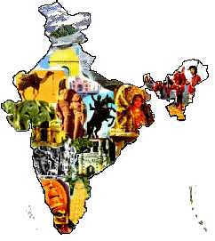
The Indian Subcontinent Achieves Freedom
Chapter 34, Section 1

Slide 28
Congress Party
India’s first national political party.
Consisted mostly of Hindus.
Some Muslim members.

Slide 29
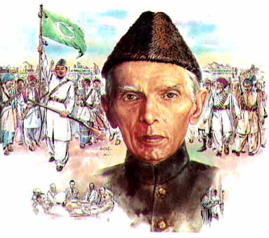
Muslim League
Political organization founded in 1906
Goal to protect Muslim interests against Congress Party.
Would not accept Indian independence under Hindu leadership.

Slide 30
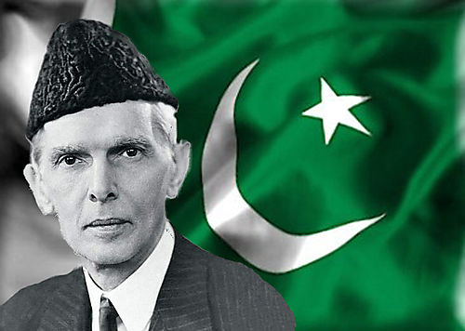
Muhammad Ali Jinnah
Leader of the Muslim League.
Insisted that Muslim members resign from the Congress Party.
Differences between parties led to riots and bloodshed in India cities.

Slide 31
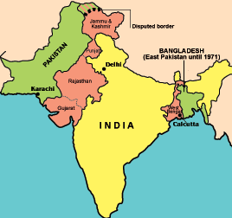
Partition
Refers to division of India into separate Hindu and Muslim nations.
Northwest and Eastern India became two separate states:
West Pakistan
East Pakistan
Partition led to enormous bloodshed – about 1 million people died.

Slide 32
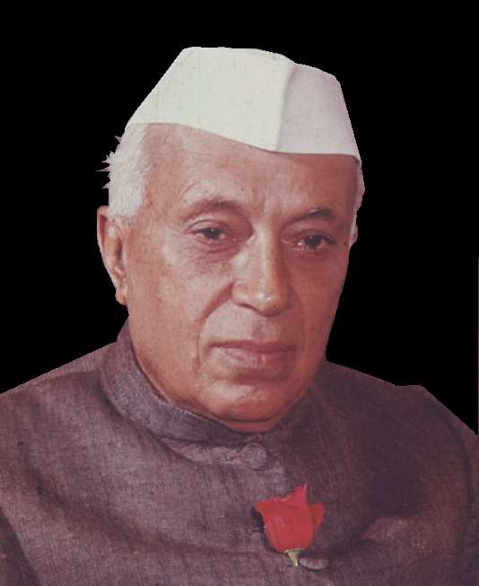
Jawaharlal Nehru
First prime minister of India after independence was granted on August 15th, 1947.
Emphasized democracy, unity and economic modernization.
India became world’s largest democracy.
Died 1964.

Slide 33
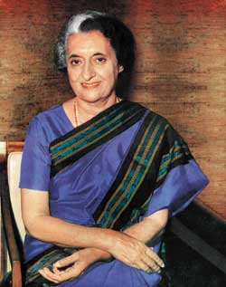
Indira Gandhi
Nehru’s daughter chosen as new prime minister.
Faced many challenges including revolt by Sikh nationalists.
Killed by two Sikh bodyguards in retaliation for an attack she ordered on Sikh temple.

Slide 34
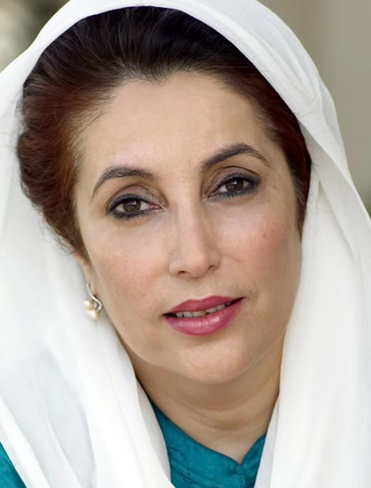
Benazir Bhutto
Elected prime minister after a series of military coups.
First woman to rule a Muslim state.
Popularity waned after months of disorder; removed from office in 1996.
Assassinated 2007 during political campaigns.

