Slide 1
European Middle Ages: 500 - 1200
Chapter 13

Slide 2
Charlemagne Unites Germanic Kingdoms
Chapter 13, Section 1

Slide 3
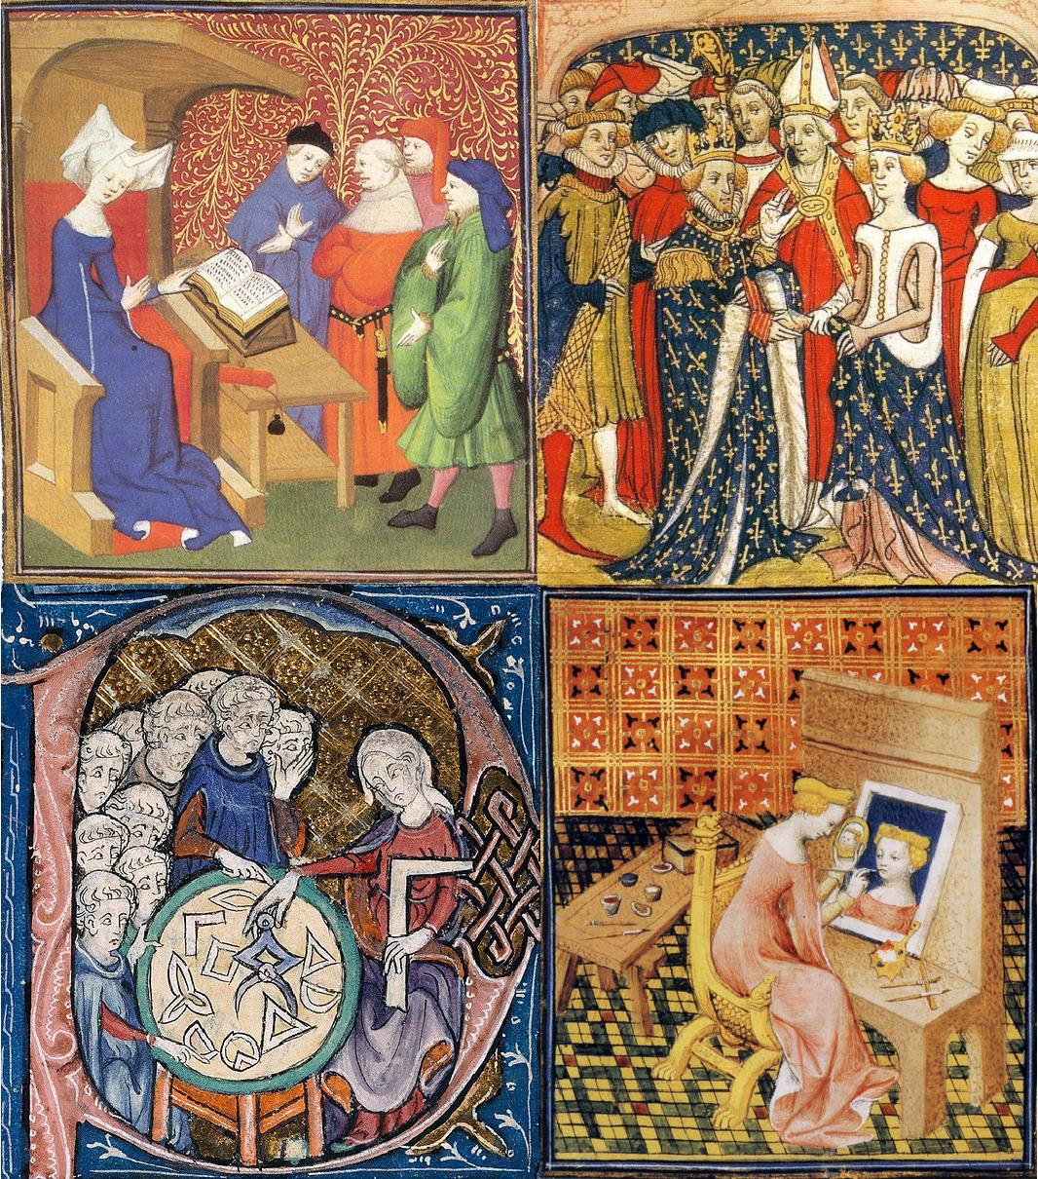
Middle Ages
500 – 1500
Also Medieval Period.
Society was based on:
Classical heritage of Rome
Beliefs of the Roman Catholic Church
Customs of various Germanic tribes

Slide 4
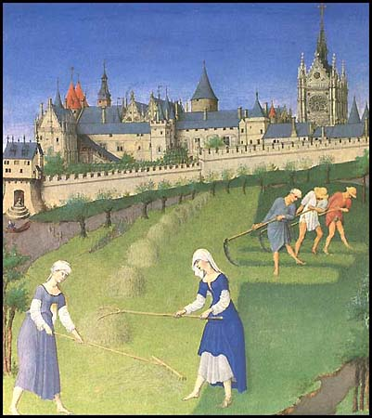
Western Europe Invaded
Disruption of Trade
Invasions cause businesses to collapse
Downfall of Cities
Abandoned as centers of administration
Population Shifts
Nobles retreat to rural areas; cities without leadership
Decline of Learning
Invaders couldn’t read or write; Greek language almost lost
Loss of Common Language
Latin not widely understood

Slide 5
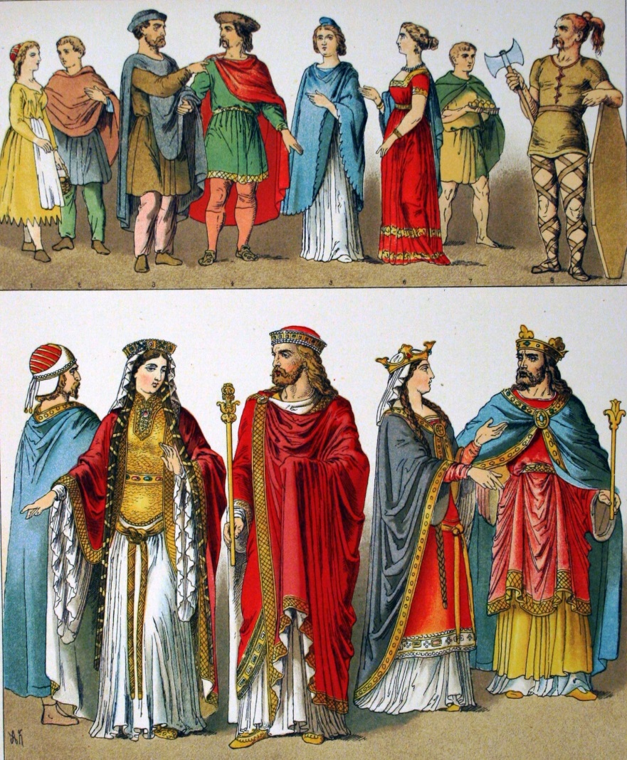
Emerging Germanic Kingdoms
Small Germanic kingdoms replaced Roman provinces
Concept of government changed – no longer unified society and common law
No loyalty to unknown king; loyalty only to Germanic leader

Slide 6
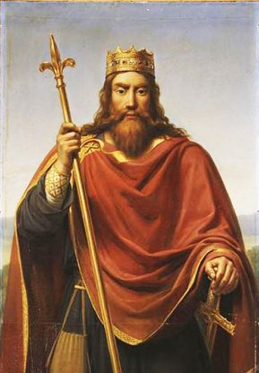
Franks
Held power in Roman province - Gaul (today France / Switzerland)
Their leader, Clovis, converted to and brought Christianity to region
Began alliance between Church and Frankish kingdom.

Slide 7
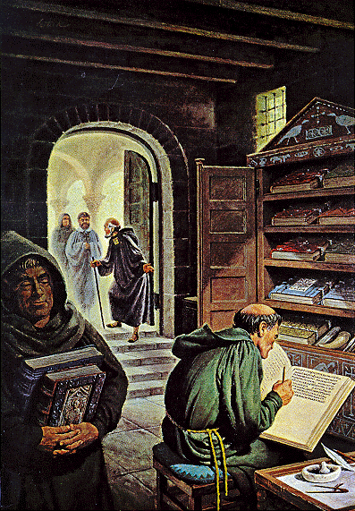
Monasteries
Church built religious communities to adapt to rural areas
Monks (men) lived in monasteries
Nuns (women) lived in convents
Gave up private possessions and dedicated their lives to serving God
Became best-educated communities in Europe

Slide 8
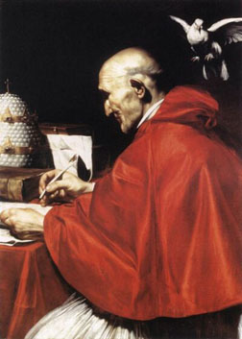
Secular
Gregory I – became pope 590; authority as pope went beyond spiritual to secular (worldly) role:
Papacy became involved in politics.
Entered into peace treaties.
Church income used to raise armies, fix roads AND help the poor.
Claimed right to spiritual kingdom from Italy to England and Spain to Germany.
Pope Gregory I

Slide 9
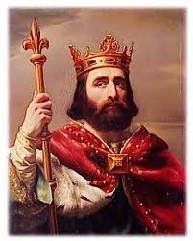
Charles Martel
Mayor of Palace was most powerful position in Frankish kingdom; 719 position was held by Charles Martel.
Held more power than King Charles; extended Franks’ reign north, south and east; also defeated Muslim Raiders at Battle of Tours; became Christian hero.

Slide 10
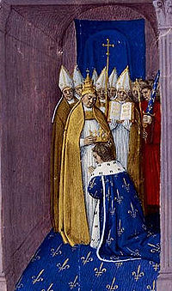
Carolingian Dynasty
Son of Charles Martel, Pepin the Short, wanted to be king
Cooperated with pope to fight Lombards who threatened Rome.
Pope anointed Pepin as king, beginning Carolingian Dynasty that ruled 751-987.
Coronation in 752
of Pépin

Slide 11
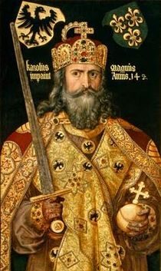
Charlemagne (Charles the Great)
Also known as Charles the Great; became king in 771.
Built enormous empire larger than Byzantine Empire, uniting entire Western Europe.
Spread Christianity; pope crowned him as “Roman Emperor”.
Managed kingdom and encouraged education.

Slide 12
Feudalism in Europe
Chapter 13, Section 2

Slide 13
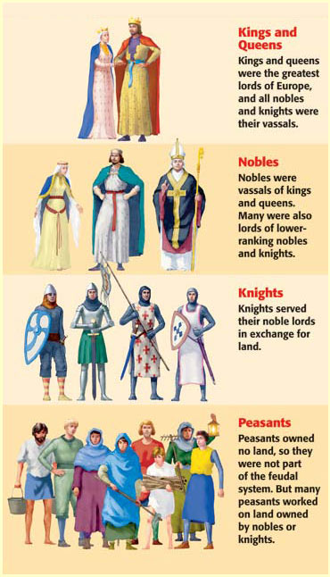
Feudalism
Similar to feudalism in Japan.
Set of legal and military customs in medieval Europe.
Based on rights and obligations.
System for structuring society based the right to hold/work land in exchange for service or labor.

Slide 14
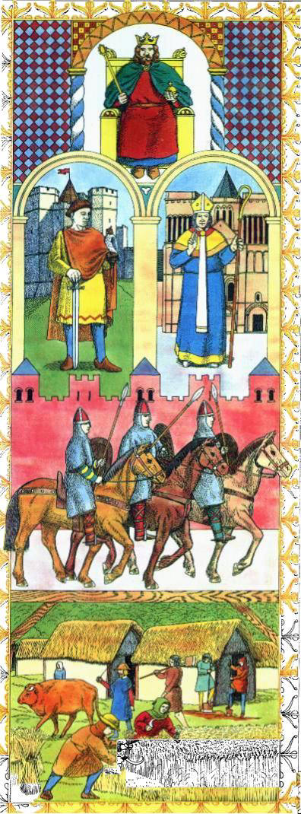
Feudalism: Terms
The noble who held land or landowner was called the lord.
The land granted to someone was called a fief.
The person receiving the land in exchange for services was the vassal.

Slide 15
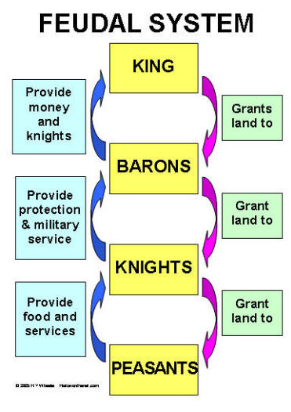
Feudal Pyramid
Status in the feudal system depended on prestige and power.
At the peak was the king, and under him the vassals.
Knights served the landowners or vassals.
At base of pyramid was peasants and serfs.

Slide 16
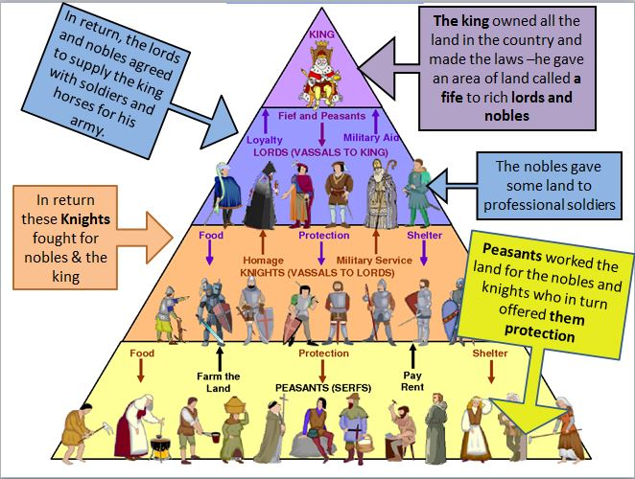
Feudal Pyramid

Slide 17
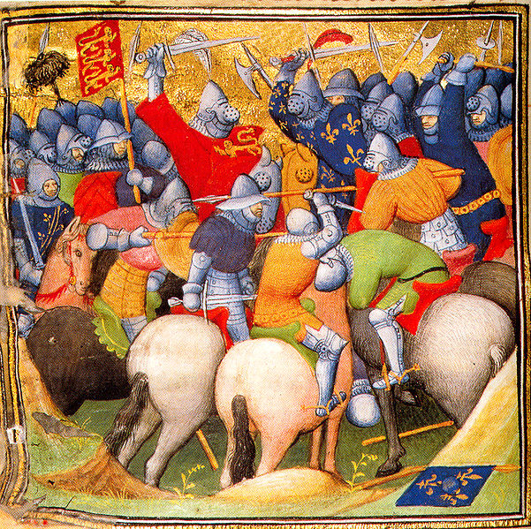
Knight
Knights served under wealthy landowners or vassals.
They were mounted horsemen who pledged to defend their lord’s lands in exchange for fiefs (land).
The rank became associated with the ideals of chivalry, i.e. a code of conduct for the perfect courtly warrior.

Slide 18
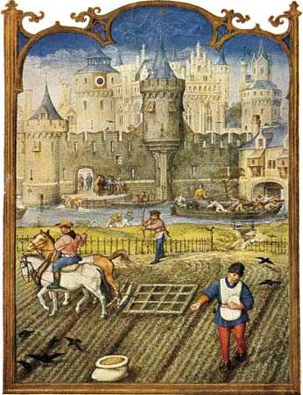
Serf
Peasant or poor person who was required to work for the Lord of the Manor.
In return they were entitled to protection, justice and the right to use certain fields within the manor.
Often required not only to work on the lord's fields, but also his mines, forests and roads.
Serfs formed the lowest social class of feudal society.

Slide 19
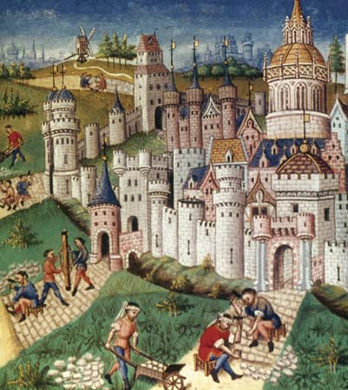
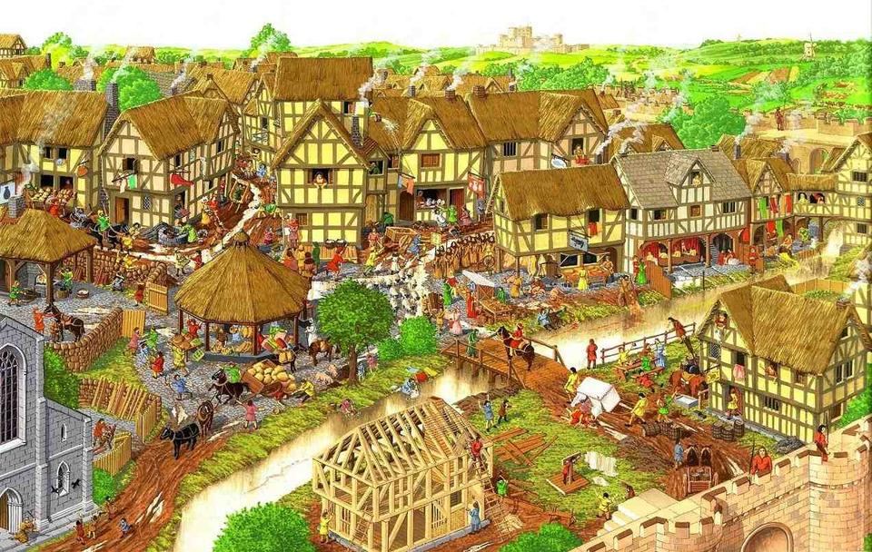
Manor
The area over which a lord had domain and could exercise certain rights and privileges in medieval Europe; 15-30 families.
The self-sufficient village would usually contain a church, workshops, fields, etc. where nearly everything the lord needed would be produced – crops, milk, cheese, cloth, leather, lumber.
The Manor House was built apart from the village where the peasants lived.

Slide 20
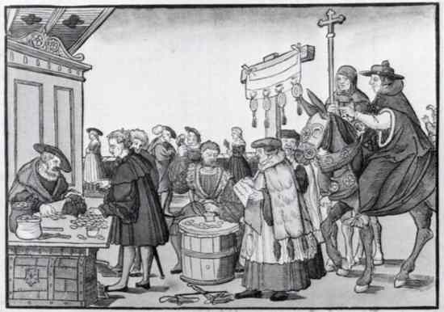
Tithe
Peasant families were required to give up one tenth of their income or what they produced.
This was paid to the priest for the church.

Slide 21
The Age of Chivalry
Chapter 13, Section 3

Slide 22
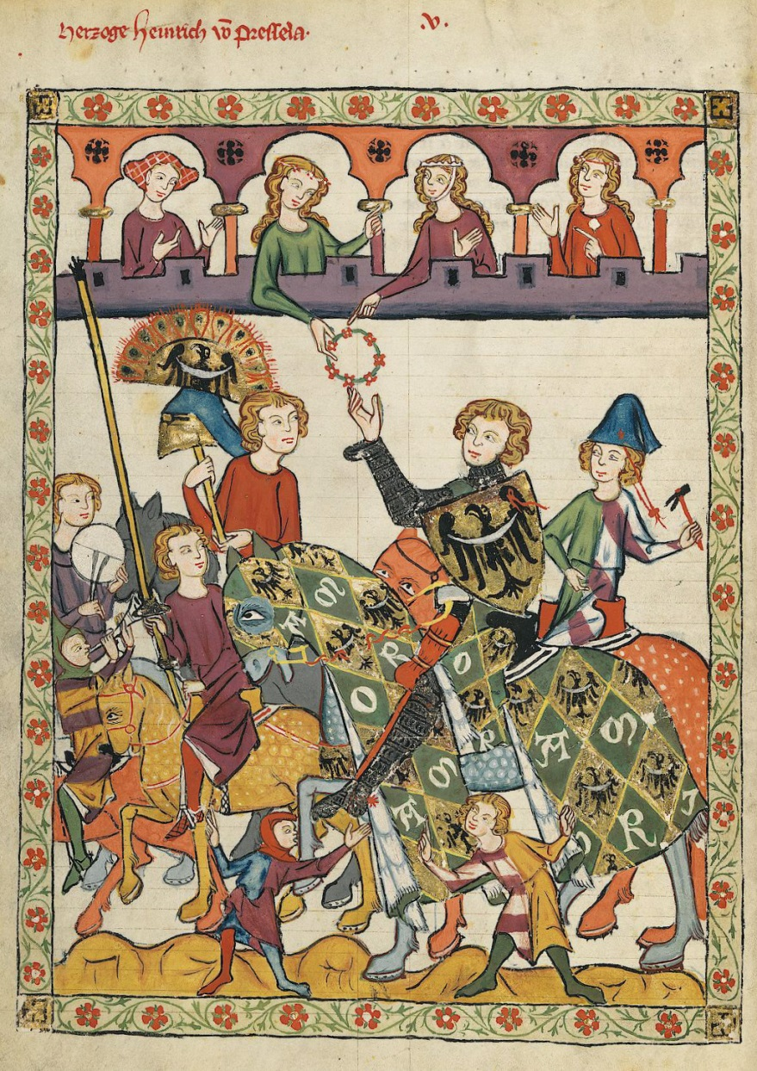
Chivalry
Knights needed strength and skills to fight wars in the Middle Ages; they had to be disciplined and strong.
Followed a Code of Conduct that required chivalry – a set of expectations and ideals that included courtesy, generosity, justice and bravery.
Had to show loyalty to their feudal lord, heavenly lord and chosen lady.

Slide 23
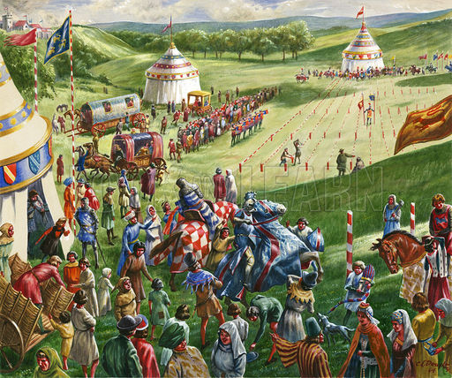
Tournament
Mock battle for knights to build experience in fighting.
Combined training and recreation; fierce and bloody competitions.
Winners could demand ransom from defeated knights.

Slide 24
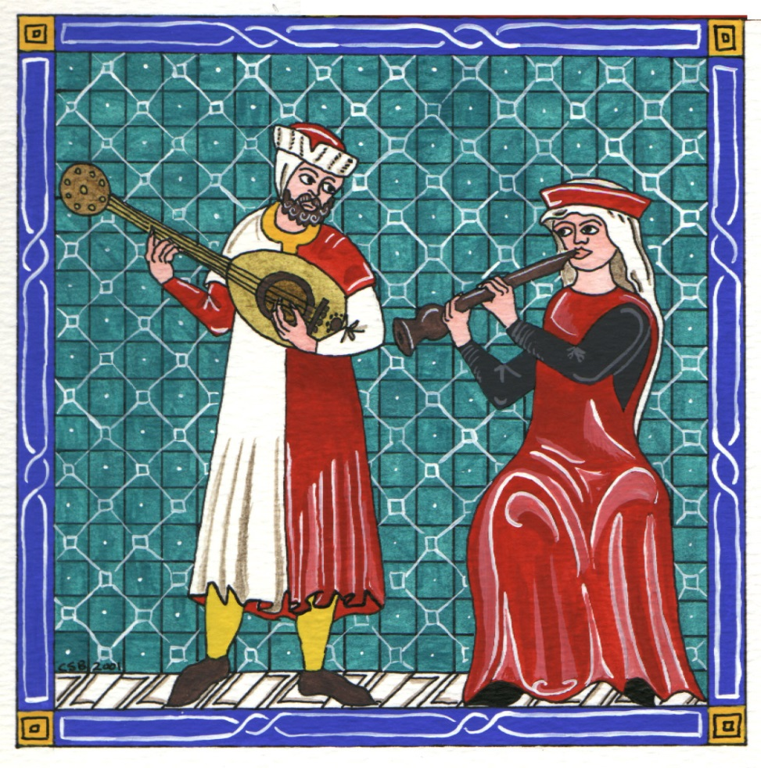
Troubadour
Traveling poet-musicians who visited castles and courts of Medieval Europe.
Composed short verses and songs about joys and sorrows of love; would perform them for the ladies.

Slide 25
The Power of the Church
Chapter 13, Section 4

Slide 26
Clergy
Included all church officials from the pope to bishops, priests and monks/nuns.
Power was based on status or rank within the church.
Priests were supervised by Bishops who also settled disputes amongst priests.

Slide 27
Sacrament
Sacred Christian rites or religious ceremonies.

Slide 28
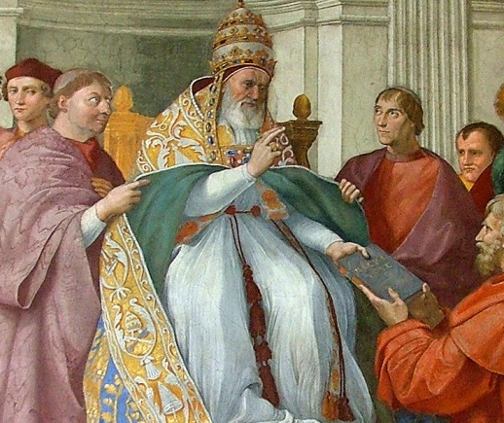
Canon Law
Church Law
Authority of the Church was both religious and political.
EVERYONE – including royalty – subject to Canon Law.
Harsh punishments for offenders included excommunication and interdict.

Slide 29
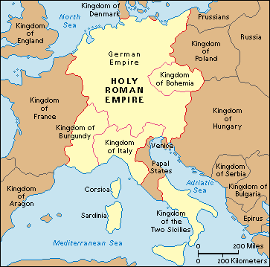
Holy Roman Empire
Territories in medieval Germany ruled by Otto the Great.
Otto also invaded Italy on Pope’s behalf; was included in what became known as the Holy Roman Empire.

Slide 30
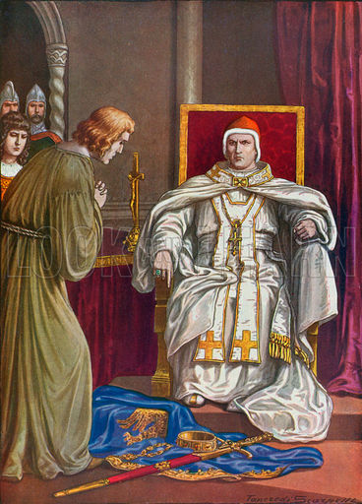
Lay Investiture
Appointment of bishops, abbots, and other church officials by feudal lords and vassals.
Banned by Church - did not want royals to have that much power.
Led to clash between Pope Gregory VII and King Henry IV.
Holy Roman Emperor Henry IV doing penance to reverse his excommunication by Pope Gregory VII

Slide 31
The Formation of Western Europe: 800 - 1500
Chapter 14

Slide 32
Church Reform and the Crusades
Chapter 14, Section 1

Slide 33
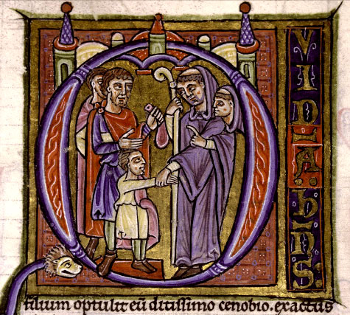
Simony
The act of selling offices and positions in the Church.
Refers to the New Testament story where Simon Magus offered the apostles money for the gift of the Holy Ghost.

Slide 34
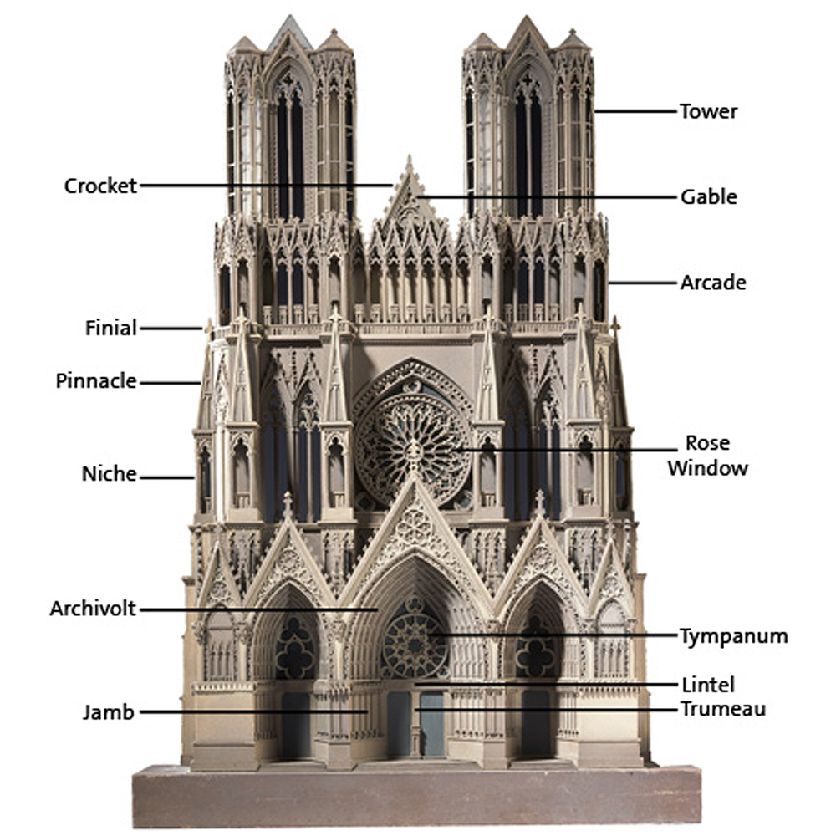
Gothic Architecture
Architects developed key techniques of structural engineering.
Features include:
Ribbed vaults to support roof’s weight
Flying buttresses that transferred weight to thick exterior walls
Pointed arches that framed huge stained glass windows
Tall spires that seemed to point to heaven

Slide 35
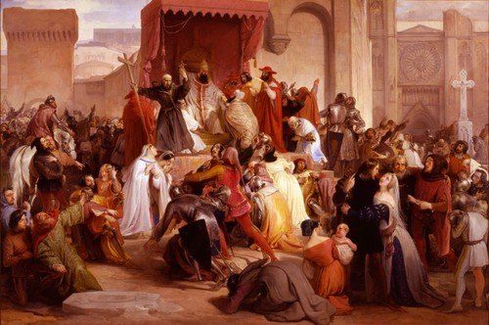
Pope Urban II
Turks massacred the Byzantine Empire’s armies; threatened Constantinople.
Pope Urban II urged revolt, marking beginning of Crusades.
“A horrible tale has gone forth,” he said. “An accursed race utterly alienated from God … has invaded the lands of the Christians and depopulated them by the sword, plundering, and fire.” Toward the end, of his sermon he made his appeal: “Tear that land from the wicked race and subject it to yourselves.”

Slide 36
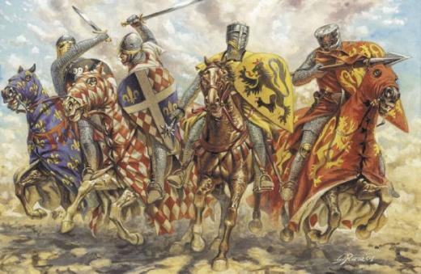
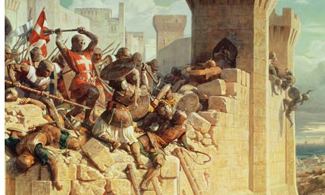
Crusade
The Crusades were military campaigns or Holy Wars sanctioned by the Roman Catholic Church.
The first crusade tried to restore Christian access to holy places in and near Jerusalem.

Slide 37
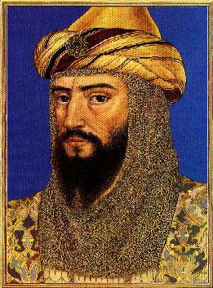
Saladin
Powerful Kurdish leader who led the Muslim opposition to the Crusaders.
He united and lead the Muslim world; recaptured Jerusalem for the Muslims in 1187.

Slide 38
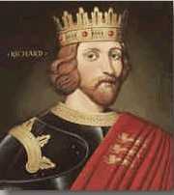
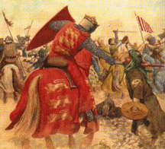
Richard the Lion-Hearted
The pope, Gregory VIII, ordered another crusade to regain the Holy City for the Christians after Saladin’s victory. This was the start of the Third Crusade.
It was initially led by Richard I (Richard the Lion-Hearted), Emperor Frederick Barbarossa of Germany and King Philip II of France; eventually only Richard I remained.
Crusade lasted from 1189 to 1192; Richard 1 and Saladin signed truce.

Slide 39
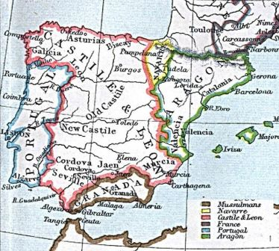
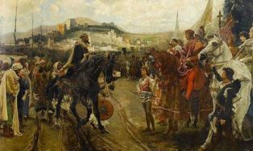
Reconquista
The Reconquista is the name given to a long series of wars and battles between the Christian Kingdoms and the Muslim Moors
Battled for control of the Iberian Peninsula (Large part of Spain and Portugal today).
It lasted from 718 to 1492.
TOP: The division of the land before Granada was retaken.
BOTTOM: The Moors surrendering to Ferdinand and Isabella.

Slide 40
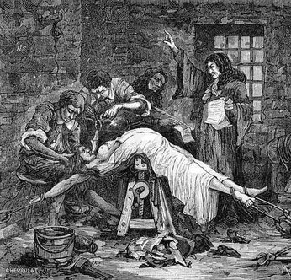
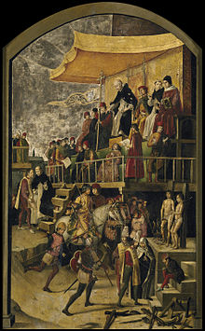
Inquisition
An organization in the Roman Catholic Church that was responsible for finding and punishing heretics (people who did not accept its beliefs and practices).
Targeted Jews and Muslims.
Involved torture, and if found guilty, burned at a stake.

Slide 41
Changes in Medieval Society
Chapter 14, Section 2

Slide 42
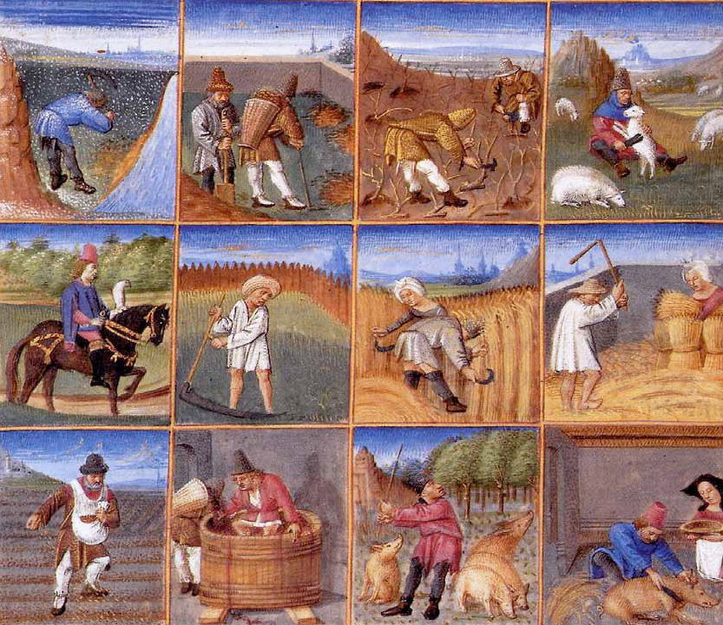
Three-field system
A system of land cultivation under which the common land is divided into three parts of which one or two in rotation lie fallow in each year and the rest are cultivated.
Increased food production; people were healthier because they could eat more and population expanded.

Slide 43
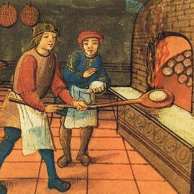
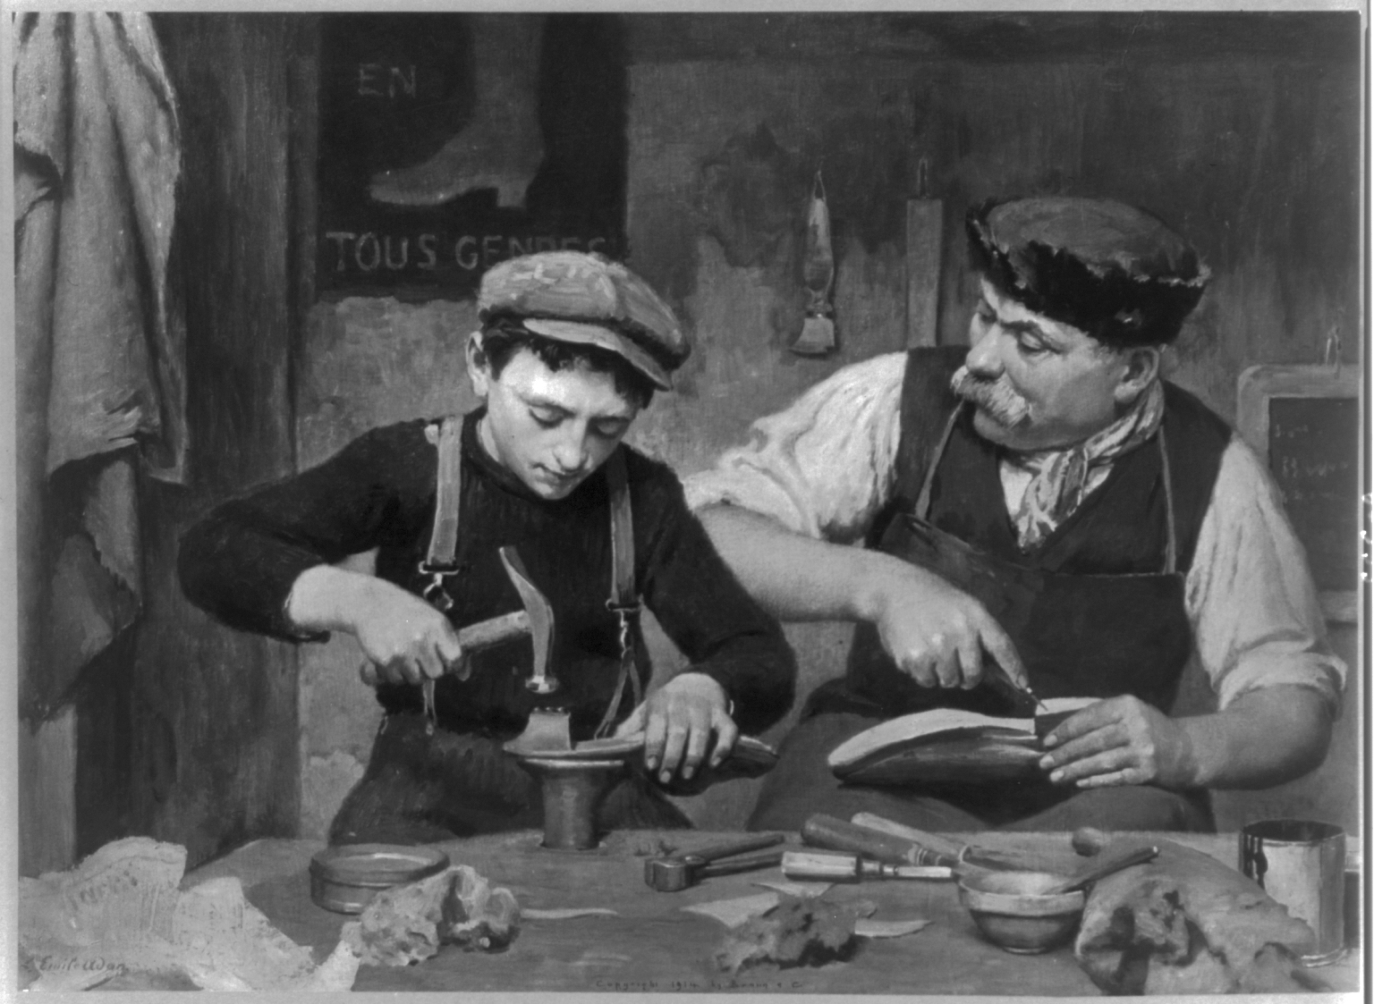
Guild
Organization of individuals in the same business / occupation.
Goal to improve economic and social conditions for members.
Merchants formed first guild to control trading prices and reduce losses.
Guilds later set standards for quality of work, wages and working conditions.

Slide 44
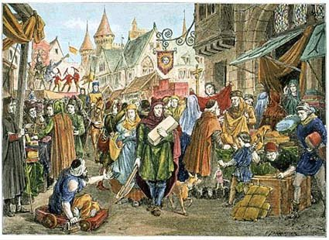
Commercial Revolution
Expanded agriculture and trade changed way business was done; led to Commercial Revolution.
No longer produced everything on self-sufficient manor.
Fairs were set up to encourage trade of cloth, food (bacon, salt, honey, cheese, wine), leather goods, knives and ropes.
Goods from foreign countries became available.
Business and banking services developed.

Slide 45
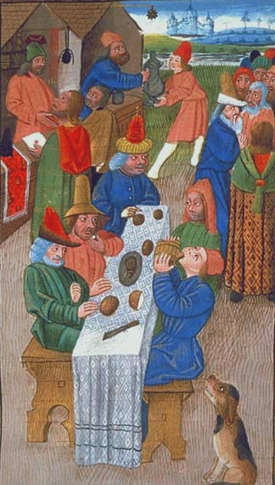
Burgher
A citizen of a borough or town, usually belonging to the middle class.
Did not fit in traditional order; resented interference from feudal lords.
Organized themselves into groups and demanded certain rights, e.g. right to govern a town.

Slide 46
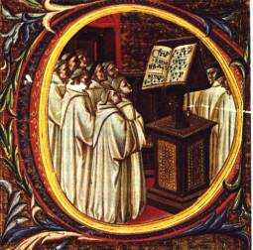
Vernacular
The language or dialect spoken by the ordinary people in a particular country or region
Different from main or official language; Shakespeare wrote his plays in vernacular spoken by ordinary people on the street.

Slide 47
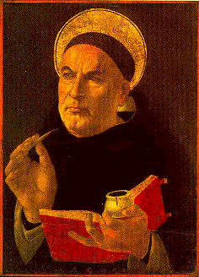
Thomas Aquinas
The Summary of Theology is considered to be Thomas Aquinas’ masterwork.
Combined the theological principles of faith with the philosophical principles of reason to prove the existence of God.
Aquinas promoted the literal reading of Scripture (not allegorical interpretation).

Slide 48
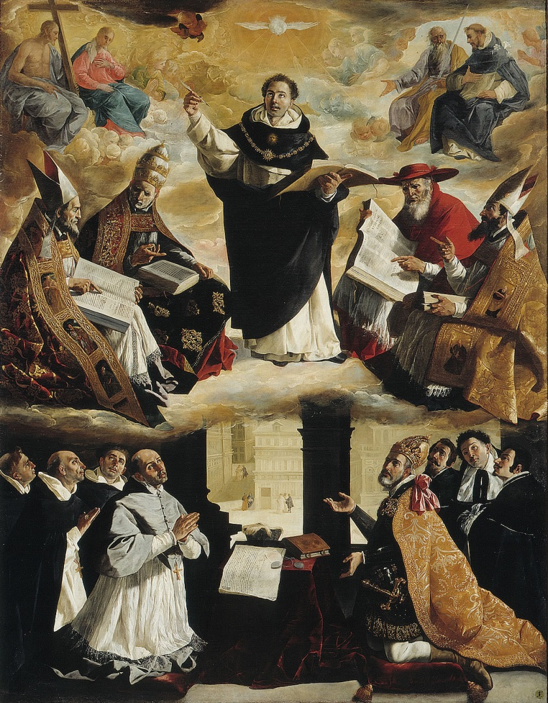
Scholastics
Men who met at universities and used their knowledge of Aristotle to debate issues of their time.
Teachings on law and government influenced Western Europeans; began development of democratic institutions and traditions.

Slide 49
England and France Develop
Chapter 14, Section 3

Slide 50
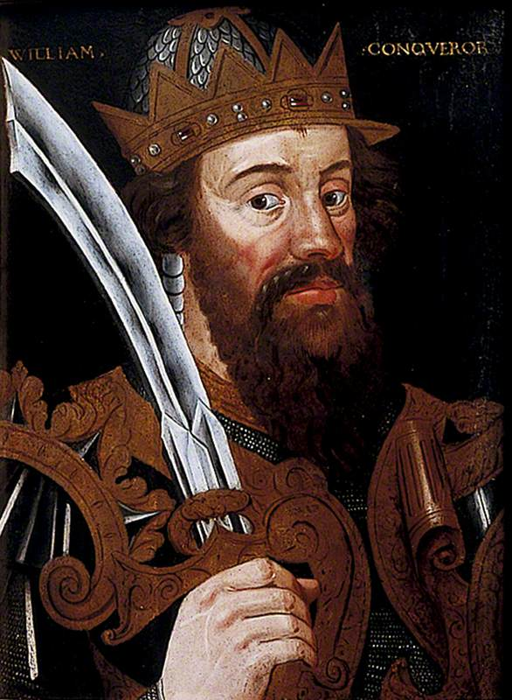
William the Conqueror
Was also Duke of Normandy.
After the death of William’s cousin Edward, Harold Godwinson claimed the throne of England for himself; William, angered by the betrayal, invaded England to enforce his claim to the throne.
Crowned King of England after the Battle of Hastings in 1066.
Laid groundwork for centralized government in England.

Slide 51
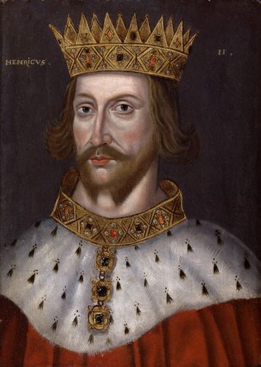
Henry II
English king who married Eleanor of Aquitine.
Obtained Aquitine in addition to Normandy; vastly expanded English territory within France.

Slide 52
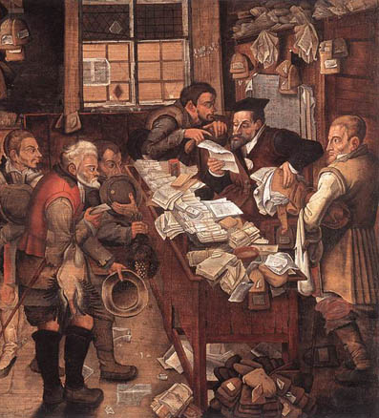
Common Law
Under Henry II justice system improved.
Royal judges sent all across England; held jury trials.
Over years ruling of judges became “common law”.
Common law still basis for law in many English-speaking countries, including USA.

Slide 53
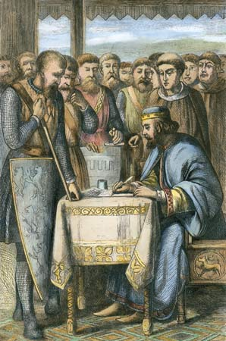
Magna Carta
Charter (contract between King John and nobles declaring all laws should be obeyed by everyone, including the king.
Limited power of the king and guaranteed certain rights for all citizens.
Basis for legal rights in England and USA.

Slide 54
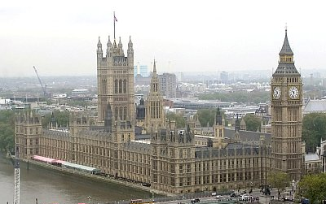
Parliament
Created by Edward I to raise taxes for warfare.
2 burgesses (wealthy property owners) from each borough and two knights from each county served in this legislative group known as parliament.

Slide 55
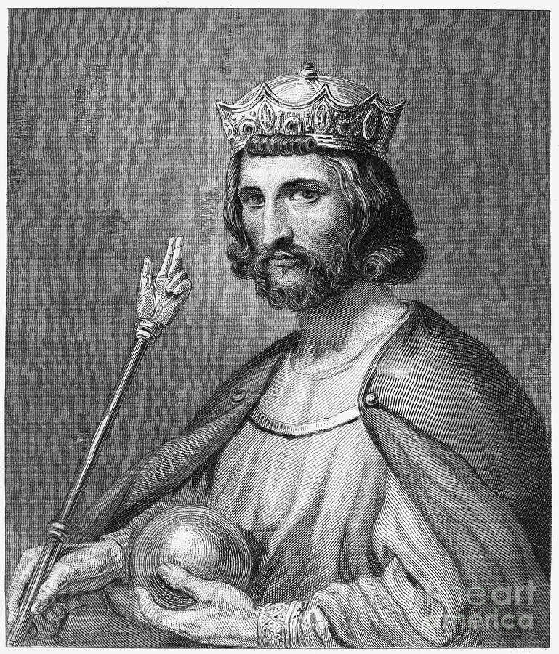
Hugh Capet
After Carolingian Dynasty came to end, Hugh Capet took over small area in France that included Paris.
Began Capetian Dynasty – lasted 300+ years.

Slide 56
Philip II
Powerful Capetian – rulled 1180 – 1223
Able to seize Normandy from English and extend French territory.
Established central government in France.

Slide 57
Estates-General
Consisted of:
Church Leaders (1st Estate)
Great Lords (2nd Estate)
Commoners (3rd Estate)
Eventually played huge role in overthrowing French monarchy during French Revolution

Slide 58
The Hundred Years’ War and the Plague
Chapter 14, Section 4

Slide 59
Avignon
Pope Clement V moved from Rome to Avignon; popes lived there following 67 years.
Move away from Rome weakened Roman Catholic Church

Slide 60
Great Schism
A split within the Catholic Church from 1378 to 1418.
Several men claimed to be the true pope.
Ended by the Council of Constance (1414–1418).
The rival claims to the papal chair damaged the reputation of the office; weakened Catholic Church further.

Slide 61
John Wycliffe
Challenged power of pope.; preached that Jesus Christ was true head of the Church (not the pope).
Offended by wealth displayed by clergy.
Maintained Bible is final authority on Christ’s life.
Inspired translation of New Testament into English.

Slide 62
Jan Hus
Admired stance taken by John Wycliffe.
Maintained that authority of the Bible was higher authority than pope.
Excommunicated from Church – 1412
Tried as heretic – 1414
Burned at stake – 1415

Slide 63
Bubonic Plague / Black Death
Epidemic started in Asia and spread across to North Africa and Europe in 1300’s.
Deadly disease spread by rats; worsened by insanitary living conditions.
Wiped out large sections of populations in China, North Africa and Europe.
Many people believed that the Black Death was a kind of divine punishment for sins against God. Resulted in:
Jews massacred
Flagellation
Pope’s power usurped

Slide 64
Hundred Years’ War
Continuous battle between England and France which eventually marked the end of the Middle Ages.
Started initially because England’s Edward III claimed the right to the French throne in 1337.
Continued for more than 100 years until 1453.
Final outcome was that the French were able to drive England out of France (except for Calais), but it also brought about big changes in the way that wars were fought.

Slide 65
Joan of Arc
Joan of Arc led the French army to victory over the British at Orléans at age 18.
Captured a year later, Joan was burned by the English and their French collaborators as a heretic.
Canonized as a Roman Catholic saint 500 years later.

