Slide 1
Mesopotamia & Ancient Egypt
Chapter 2, Sections 1 & 2

Slide 2
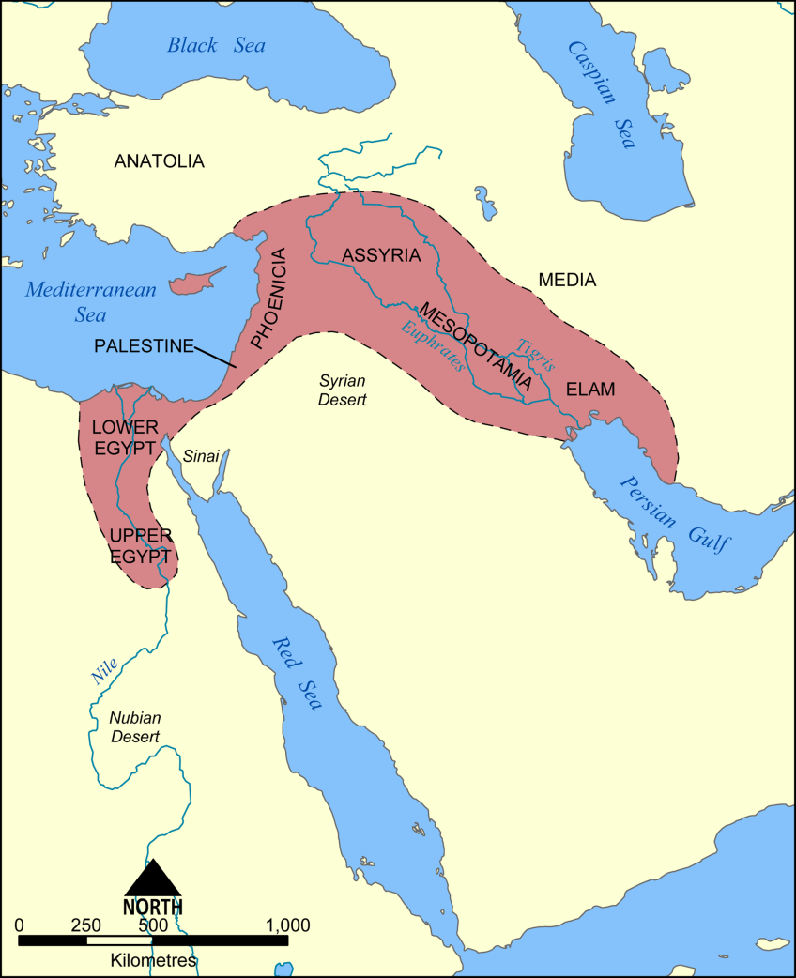
Fertile Crescent
Fertile farming area in Southwest Asia.
Includes lands facing Mediterranean Sea and Mesopotamia.
Region is curved-shaped, hence name “Fertile Crescent”.

Slide 3
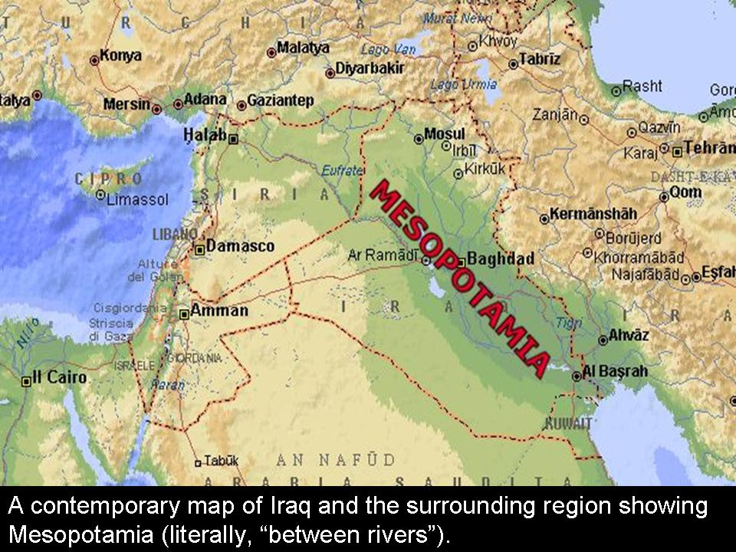
Mesopotamia
Lies between Tigris and Euphrates rivers.
Means “land between rivers”.
Today known as Iraq.
Rivers flooded plain at least once a year, leaving behind fertile silt, which could be planted with grains.

Slide 4
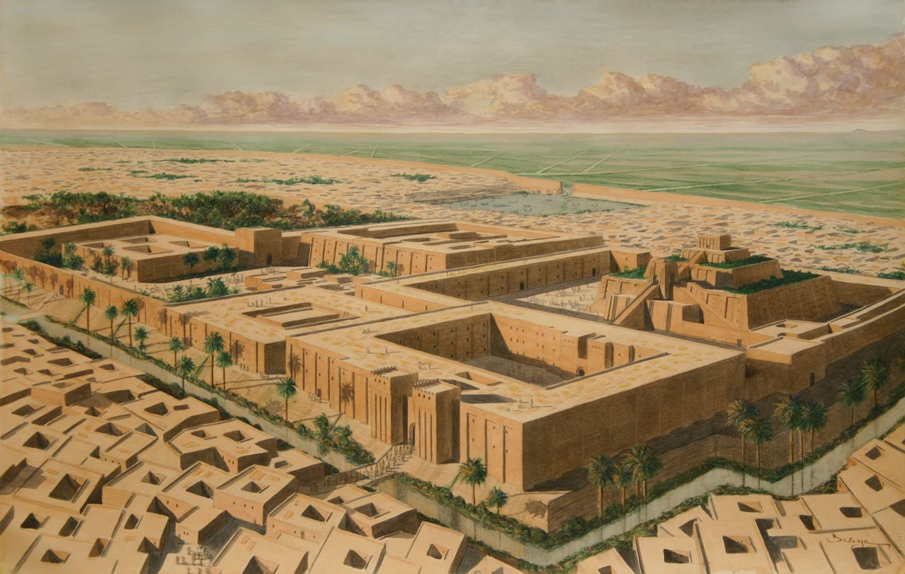
City-state
Sumerians built a number of cities.
Shared same culture, but each city-state was ruled independently by own rulers.

Slide 5
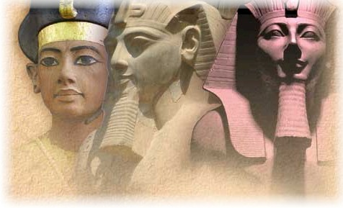
Dynasty
Series of rulers from one family over several generations.
Power usually passed on from father to son.

Slide 6
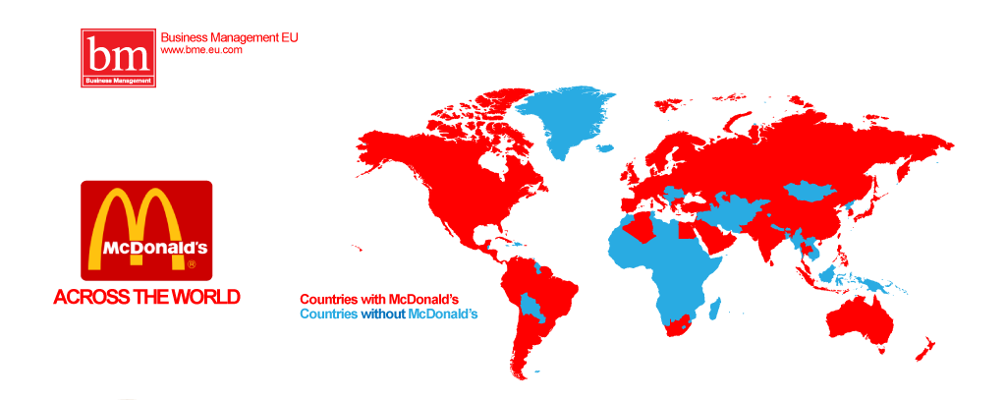
Cultural Diffusion
Process of exchanging products and ideas with neighboring cultures.

Slide 7
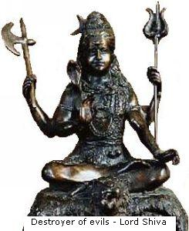
Polytheism
Belief in more than one god; various gods have different powers.
Sacrifices made to gods to keep them happy.
EXAMPLE: Hinduism

Slide 8
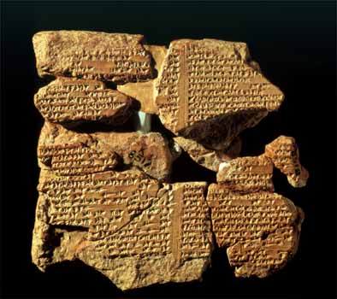
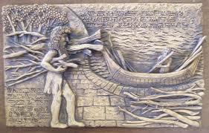
Epic of Gilgamesh
Long narrative poem.
Account of many Mesopotamian myths and legends.

Slide 9
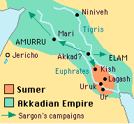
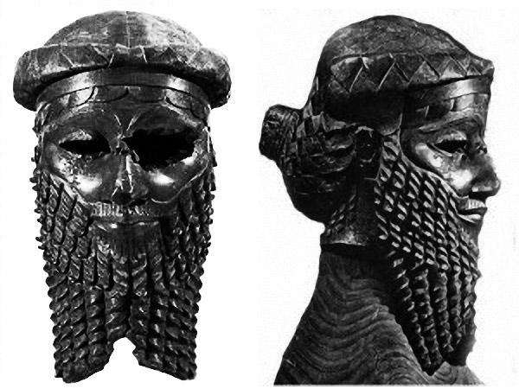
Empire
Empire brings together several people, nations or previously independent states under one ruler.
Sargon of Akkad conquered city-states of Sumer 2350 B.C. and created world’s first empire.

Slide 10
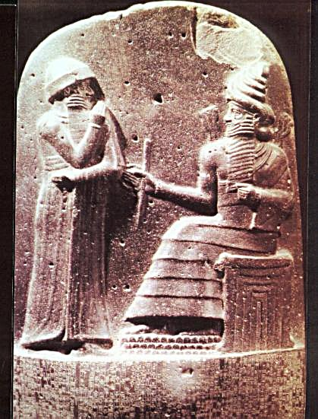
Hammurabi
Leader of Babylonian Empire 1792 - 1750 B.C.
Gifted military leader, diplomat and administrator.
Put together a uniform code of laws to help unify diverse groups within empire known as the Code of Hammurabi.

Slide 11
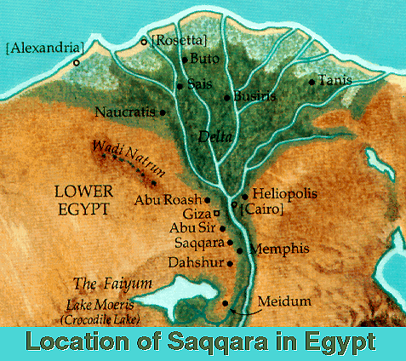
Delta
Refers to section of Nile in Lower Egypt, about 100 miles before the river enters the Mediterranean.
Broad, marshy triangular area formed by deposits of very fertile silt at mouth of river.

Slide 12
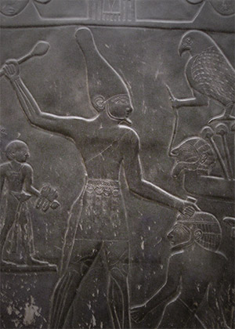
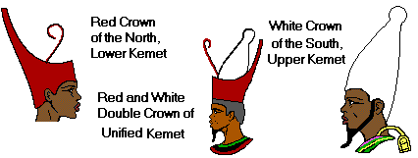
Narmer
Possibly first king to unite Upper and Lower Egypt around 3000 B.C.
Wore double crown of red and white - symbolized united kingdom.
Narmer Tablet

Slide 13
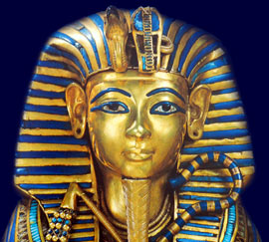
Pharaohs
Egyptian king-gods.
Were thought to be almost as splendid as gods of the heavens.
Stood at the center of Egypt’s religion, army and government.

Slide 14
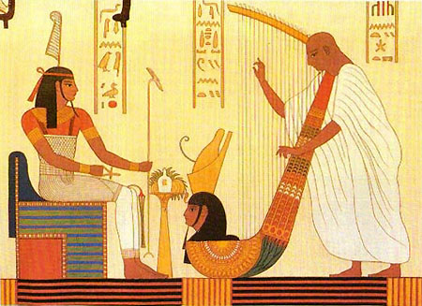
Theocracy
Type of government in which rule is based on religious authority, e.g. pharaohs in Egypt.

Slide 15
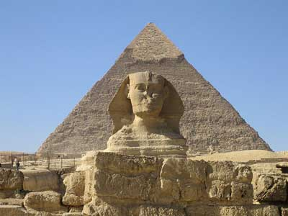
Pyramid
Egyptians believed pharaohs ruled even after death, so their tombs were important.
Buried in an immense structure called a pyramid.
Remarkable engineering feat built from granite and limestone.

Slide 16
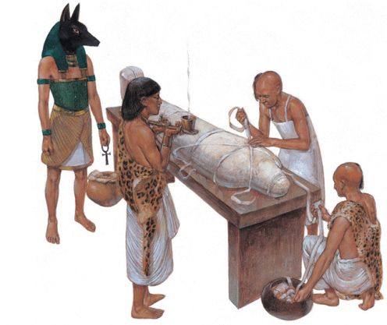
Mummification
Royal and elite Egyptian people’s bodies were preserved through mummification.
Involved embalming and drying of corpses to prevent decay.

Slide 17
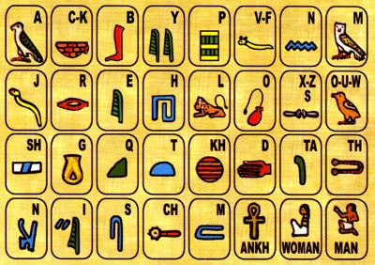
Hieroglyphics
Egyptian system if writing.
From Greek words meaning sacred carving.
Consisted of pictures, each picture represents a specific idea.

Slide 18
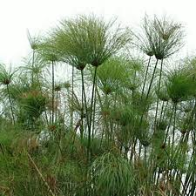
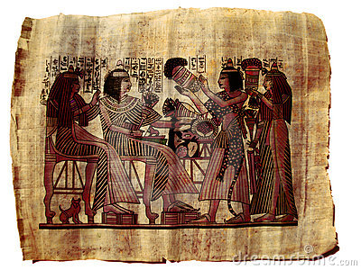
Papyrus
Writing surface invented by Egyptians made from papyrus reeds.
Reeds were split into narrow strips and placed crosswise in two layers before dampening and pressing them. When dried, plant’s sap glued strips together.

Slide 19
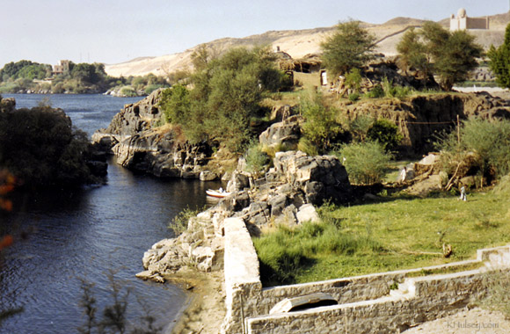
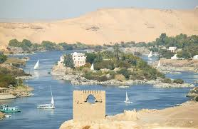
Cataract
Shallow lengths of the Nile River where the surface of the water is broken by boulders or stones protruding out of the river bed.
Makes navigation challenging.

