Slide 1
Ancient Greece and Rome
Legacy to Western Civilization

Slide 2
Political System
Greek Legacy
Western Civilization
Democracy developed in Athens.
The USA government today can be described as a democratic republic.

Slide 3
Political System (Cont.)
Greek Legacy
Western Civilization
The government of Athens included three major bodies:
the Assembly,
the Council of 500,
the People’s Court.
The USA government includes three major bodies:
Legislative Branch
Executive Branch
Judiciary Branch

Slide 4
Political System
Roman Legacy
Western Civilization
Romans developed a form of government known as a republic.
The USA government today can be described as a democratic republic.

Slide 5
Legal System
Roman Legacy
Western Civilization
Romans created their first legal code by formally writing down some of their laws; called the Twelve Tables.
Having the law written down protected the rights of all citizens.
Law systems across the world, including Western Europe and the USA, are based on many of the principles of Roman Law.
It is from the Romans that we inherited the belief that
a man should not be accused anonymously,
that he should not be penalized for what he thinks,
that he should be considered innocent until he is proven guilty.

Slide 6
Philosophy
Greek Legacy
Western Civilization TODAY!
Focused on reason and enquiry; looked for explanations beyond mythology.
Included
Socrates
Plato
Aristotle
Important effect on modern philosophy as well as science.
Examples:
Socratic Method
Scientific Method

Slide 7
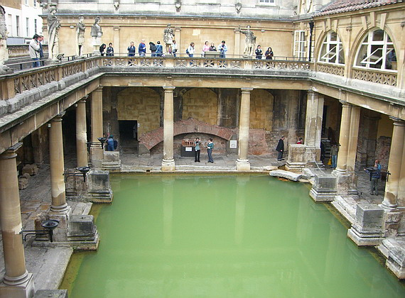
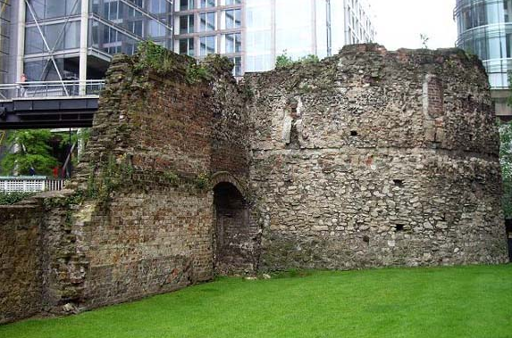
Founding Cities
Many existing European cities were founded by the Romans
Cologne Germany)
Bath (Great Britain)
London (Great Britain)
Bath, England
Remains of Roman Wall, London

Slide 8
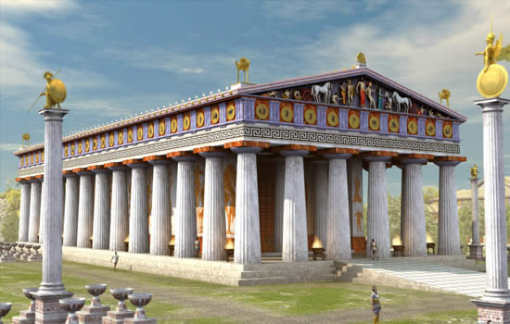
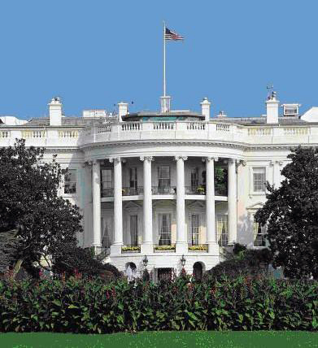
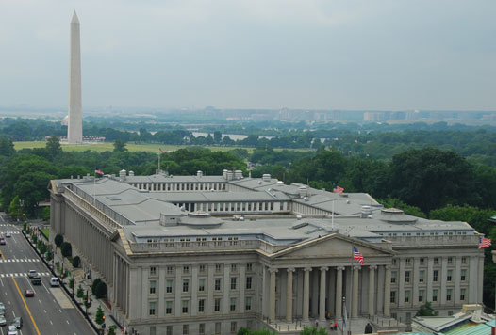
Greek Architecture

Slide 9
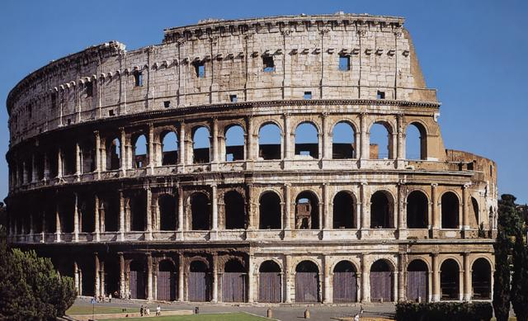
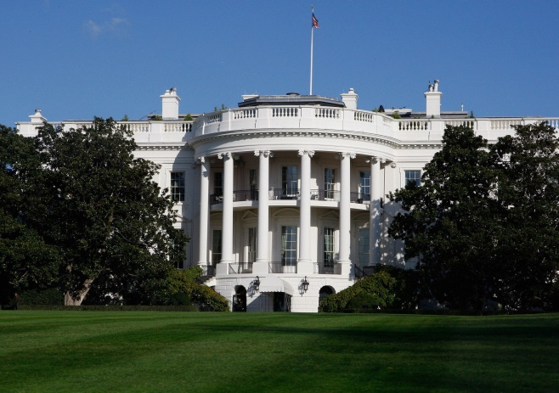
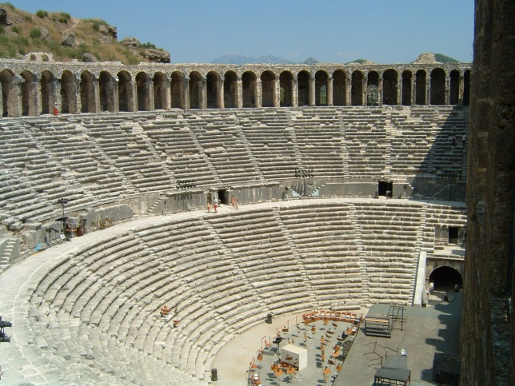
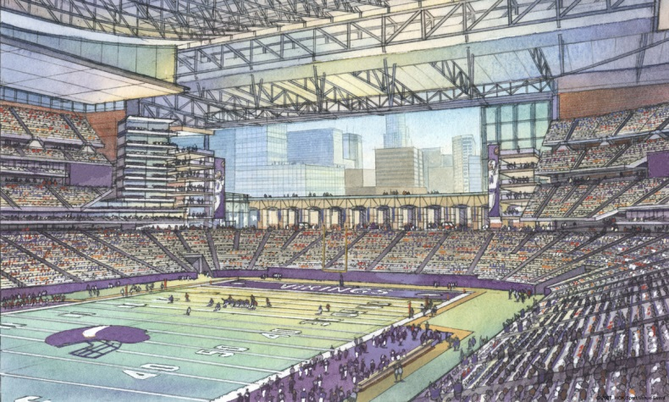
Roman Architecture

Slide 10
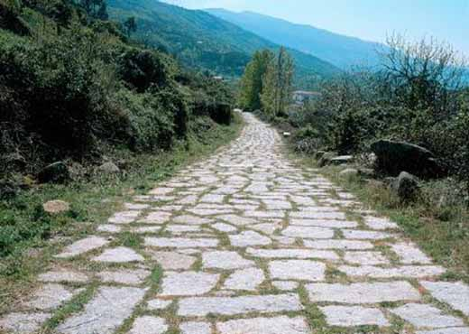
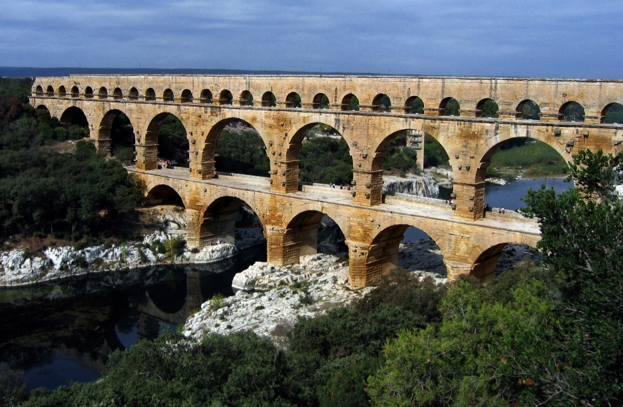
Roman Architecture and Engineering
The Romans were known for their building and engineering skills, e.g. development of fast-drying concrete/cement!
EXAMPLES:
Aqueducts (fresh water)
Arches
Arenas (Colosseum is still a model for many modern sport stadiums today!)
Baths
Indoor Plumbing
Palaces
Roads
Theatres
Walls

Slide 11
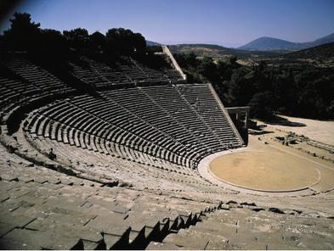
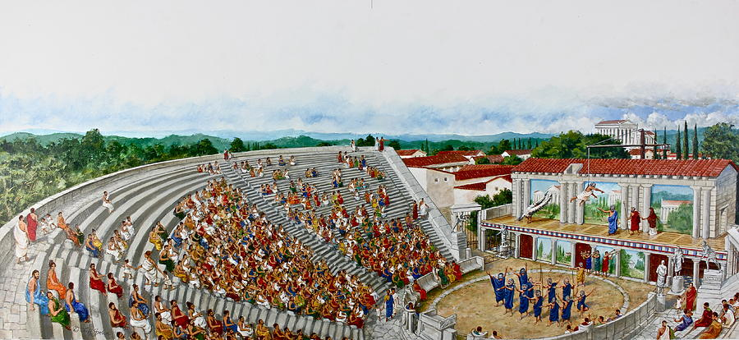
Greek Literature, Theater and Music
The Iliad and The Odyssey by Homer – still studied!
Greek Drama influence authors such as Shakespeare, and still influence modern drama and movies today.
Music played a significant role in Greek society; The word music derives from the name of the Muses, the daughters of Zeus, who were patron goddesses of the arts.

Slide 12
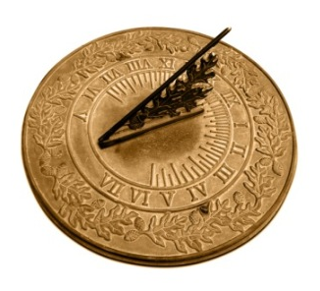
Calendar
The calendar used in the West derives from the one created by Julius Caesar.
Names of the days of the week (in the romance languages) and months of the year also come from Rome.

Slide 13
Languages
Greek and Roman alphabet – basis for our alphabet
Greek root words
ancient, autobiography, chronic, democracy, encyclopedia, geography, Minneapolis, telephone
Latin – basis for many languages spoken today
French, Italian, Portuguese and Spanish
Latin root words
box, delete, erase, enquire, hyphen, joke, merge, obnoxious, query, retaliate, scholar, trivia

Slide 14
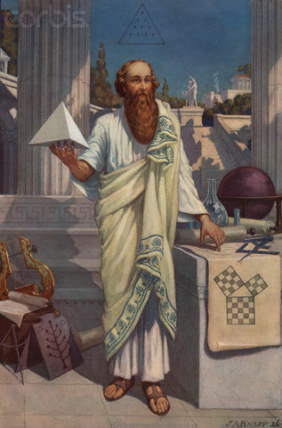
Greek Math
Important developments, e.g.
Rules of Geometry
Idea of Mathematical Proof
Discoveries in Number Theory
Applied Mathematics
Mathematicians included
Pythagoras
Euclid
Archimedes

Slide 15
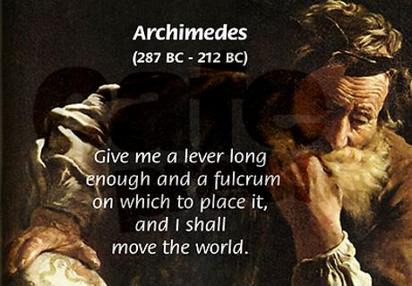
Greek Science and Medicine
Developed astronomy, e.g. proposed that earth moves around an axis, and earth revolves around sun.
Made important discoveries in the medical field; Hippocrates considered Father of Medicine.

Slide 16
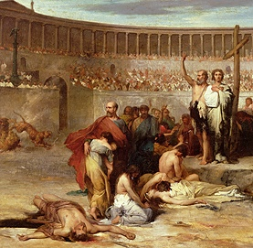
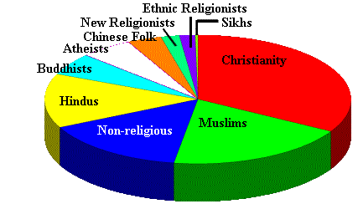
Religion
After Theodosius declared Christianity to be the official religion of Rome, former Roman territories became Christian states.
Exported their religion to other parts of the world, through colonization and missionaries.
Today largest religious group in the world.

Slide 17
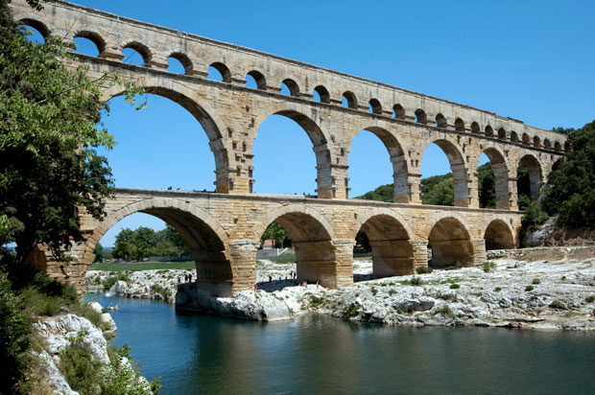
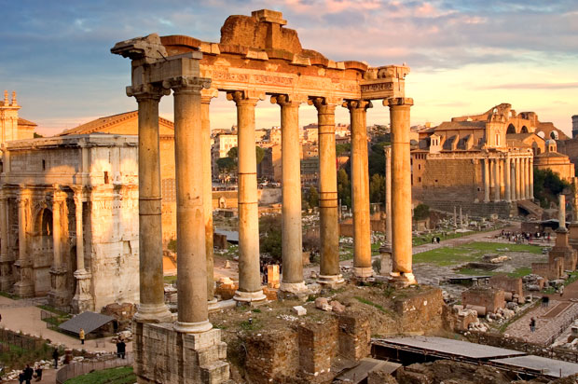
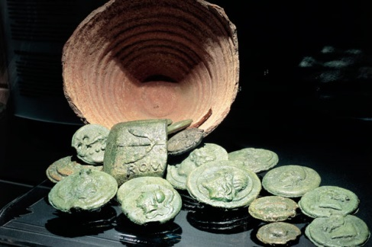
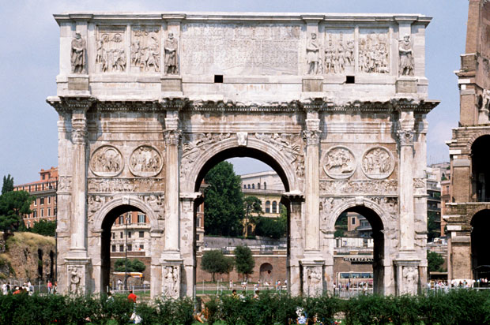
Roman Inventions
Aqueducts
Concrete
Newspapers
Welfare
Bound Books
Roads and Highways
Roman Arches
Julian Calendar
Twelve Tables
Battlefield Surgery

Slide 18
In conclusion...
The lessons of history would suggest that civilizations move in cycles. You can track that back quite far – the Babylonians, the Sumerians, followed by the Egyptians, the Romans, China. We’re obviously in an upward cycle right now, and hopefully that remains the case. But, it may not.
(Elon Musk)

