Slide 1
The Americas
Chapter 9, Section 2 & 3

Slide 2
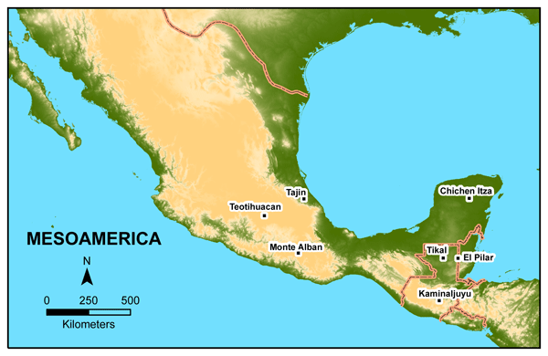
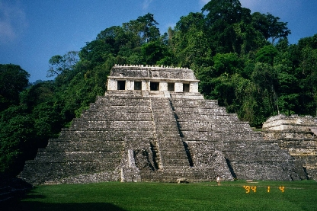
Mesoamerica
Geographical area stretching from central Mexico to northern Honduras.
Hot and humid jungle area; giant trees that form thick cover preventing sunlight reaching ground; 100 inches rain/year.
Rich in resources – salt, tar, clay, wood and rubber.

Slide 3
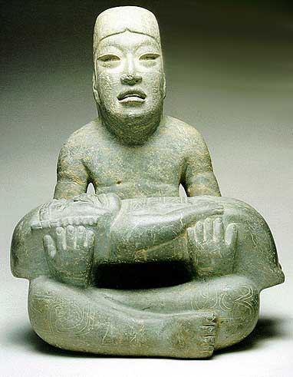
Olmec
Lived in Mesoamerica around 1200 B.C.
Known as mother culture.
Built thriving communities – San Lorenzo and La Venta.
Evidence of religious ceremonies and practices.
Active trading with other tribes in area.
Rich cultural heritage including large stone monuments.
Olmec holds a half human-half jaguar baby.

Slide 4
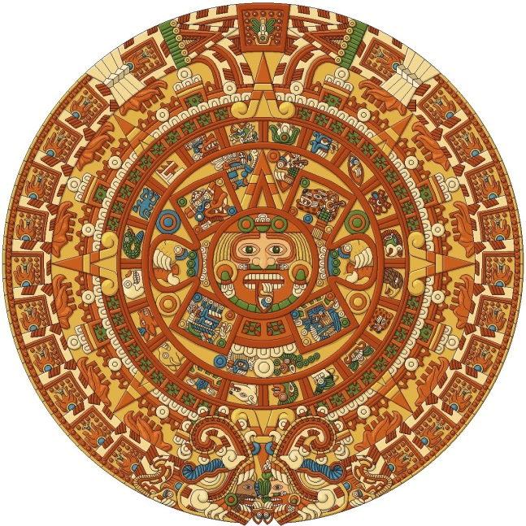
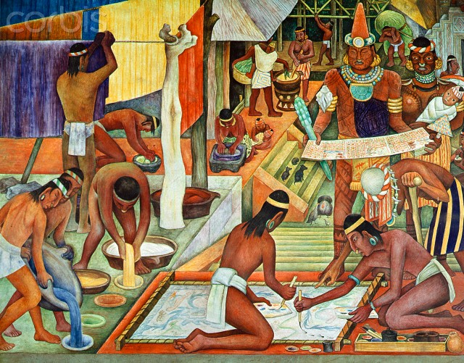
Zapotec
Situated in southern Mexico in Oaxaca Valley.
Large open area with fertile soil and mild climate.
Active trade and prosperous cities developed.
Rich cultural heritage and advancements including hieroglyphic writing system and calendar based on sun.

Slide 5
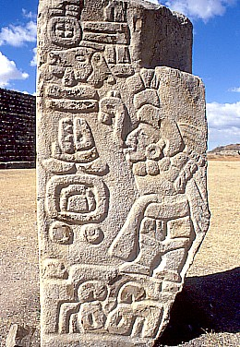
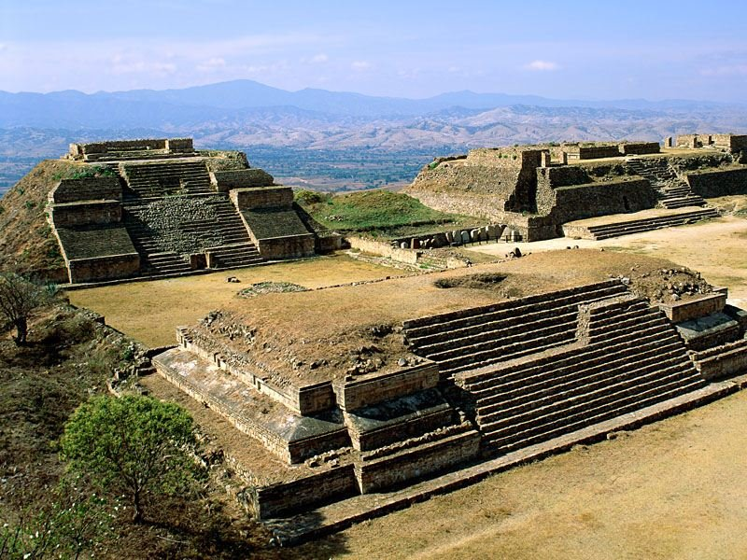
Monte Alban
First urban development in Americas built by the Zapotec people.
City grew and flourished over centuries; by 200 B.C. 15,000 people; would grow to 25,000.
Planned urban development; huge plaza at center surrounded by pyramids, temples and palaces.

Slide 6
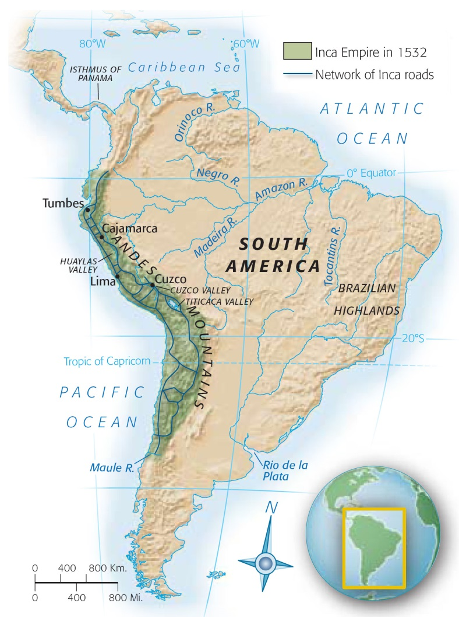
Early Civilizations
Andes Mountains stretch for 4,500 miles along Western edge of South America.
Harsh area – steep and rocky; poor soil.
Extreme climate – hot and dry during day and cold at night; snow in high elevations.
Some places have rivers flowing towards sea; various tribes settled in these river valleys.
Tribes include
Chavin
Nazca
Moche

Slide 7
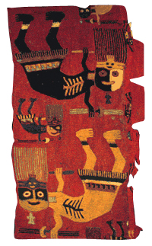
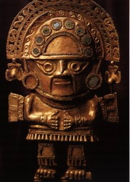
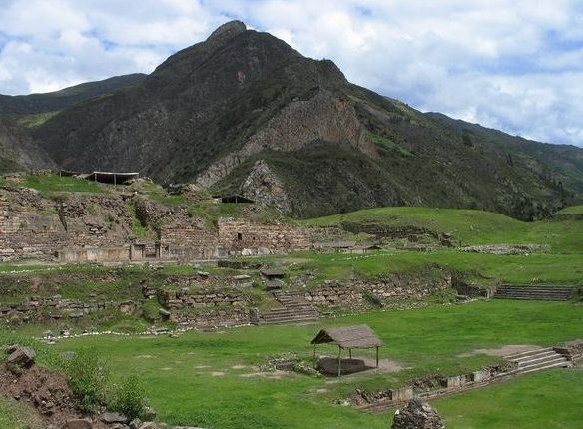
Chavin
Society arose in mountainous area; flourished around 900 – 200 B.C.
Religious community; left art styles and religious images as seen in stone carvings, pottery and textiles.

Slide 8
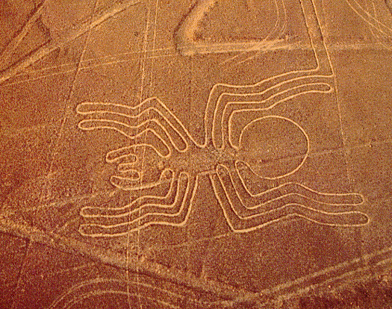
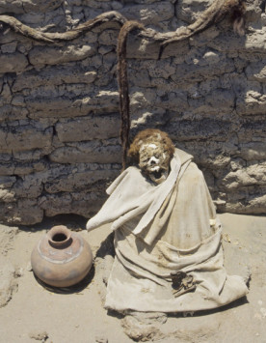
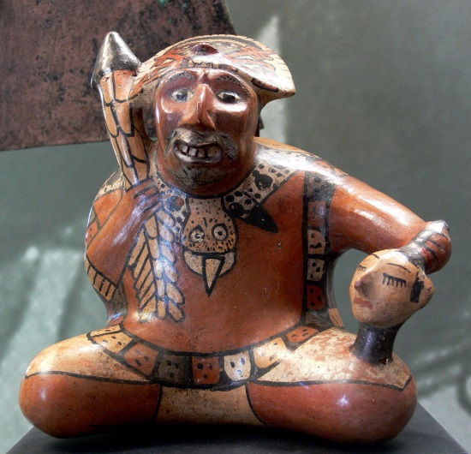
Nazca
Lived on southern coast of Peru; 200 B.C. – A.D. 600.
May have been headhunters; even evidence of brain surgery done!
Developed irrigation systems, but best know for Nazca lines.
Known for pottery and textiles with images of animals and mythical beings.

Slide 9
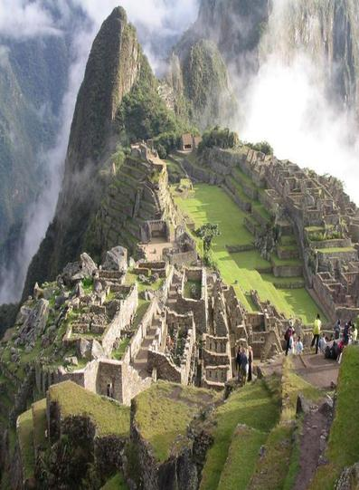
Moche
From northern coast of Peru; flourished A.D. 100 – A.D. 700.
Took advantage of rivers flowing from Andes Mountains to develop extensive irrigation systems; cultivated wide range of crops.
Very wealthy; jewelry made of gold, silver and precious stones found.

Slide 10
North American Societies
Chapter 16, Section 1

Slide 11
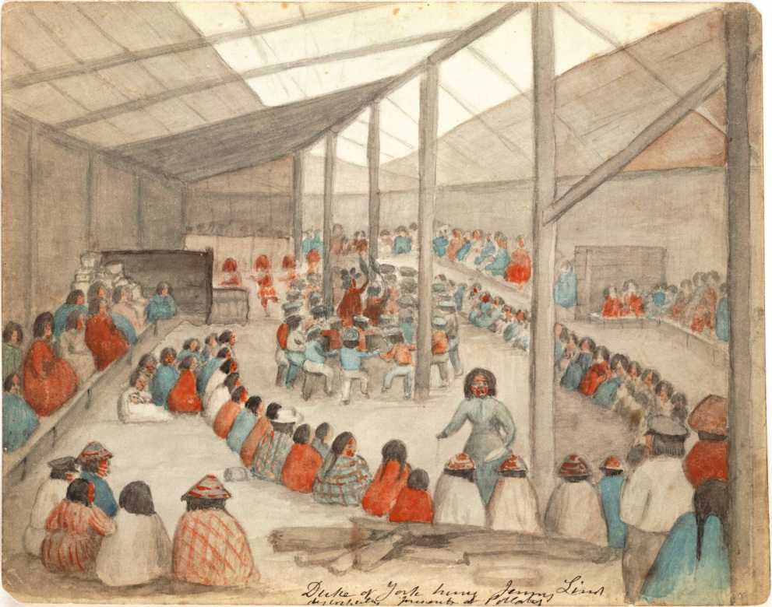
Potlatch
Tribes in northwest developed societies; wealth created different classes within societies.
Families displayed rank and status in ceremony called potlatch.
Provided community with food, drink and gifts.

Slide 12
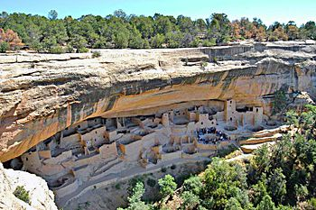
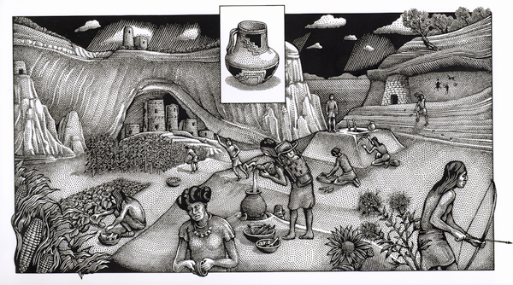
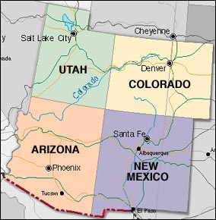
Anasazi
Group of people who lived in Four Corners region (where Arizona, Colorado, New Mexico and Utah meet).
Built impressive cliff dwellings on top of flat-topped hills (mesas) or in shallow caves.
Mesa Verde

Slide 13
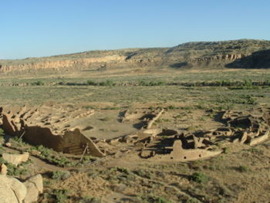
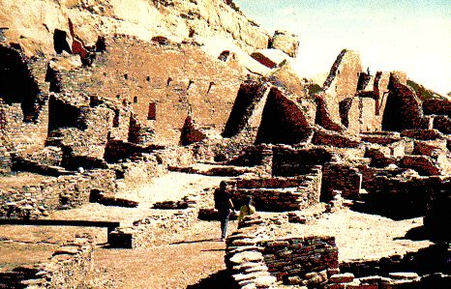
Pueblo
Villages of large, apartment-style compounds built by Anasazi.
Made of stone or adobe (sun baked clay).
Small windows to keep out sun.
Buildings indicate high degree of social organization and inventiveness.
Pueblo Bonito, the largest of the Chacoan Great Houses

Slide 14
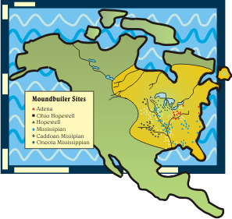
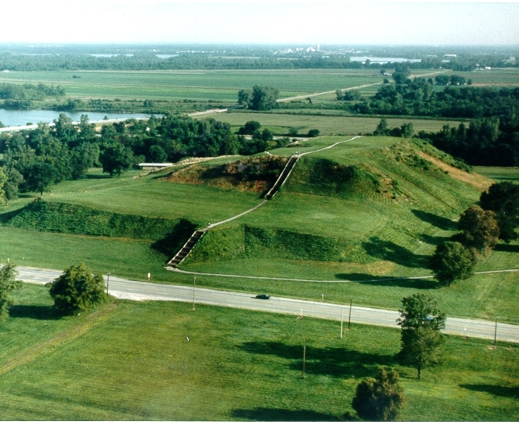
Mississippian Mound Builders
Culture in woodlands east of Mississippi around A.D. 800.
Created thriving villages based on farming and trade.
Built huge burial mounds where they buried their dead.
Mounds of tribal leaders often filled with gifts.

Slide 15
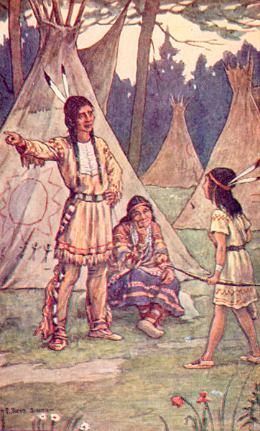
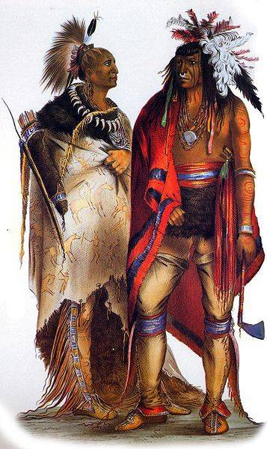
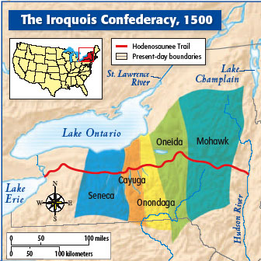
Iroquois
Five Indian tribes in eastern Upper New York region; spoke similar language.
Formed alliance under Chief Hiawatha in late 1500’s.
Purpose to promote joint defense and cooperation amongst tribes.

Slide 16
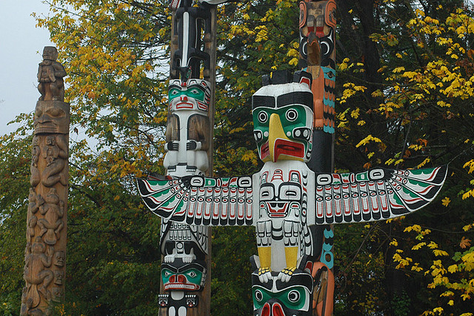
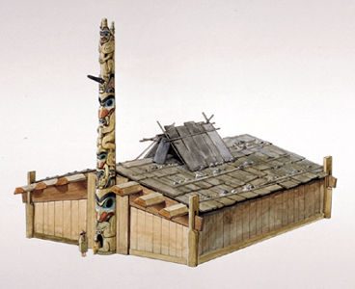
Totem
Used by Native American clans.
Natural object which an individual, clan or group identifies itself.
Would also define certain cultural practices, e.g. symbols on masks, huge poles in front of houses, etc.

Slide 17
Maya Kings and Cities
Chapter 16, Section 2

Slide 18
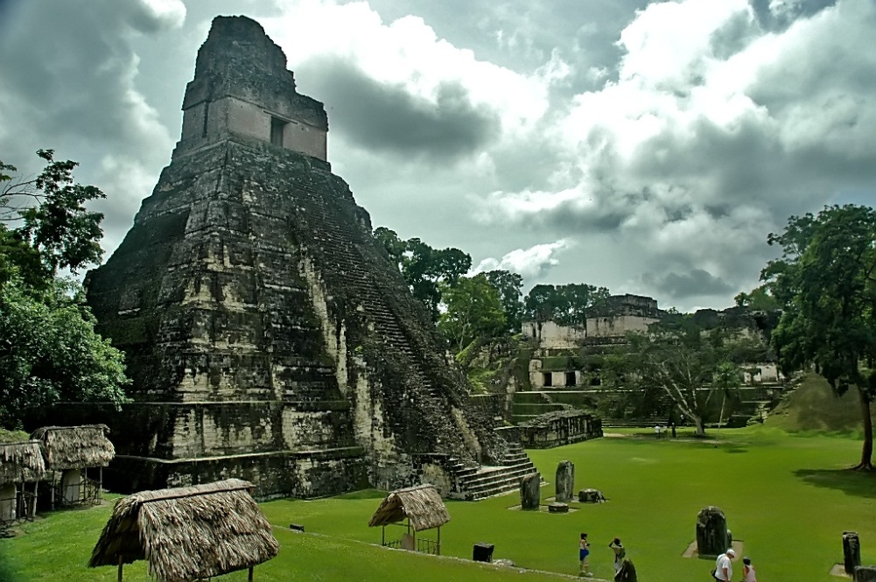
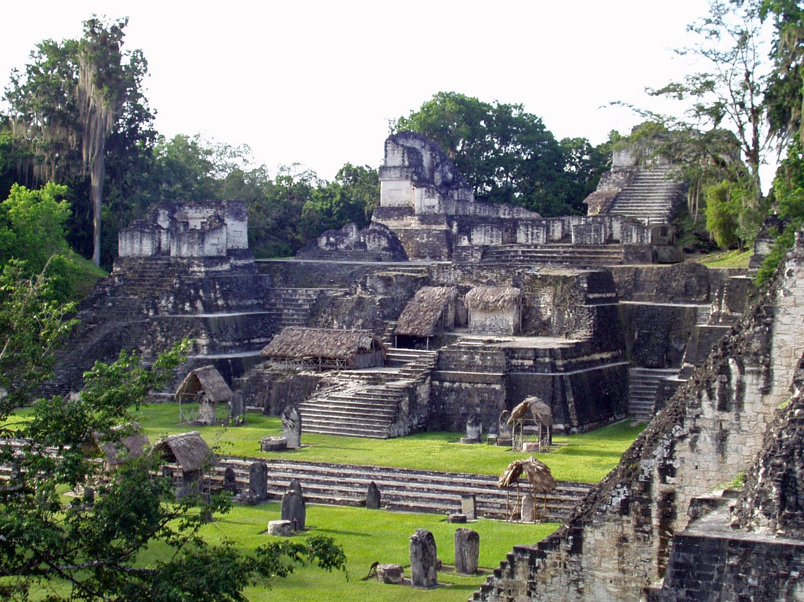
Tikal
Large city built by Maya civilization in northern Guatemala.
Independent city state ruled by god-king; center for religion and trade.
Typical city state featured giant pyramids, temples, palaces and elaborate stone carvings.

Slide 19
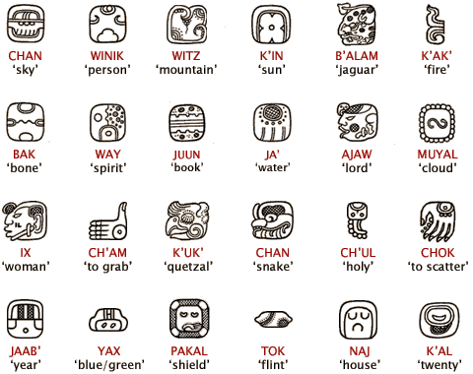
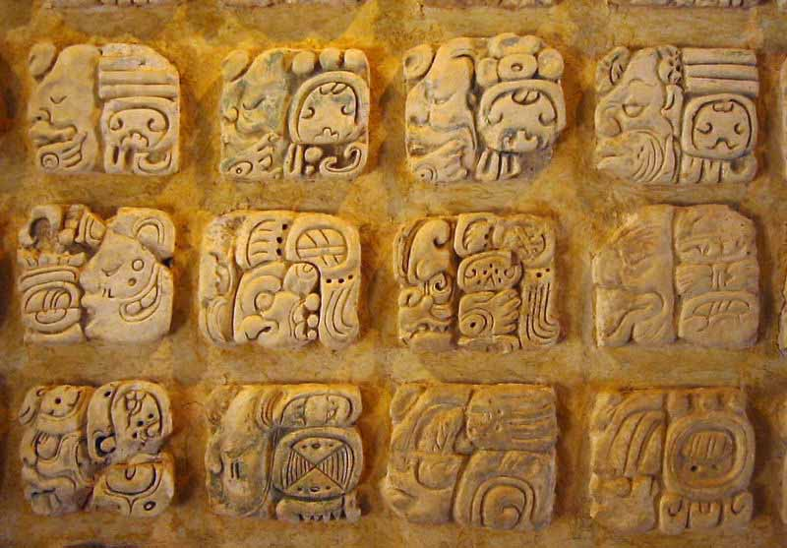
Glyph
800 hieroglyphic symbols used in Maya writing system.
Some glyphs stood for whole words, and others represented syllables.
Most advanced writing system in ancient Americas.

Slide 20
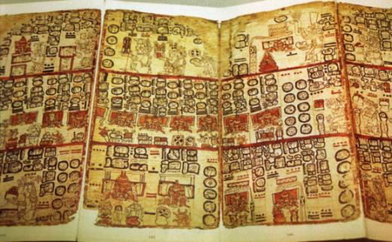
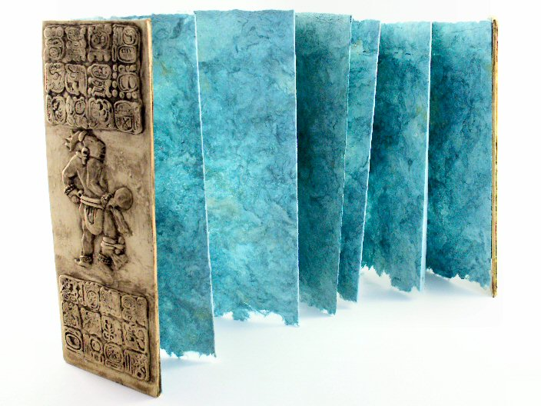
Codex
Bark-paper book used by Mayan to record historical events.
Only three of these ancient books have survived.

Slide 21
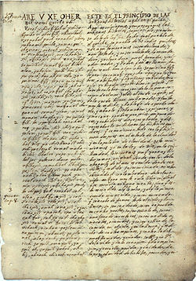
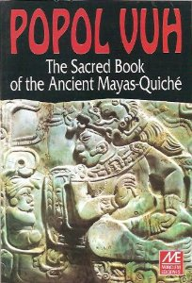
Popol Vuh
One of just a few surviving Maya books recording history after arrival of Spanish.
Often considered the single most important piece of Mesoamerican literature.
Recounts Maya’s version of the creation.

Slide 22
The Aztecs Control Central Mexico
Chapter 16, Section 3

Slide 23
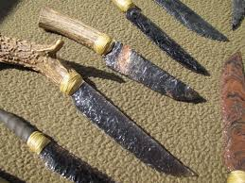
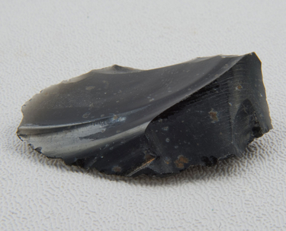
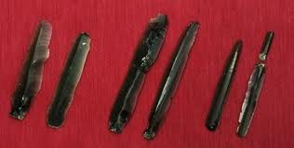
Obsidian
Green or black volcanic glass found in Valley of Mexico.
Used to make sharp weapons.
Valuable trading item.

Slide 24
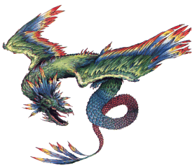
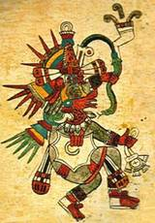
Quetzalcóatl
Toltec god known as the Feathered Serpent.
Revered as
the patron of priests
the inventor of the calendar and of books
protector of goldsmiths and other craftsmen
Represented by morning and evening star; symbol of death and resurrection.

Slide 25
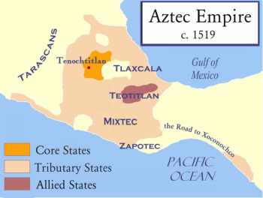
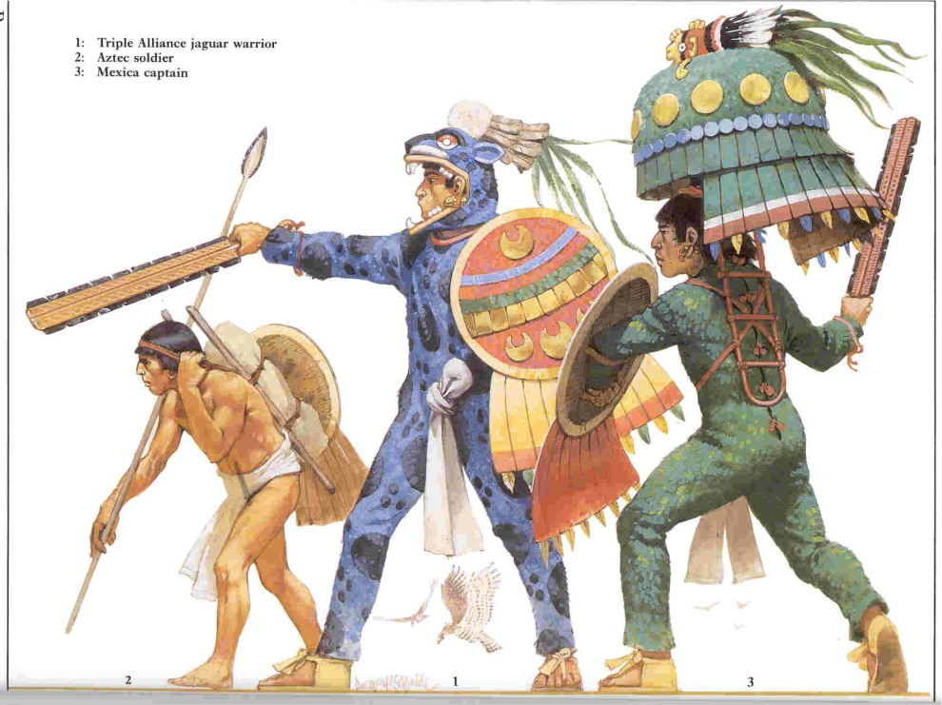
Triple Alliance
Aztecs arrived about A.D. 1200.
In 1428 joined two other city-states:
Texcoco
Tlacopan
Alliance became leading power in Valley of Mexico; by 1500’s controlled vast empire.

Slide 26
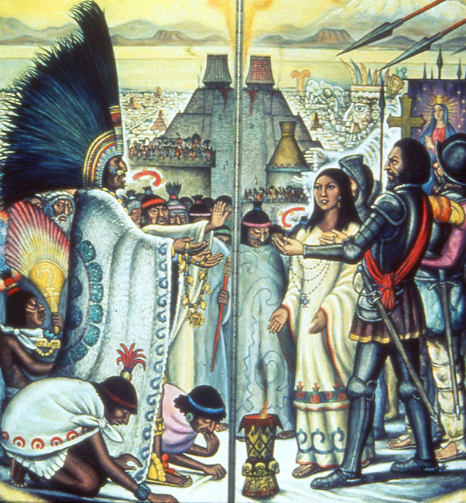
Montezuma II
Crowned emperor 1502
Empire weakened under his rule; period of unrest and rebellion in several provinces.
Arrival of Spanish further weakened empire.

Slide 27
The Inca Create a Mountain Empire
Chapter 16, Section 4

Slide 28
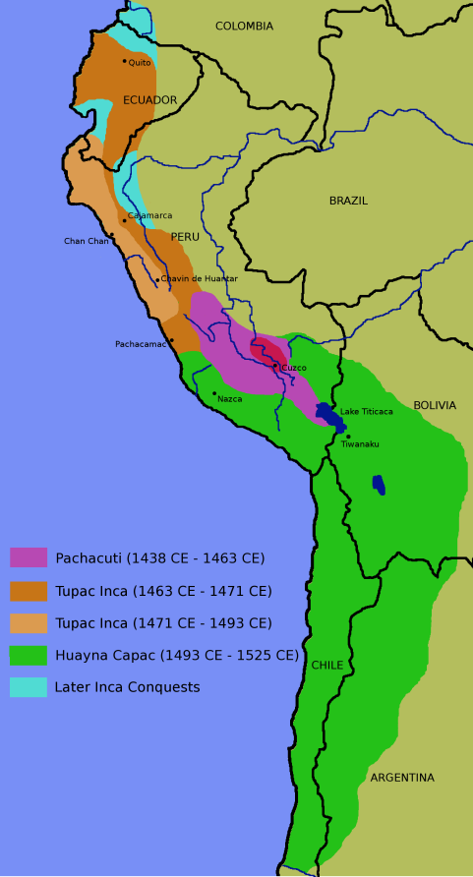
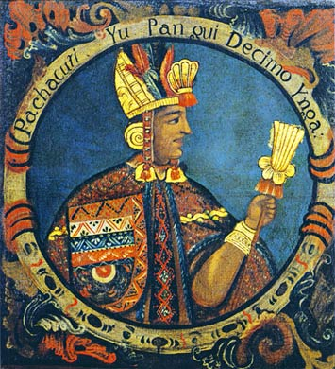
Pachacuti
Powerful and ambitious ruler of Inca Kingdom, 1438.
Conquered all of Peru; moved into neighboring countries.
By 1500 Incas ruled area 2,500 miles along western coast of South America.

Slide 29
Ayllu
Incan social system was based on community cooperation.
Ayllu (extended family) undertook tasks too big for single family.
Included
Building irrigation canals
Cutting agricultural terraces
Storing food and supplies for hard times

Slide 30
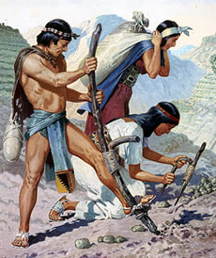
Mita
Incan state demanded tribute in form of labor; called mita.
All able-bodied citizens had to work specific number of days for state, e.g.
labor on state farmlands
Produce craft goods
Help with public works projects

Slide 31
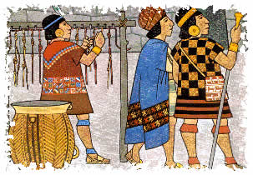
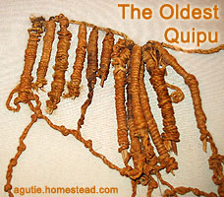
Quipu
System of knotted cords used by the Incas to store massive amounts of information.
The colors of the cords, the way the cords are connected together, the relative placement of the cords, the spaces between the cords, the types of knots on the individual cords, and the relative placement of the knots are all part of the logical-numerical recording.

