Slide 1
African Civilizations
Chapter 8, Sections 1, 2 & 3

Slide 2
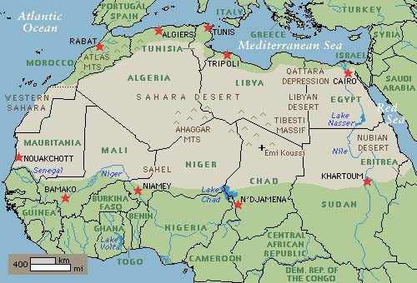
Sahara
Sahara covers an area roughly size of the USA.
Small part dunes; rest flat gray wasteland consisting of rocks and gravel.

Slide 3
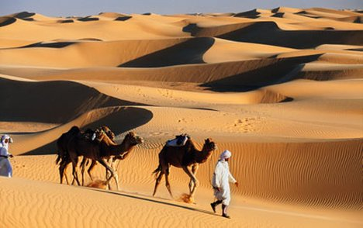
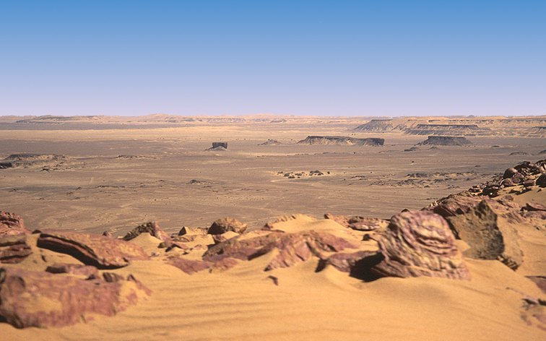
Sahel
Each year the desert takes over more and more land at the southern edge of the Sahara Desert.

Slide 4
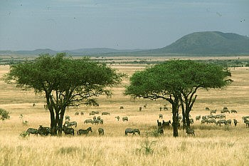
Savanna
Grassy plains; includes mountainous highlands and swampy tropical stretches.
Covers 40% of continent.
Only two seasons – dry and rainy.

Slide 5
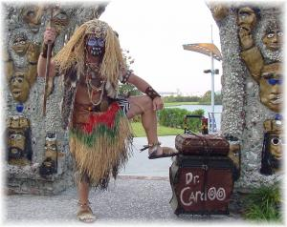
Animism
Belief systems helped Africans organize and understand information about their world.
Spirits play important role in regulating life.
Spirits are present in animals, plants and other natural forces.

Slide 6
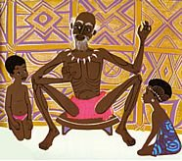
Griot
Few African societies have a written language; history shared orally by storytellers called griots.

Slide 7
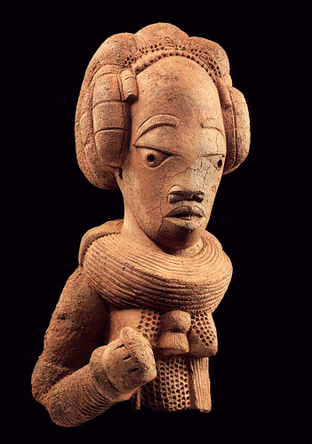
The Nok Culture
Earliest known culture in West Africa.
Nigeria 500 B.C. - 200 A.D.
First West African culture to smelt iron to make tools and weapons.
Traded tools and weapons.

Slide 8
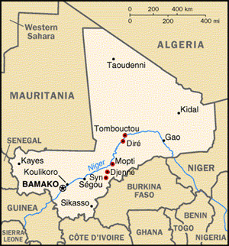
Djenne-Djeno
Ancient Mali city discovered in 1977.
Dates back to 250 B.C. - 1400 A.D.
Located on tributary of Niger River in West Africa.
Artifacts include pottery, clay toys, glass beads, stone bracelets, etc.

Slide 9
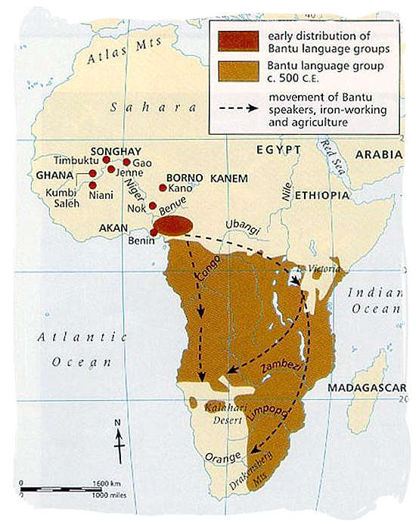
Migration
Bantu-speaking peoples.
For about 1,500 years small groups of people moved to southern parts of Africa Following Congo River.
Settled in savannah area south of the Sahara (southeastern Nigeria).

Slide 10
Push-Pull Factors
MIGRATION
CAUSES:
Environmental
Economic
Political
NEGATIVE
EFFECTS
Tracing
Migration
Through
Language
POSITIVE
EFFECTS
PUSH
PULL

Slide 11
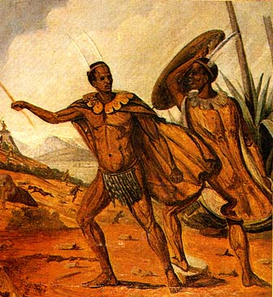
Bantu Speaking People
Bantu-speaking people did not always move into unpopulated areas; clashes occurred; smaller groups (San and BaMbuti) were conquered.
Bantu brought new and exchanged agricultural techniques, technology, and ideas about government to invaded areas.

Slide 12
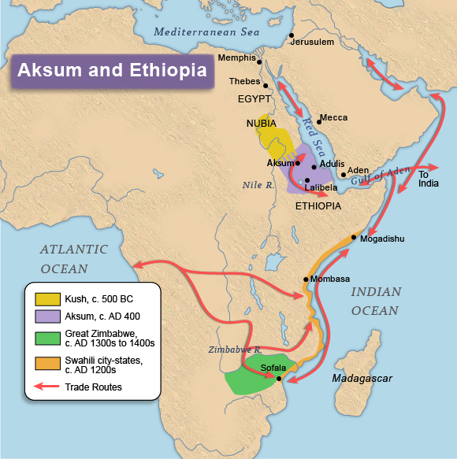
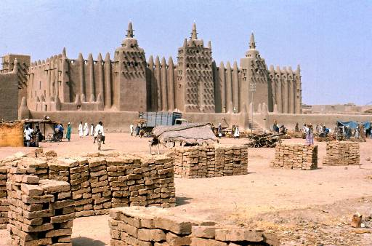
Aksum
Kingdom of Aksum located along plateaus of the Red Sea and south of Kush; now Eritrea and Ethiopia.

Slide 13
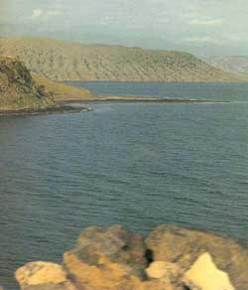
Adulis
Aksum provided access to Mediterranean Sea and Indian Ocean; chief seaport called Adulis.
Crowded with traders from Egypt, Arabia, India and Roman Empire.
Merchants traded a variety of goods.

Slide 14
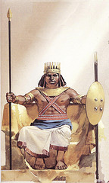
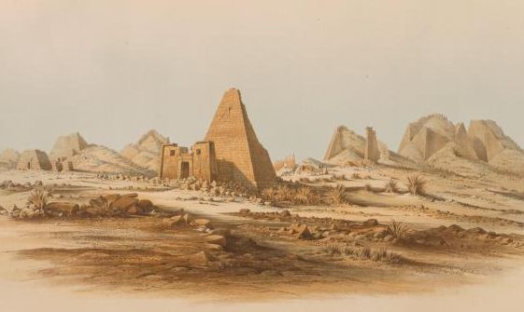
Ezana
Aksum reached height 325 – 360 A.D. under Ezana.
First conquered what is known today as Yemen; then conquered Kush and Meroë (today Sudan).
Ezana
Meroë

Slide 15
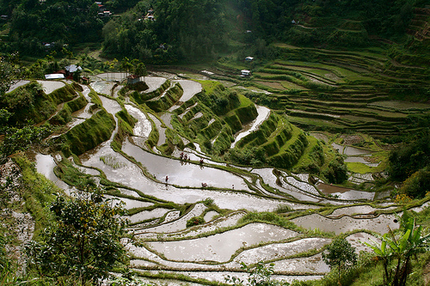
Terraces
Aksumites adapted farming to hilly environment by building terraces.
Step-like ridges on mountain slopes helped soil retain water and prevented it from being washed away.

Slide 16
African Society and Empires
Chapter 15, Sections 1, 2 & 3

Slide 17
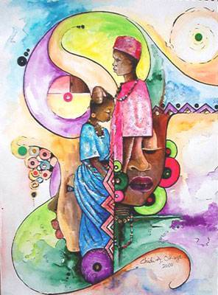
Lineage
Way many African families are organized.
Believe they are descendants of a common ancestor.
Lineage includes spirits of ancestors and future generations.

Slide 18
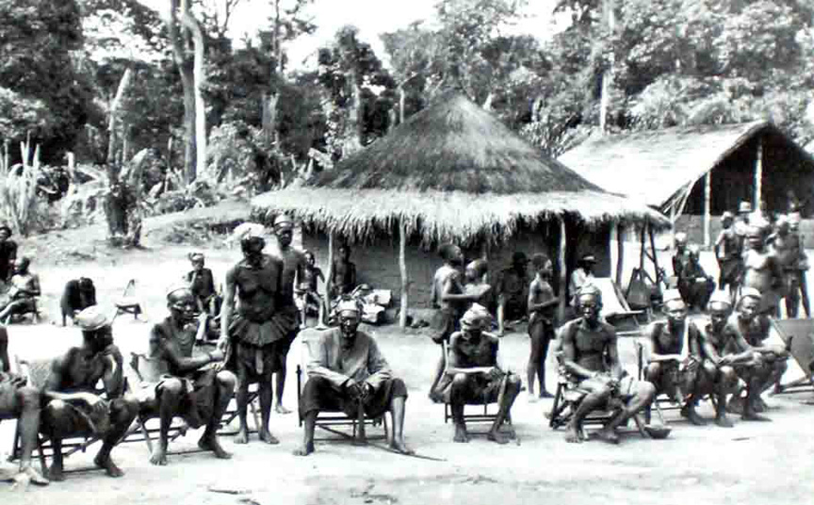
Stateless Societies
Societies where lineage groups took the place of rulers; no centralized system of government.
Balance of power lay between lineages of equal power.
Disputes settled by elders from various lineages.

Slide 19
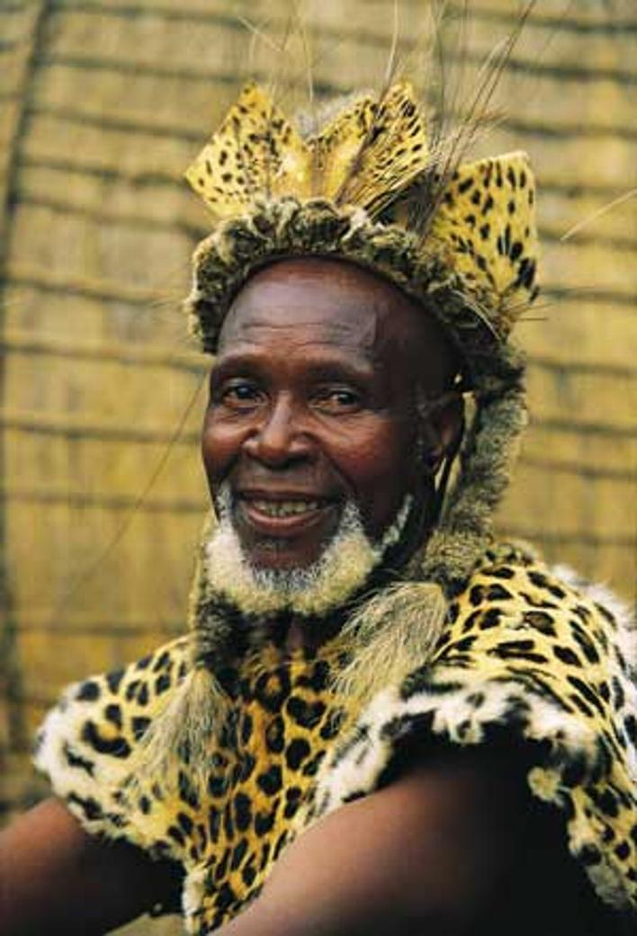
Patrilineal
Members of patrilineal society trace ancestors through their fathers.
Inheritance passes from father to son.
When a son marries, his wife and children remain part of father’s extended family.

Slide 20
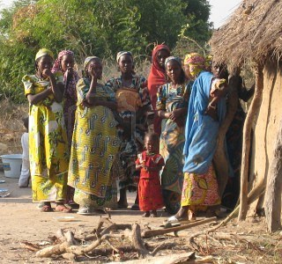
Matrilineal
Members of matrilineal society trace ancestors through their mothers.
Young men inherit land and wealth from mother’s family.
Men usually still hold positions of authority.

Slide 21
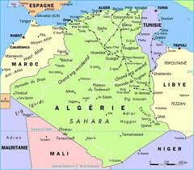
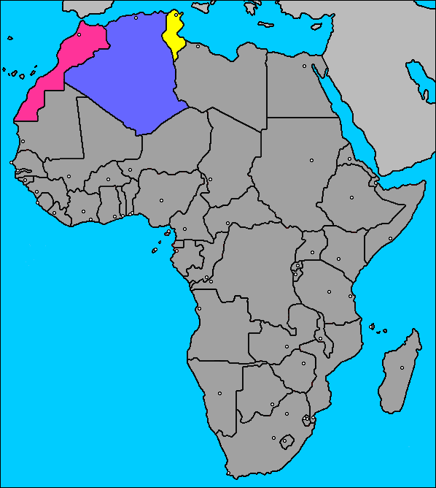
Maghrib
Area in North Africa ruled by Muslims.
Includes Mediterranean coast of Libya, Tunisia, Algeria and Morocco.

Slide 22
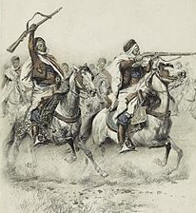
Berbers
Original inhabitants of North Africa.
Converted to Islam while maintaining Berber identities and loyalties.
Two groups – Almovarids and Almohads – united Maghrib under Muslim rule.

Slide 23
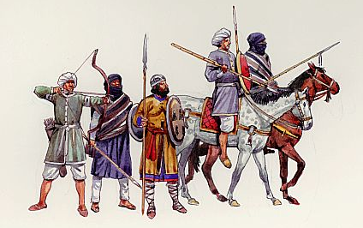
Almoravids
Muslim brotherhood - began 11th Century.
Spread Islam in Morocco
Captured Ghana in West Africa
Captured areas of Spain (known as Moors)

Slide 24
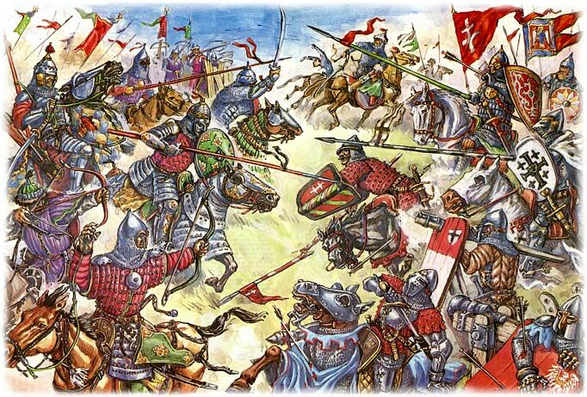
Almohads
Berber Muslim reformers who seized power from the Almoravids in mid- 1100’s.
United Maghrib under one rule for about 100 years.

Slide 25
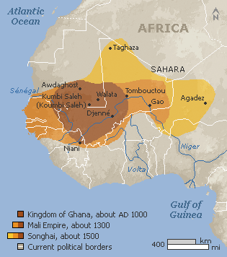
Ancient African Kingdoms

Slide 26
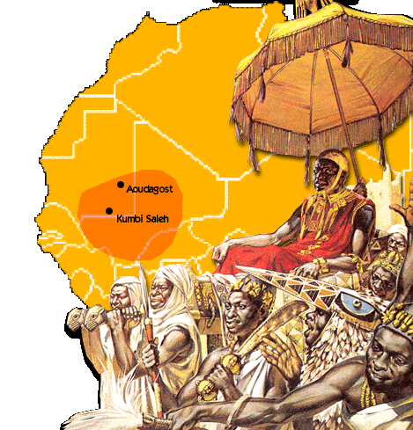
Ghana
Trade routes crossed an area farmed by Soninke people; called their ruler ghana.
Word came to represent Soninke region.
Ghana became rich kingdom in 700’s trading gold and salt.

Slide 27
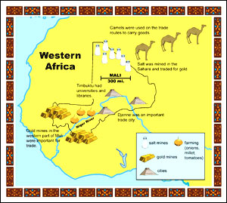
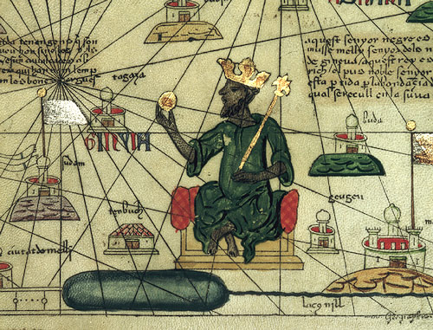
Mali
People came from the area south of Ghana.
Seized power from weakened Ghana around 1235.

Slide 28
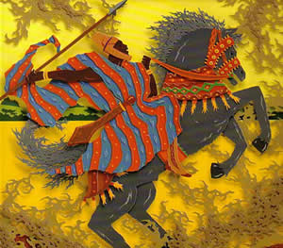
Sundiata
Mali’s first great leader.
Came to power after crushing cruel and popular leader; became emperor.
Strong leader in war and peace; made important changes in government and finances.

Slide 29
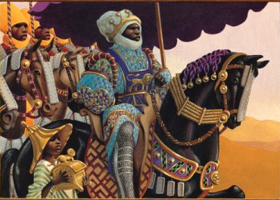
Mansa Musa
Mali ruler 1312 – 1332.
Followed series of seven rulers after Sundiata’s death; time of turmoil.
Mansa Musa put down rebellions, expanded empire and brought effective government to area.

Slide 30
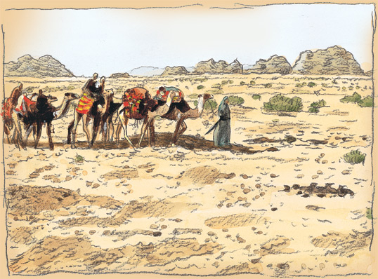
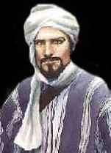
Ibn Battuta
Traveler and historian from Tangier in North Africa; travelled 27 years before visiting Mali.
Criticized leaders for not practicing Islam code more strictly.

Slide 31
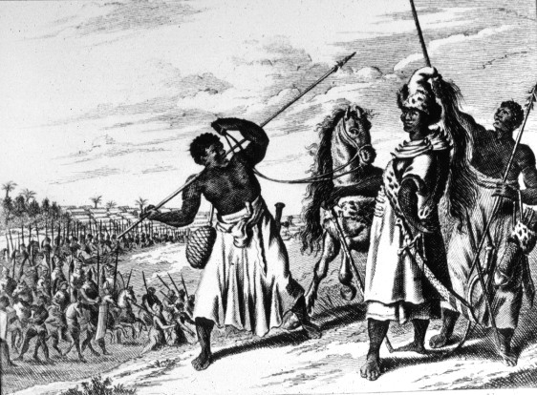
Songhai
After decline of Mali, groups broke away, among them Songhai people in east.
Built up area and extended territory, gaining control over important trade routes.

Slide 32
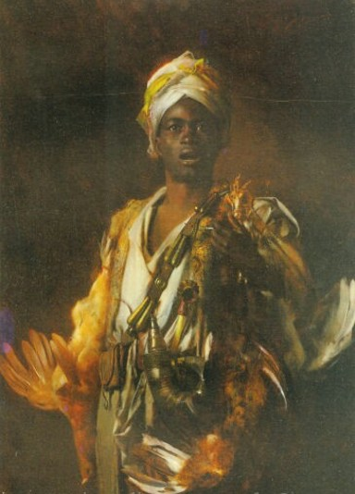
Hausa
Group of people named after the language they spoke.
Created several city-states in today’s northern Nigeria 1000 -1200 A.D.
Fighting amongst city-states prevented Hausa from becoming an empire.

Slide 33
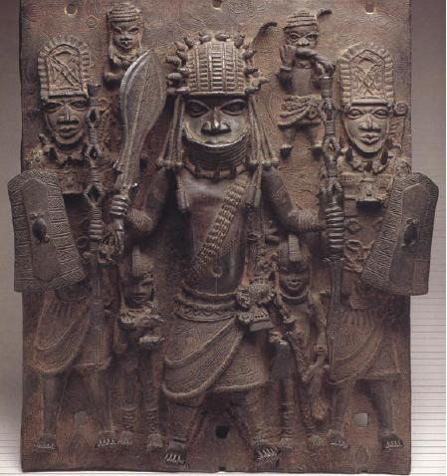
Yoruba
Group of people with common language.
Consisted of small, independent communities; joined together to form powerful kingdom.
King considered highest spiritual authority.

Slide 34
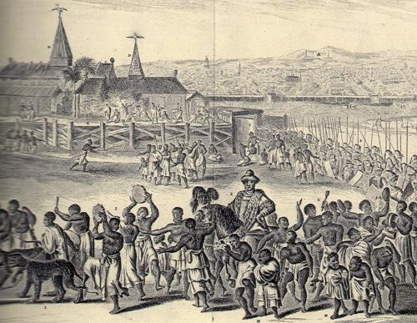
Benin
Kingdom situated to south and west of Ife, near delta of Niger River.
Under oba (king) Ewuare became major state in West Africa.
Walled city with broad streets and houses; huge palace with artworks.

Slide 35
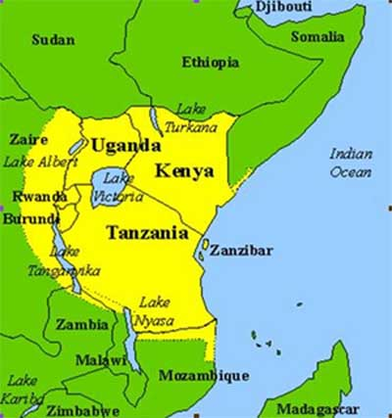
Swahili
Language spoken on east coast of Africa.
Combination of Arabic and Bantu languages.

Slide 36
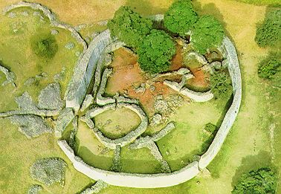
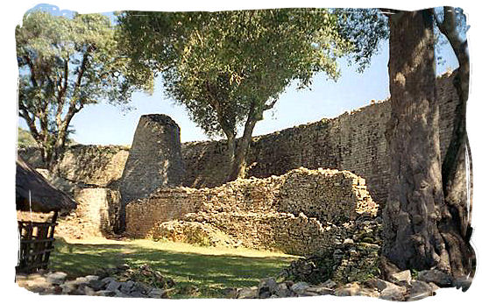
Great Zimbabwe
City in southeastern Africa between Zambezi and Limpopo rivers.
Established by Shona people.
Grew into an empire built on gold trade 1200 – 1400.

Slide 37
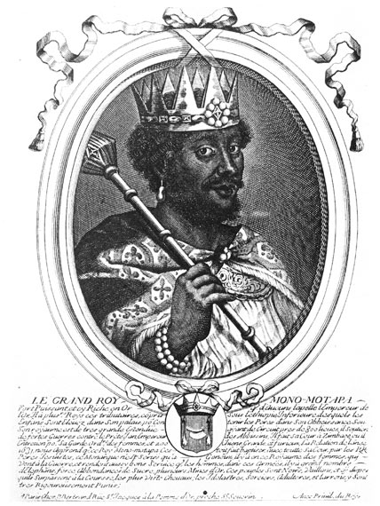
Mutapa
State started by Mutota, who left Great Zimbabwe about 1450.
Dominated Shona people and forced them to make payments.
Start of what became Mutapa Empire.
Eventually displaced by the Portuguese.

